Slide 1
九年级英语上 新课标 [冀教]
Unit 5 Look into Science
Planet Danny
WWW.PPT818.COM

Slide 2
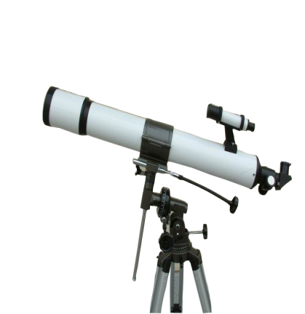
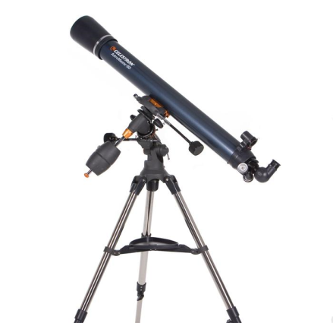

Slide 3
Think About It ！
▲ Do you like science? Why or why not?
▲ Do you know any of the planets in the solar system?

Slide 4
New Words
telescope
solar
certainly
unless
double
mystery

Slide 5
Listen to the dialogue and tick the correct answers.
(1)What did Danny do last night?
He tried to study the moon.
He tried to find a new planet.
(2)What did Danny use?
A telescope.
A book.
(3)What did Danny need?
More sleep.
More stars.
√
√
√

Slide 6
Read the lesson and write true(T)or false(F).
(1)Danny is studying the solar system at school.
(2)Danny is looking through the telescope when Jenny and Brian come to visit.
(3)During the day,Danny can see many stars in the sky through the telescope.
(4)Jenny and Brian will join Danny after supper.
(5)Danny has discovered a new planet.
T
T
F
T
F

Slide 7
Read the lesson and fill in the blanks.
On Saturday afternoon,Brian and Jenny visited Danny at his house.When they arrived,Danny was outside looking a telescope.Brian and Jenny laughed at Danny because he was using the wrong of the telescope.Of course,Danny couldn’t see the during the day.Brian and Jenny also wanted to join Danny.They decided to come back after supper.After the sun went down,they could see the stars.Danny hoped to a new planet.
through
end
stars
discover

Slide 8
Read the text and find out main phrases and sentences.
Main phrases:
·solar system
·at night
·even if
·turn around/round

Slide 9
Main sentences:
·When they arrive,Danny is outside in the yard.
·He said that I could use his telescope.
·Maybe Brian and I can join you after supper.
·I don’t think you can find one unless you have a bigger telescope.
·Actually,double the size of your house!
·Well,it’s worth a try,even if I don’t find a planet.
·Maybe we’ll find other amazing things!

Slide 10
☆教材解读☆
1.When they arrive,Danny is outside in the yard.
arrive为不及物动词,意为“到达,来到”,后接表地点的名词时,需使用介词in或at。in用于指较大的地点,at则指比较具体的小地点。arrive at/in与get to/reach同义。

Slide 11
2.He said that I could use his telescope.
本句含有that引导的宾语从句。无论主句是陈述句还是疑问句,宾语从句都应使用陈述语序。含宾语从句的复合句,主从句谓语动词的时态呼应包括以下三点:
(1)如果主句的谓语动词是一般现在时,宾语从句的谓语动词可根据需要,选用相应的时态。
(2)如果主句的谓语动词是一般过去时,宾语从句的谓语动词应用相应的过去时态。
(3)如果宾语从句所表示的是客观事实、普遍真理、自然现象或习惯性动作等,不管主句用什么时态,从句时态都用一般现在时。

Slide 12
3.Danny turns the telescope around and looks through it again.
turn around/round意为“调转方向,转身”。
4.Maybe Brian and I can join you after supper.
◆maybe为副词,意为“也许”;may是情态动词,也表示“也许”,但后面必须跟动词原形。
◆join为及物动词,意为“参加,加入”,其后可接人,也可接表示团体、组织、党派等的名词。join为非延续性动词,和表示一段时间的状语连用时应变为be in。

Slide 13
5.I don’t think you can find one unless you have a bigger telescope.
unless为连词,意为“除非,如果不”。由unless引导的条件状语从句既可以是真实条件,也可以是非真实条件。unless通常相当于if…not…。
6.Actually,double the size of your house!
double可作名词或形容词,意为“两倍(的);双重(的)”,也可作动词,意为“使加倍”

Slide 14
7.Well,it’s worth a try,even if I don’t find a planet.
◆worth意为“相当……价值,值得”,常用于be worth+n./doing结构。
◆even if为从属连词词组,表示假设情况,意为“即使……”,用来引导让步状语从句。
8.Maybe we’ll find other amazing things!
amazing是amaze的-ing形式,意为“(令人)惊异的”;过去分词amazed则表示“(感到)惊异的”。

Slide 15
9.The earth,the sun and the moon all belong to the solar system.
belong to sb.意为“属于某人”,相当于be sb.’s。belong to不能用于进行时态和被动语态。
10.Scientists say the universe contains billions of galaxies.
billions of意为“数十亿计的”,billion,million,thousand,hundred等数词与具体数字或限定词some,a few,many等词连用时,其后不应加-s。

Slide 16
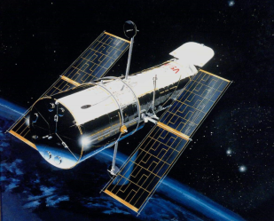
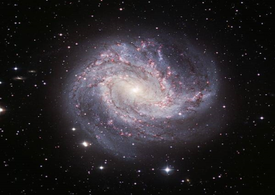
What interests you about the solar system?If you had a chance to go to space,would you go?Share your ideas with a partner.

Slide 17
Practice
Ⅰ.用方框中所给词的适当形式填空
other, try, my, big, amaze
1.Why do you think science is ?
2.Nothing happened,though he his best.
3.Your apple is much than my apple.
4.I have two friends.One is in Class Four,and the is in Class Five.
5.This coat is blue,but is black.
amazing
tried
bigger
other
mine

Slide 18
Ⅱ.根据句意及首字母提示补全单词
1.With a t ,you can see stars in the sky at night.
2.Without treatment,she will almost c die.
3.Don’t ask me to explain u you really don’t understand.
4.According to the research,the total output is
d that of last year.
5.In this way,he was able to solve the m .
elescope
ertainly
nless
ouble
ystery

Slide 19
Ⅲ.句型转换
1.The camera must be Mike’s.(同义句转换)
The camera must Mike.
2.If you don’t go for it,your dream won’t come true.(同义句转换)
Your dream come true you go for it.
3.He decided to join an English club.(同义句转换)
He to join an English club.
4.I hope I can pass the exam.(改为简单句)
I pass the exam.
5.I would like to have a cup of coffee.(同义句转换)
I a cup of coffee.
belong to
won’t unless
made decisions
hope to
feel like having

Slide 20
Homework
1.Finish off the exercises in the activity book.
2.Preview Lesson 28.

