Slide 1
Module 4 Unit 1
I can’t carry all these things.
WWW.PPT818.COM

Slide 2
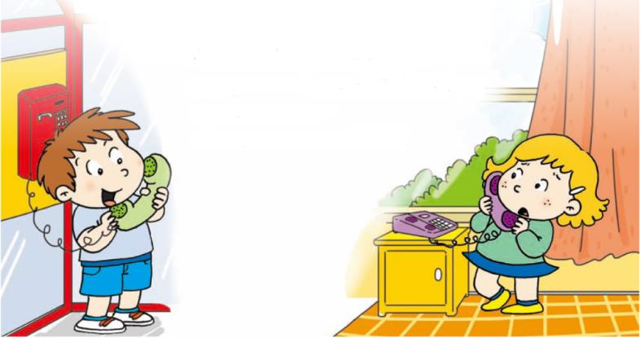
创设情境
Let’s chant
Are you doing your homework?
Are you making a birthday card?
No, no, I’m not.
I’m studying music hard.

Slide 3
Verbs in present continuous
do + ing = doing
make + ing = making
study + ing = studying

Slide 4
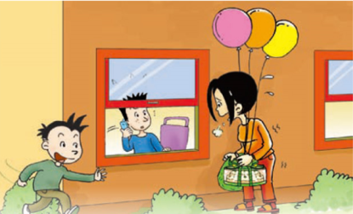
启发思考
Can the woman carry all these things?
No, she cannot.
What are boys doing?
The boy in blue is calling (on the phone). The boy in green is running.

Slide 5
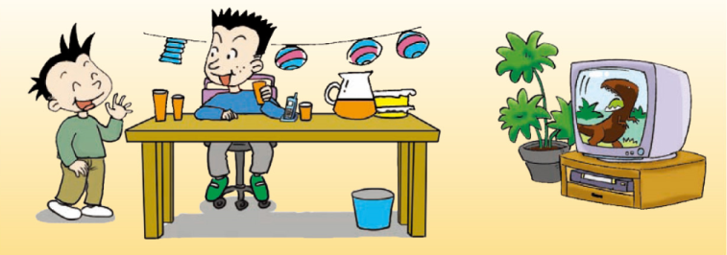
自主或小组探究
Daming is going to have a birthday party. What happened? Let’s see.

Slide 6
Collect words
ate
eat的过去式
all
pron. 所有
fall
v. 掉落
grab
v. 抓住
fly away
v. 飞走

Slide 7
Ask and answer
1. Where is Simon’s mum?
She’s at the supermarket.
2. What is she doing?
She’s buying things for Daming’s birthday party.
3. Who can help Simon’s mum?
Daming can help her.
4. What is Simon doing?
He’s on the phone.

Slide 8
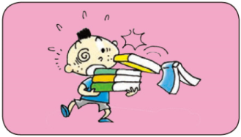
Look and say
Write dialogues and act them out.
My books are falling. Who can help me?
Sorry, I can’t. I’m on the phone.
I can help you.

Slide 9
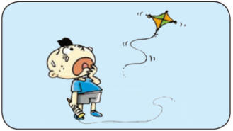
My kite is flying away. Who can help me?
Sorry, I can’t. I’m on the phone.
I can help you.

Slide 10
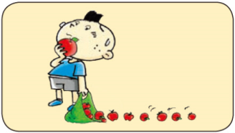
My apples are falling. Who can help me?
Sorry, I can’t. I’m on the phone.
I can help you.

Slide 11
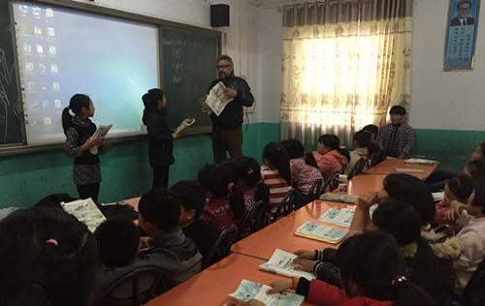
协作交流
Let’s act out the dialogue!

Slide 12
总结提高
现在进行时
现在进行时怎么构成?
主语 + am/is/are + doing (动词+ing)
什么时候用现在进行时?
表示某人正在做某事的时候用现在进行时。

Slide 13
Present continuous tense 现在进行时
去e再加ing。
come
ing
coming
Practice
have
having
live
living
writing
drive
write
driving
ride
riding
move
moving

Slide 14
Present continuous tense 现在进行时
 以重读、“辅元辅”结构结尾的动词需要双写最后一个字母再加-ing。
swim
m
ing
swimming
Practice
jog
jogging
run
running
sit
getting
sitting
get
drop
putting
dropping
put

Slide 15
Homework
1.完成 配套练习。
2.记诵本课出现的生词。

