Slide 1
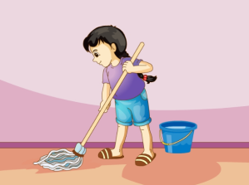
人教精通版五年级下册
Unit 5 I’m cleaning my room.
WWW.PPT818.COM

Slide 2
>>Warm-up
Let’s chant

Slide 3
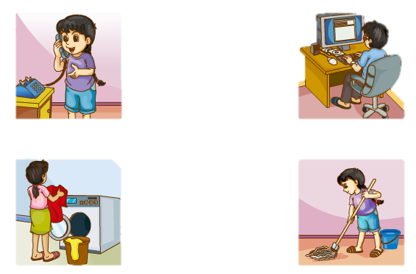
>>Lead-in
Review
make a call
write an email
wash the clothes
clean the room

Slide 4
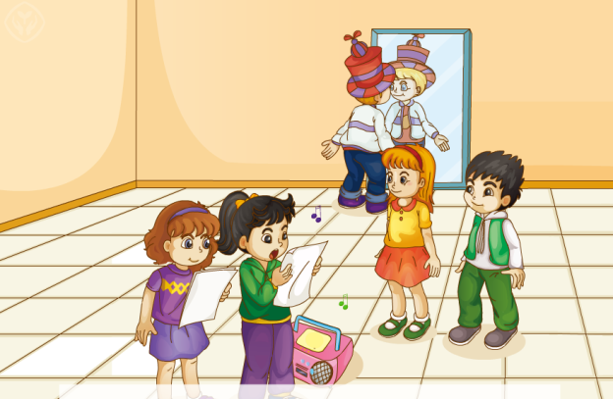
>>Lead-in
Discuss
What are they doing?

Slide 5
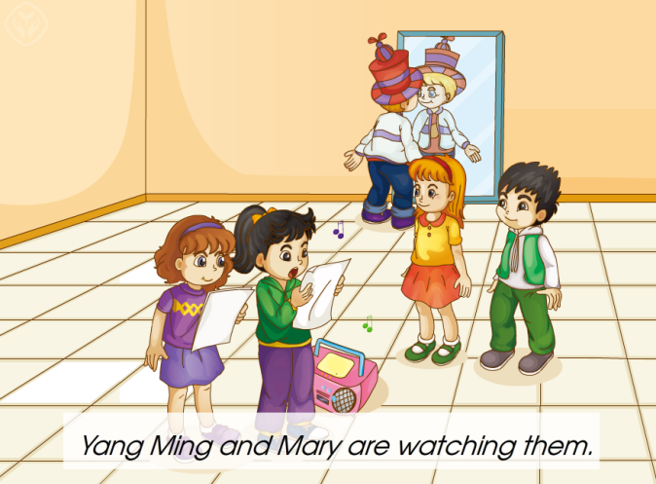
>>Presentation
Just talk

Slide 6
>>Presentation
Just talk
Yang Ming: Look at Peter! He’s wearing a
funny hat.
Mary: Wow! How cool! What’s he doing?
Yang Ming: He’s telling a story about the
funny hat.

Slide 7
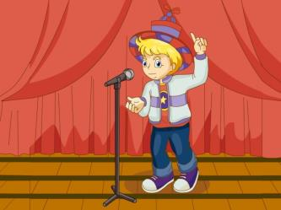
>>Presentation
Just talk
tell a story
---What’s he doing?
---He’s telling a story about the funny hat.

Slide 8
>>Presentation
Just talk
Mary: What’s Li Yan doing?
Yang Ming: She’s singing a very famous song.
Mary: Wow! What a beautiful song!
What are you doing, Yang Ming?
Yang Ming: I’m singing, too.

Slide 9
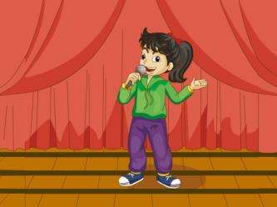
>>Presentation
Just talk
sing a song
---What’s Li Yan doing?
---She’s singing a very famous song.

Slide 10
>>Practice
---What’s he doing?
---What’s she doing?
---He’s _____________about the funny hat.
telling a story
---She’s ________a very famous song.
singing

Slide 11
>>Practice
Let’s act!
Mary
Li YAN
Yang Ming
Peter

Slide 12
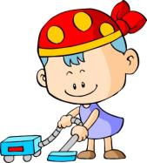
>>Practice
Group Work
What are you doing?
I’m...
What’s he/she doing?
He/She is...

Slide 13
>>Summary
重点词组：
tell a story
sing a song
如何询问和回答“你正在做什么”？
---What are you doing?
---I’m v-ing.
如何询问和回答“他/她正在做什么”？
---What is he/she doing?
---He’s/She’s v-ing.

Slide 14
>>Homework
1. 观看课文动画，按照正确的语音、语调朗读课文。
2 . 熟练表演对话。
3 . 预习Lesson28。
close

