Slide 1
Unit 7
What's the highest mountain in the world?
Section B 第2课时
WWW.PPT818.COM

Slide 2

1. Talk about geography and nature.
2. To compare things using comparisons.
3. To practice students' listening skills.

Slide 3
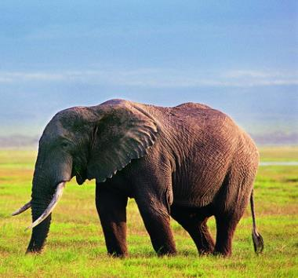
Compare facts about these two animals. Use the language in the box to help you make sentences.
1a
Elephant
- is 350 cm tall
weighs 5,000 kilos
eats 150 kilos of food a day
Try to describe the elephant using the information above.

Slide 4
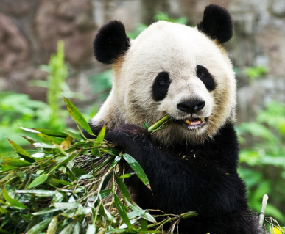
Panda
- is 150 cm tall
(standing on two legs)
- weighs 100 kilos
- eats 10 kilos of food a
day

Slide 5
Example sentences:
This elephant weighs many times more than this panda.
(200 cm taller/shorter, weigh much more/less, eat much more/less, eat many times more)
This elephant weighs much more than this panda.
This panda weighs much less than this elephant.

Slide 6
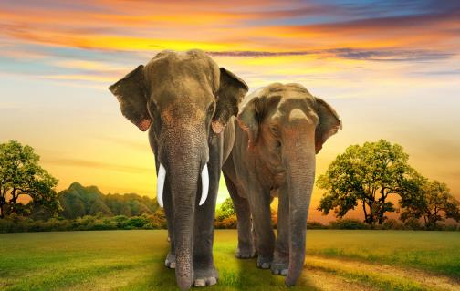
大象是现存世界最大的陆栖动物，主要外部特征为柔韧而肌肉发达的长鼻和扇大的耳朵，具缠卷的功能，是象自卫和取食的有力工具。象肩高约2米，体重3～7吨。非洲象耳大，体型较大，体重较重。亚洲象耳小，身体较小，体重较轻。

Slide 7
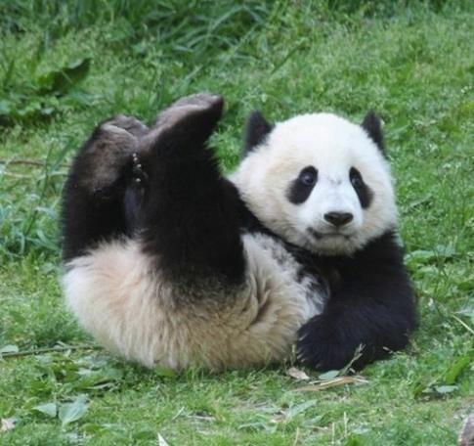
成都大熊猫繁育研究基地(Chengdu Research Base)位于成都北郊斧头山，距市区10公里，是一个专门从事濒危野生动物研究、繁育、保护教育和教育旅游的非营利性机构。该基地建有一座大熊猫博物馆，存有珍贵的资料和丰富的展品。除大熊猫外，该基地还从事对小熊猫、黑颈鹤等珍稀濒危动物的研究及繁育工作。

Slide 8
1b
Listen and check (√) the numbers you hear.
√
√
_______ 100 ______ 16 _______ 20
______ 50 ______ 120 _______ 0.1
______ 0.2 ______ 150
√
√
√

Slide 9
1c
Listen again and complete the sentences.
1. At birth, a baby panda is about ___ to ___ kilos.
2. At birth, a baby panda is about ___ cm long.
3. A baby panda is not black. It is ____ and it has no _____.
4. A panda can live up to ___ to ___ years.
0.1
0.2
15
pink
teeth
20
30

Slide 10
1d
Take turns telling your classmates about pandas.
A: A baby panda cannot see.
B: An adult panda weighs many
times more than a baby panda.

Slide 11

An adult panda weighs many times more than a baby.
“倍数+比较级+than…”，表示“……比……(大/小/长/短……)几倍”。
这个盒子比那个盒子大三倍。
This box is three times bigger than that one.

Slide 12

倍数+比较级+than…
This elephant weighs many times more than that panda.
An adult panda weighs many times more than a baby.

Slide 13

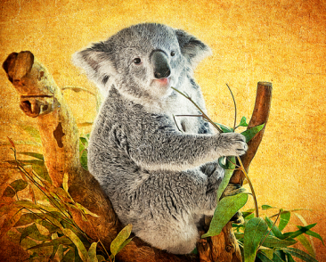
Here are some facts about koala, use the information above to make sentences.
Koala
- is 75 cm tall
- weighs 10 kilos
- eats leaves
- sleeps 20 hours a day

Slide 14

1. Copy and read new words three times.
2. Make sentences to tell about Pandas.

