Slide 1
Module 12 Help
Unit 3 Language in use
WWW.PPT818.COM

Slide 2
学习目标:
1、掌握本模块的词汇与重点句子。
2、掌握祈使句的用法。
3、掌握情态动词 must,
can, could 表示推测的用法。

Slide 3
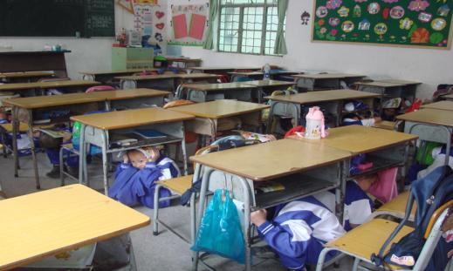
Lead-in
Look at the pictures and fill in the blanks.
What are they doing?
They are ______ ______ a table.
hiding under

Slide 4
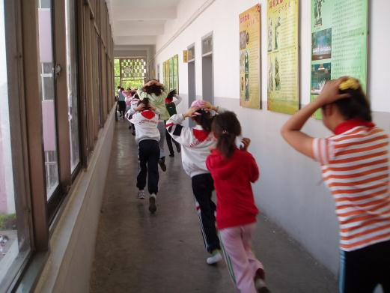
What are they doing?
They ____ _______ the building quickly when the ground stops shaking.
are leaving

Slide 5
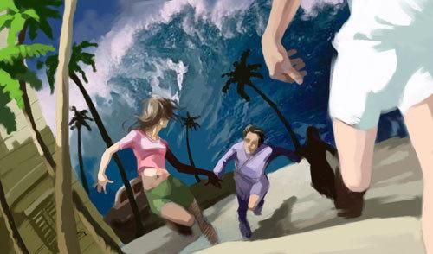
What are they doing?
They are ________ ______ from the sea and move quickly to higher ground.
running away

Slide 6
Language practice
用适当的单词补全句子。
That ______ be harmful!
Betty, you ______ know!
_____ _____ from windows and heavy furniture.
______ ______ _____ street lights or under power lines.
could
must
Stay away
Don’t stand near

Slide 7
Complete the sentences with could, must or mustn't.
must
1. It’s dangerous. You ______ keep out!
2. These stairs are not safe. You ________ use them.
3. The rocks are falling down. You ______ get hit.
4. The river is too deep. You _________ swim in it.
5. Betty ______ know what to do because she did some basic medical training.
mustn’t
could
mustn’t
must

Slide 8
Underline the correct words to
complete the first aid instructions.
1. Get / Do not get medical help immediately.
2. Ask / Do not ask them where the pain is.
3. Lift / Do not lift them because you may drop them.
4. Keep / Do not keep them warm.

Slide 9
Complete the poster about earthquakes with the correct
form of the words and expressions in the box.
do not use hide under keep leave stay away
When there is an earthquake ...
1. ____________ from the windows.
2. ____________ a table.
3. ____________ the lift.
4. ____________ the building quickly when the ground stops shaking.
6. ____________ calm.
Stay away
Hide under
Do not use
Leave
Keep

Slide 10
Complete the conversation
with the words and expressions in the box.
chance Cover in pain in trouble medical
Tony: Daming is training hard for the big
match.
Lingling: Yes, the team has a good
(1)_______ this year.
Tony: Oh, no, Daming’s (2)_________.
He’s down!
Lingling: It looks like he’s (3)__________.
chance
in trouble
in pain

Slide 11
Tony: Daming, what happened?
Daming: It’s my leg.
Lingling: (4)_______ him with my coat.
Tony: But don’t move him. Let’s wait for
someone with (5)_________
training.
Lingling: OK.
Cover
medical

Slide 12
Complete the news report
with the correct form of the words in the box.
clear inside power rock trouble warn
Information is coming in that there could be (1)_______ because of heavy rain in the north. The government is (2)________ people about falling (3)______. Some roads have a lot of rocks on them, but people are trying to (4)______ them quickly.
trouble
warning
rocks
clear

Slide 13
power
In some places there is no (5)________.
And people must stay (6)________ to keep away from falling rocks.
inside

Slide 14
Now read the report again
and check (√) the true sentences.
1. There are problems everywhere because of rain.
2. The government is warning people about an earthquake.
3. Some roads in the mountains have a lot of rocks on them.
4. People are trying to clear the rocks off the roads.
5. There is no problem with power.
×
×
√
√
×

Slide 15
Read the passage and choose the correct answer.
1. What’s the best title for this passage?
2004 Asian tsunami.
A girl saves tourists from tsunami.
c) Underwater earthquakes.
2. What did Tilly notice?
a) Water coming to the beach.
b) People watching the water.
c) Bubbles in the water.
√
√

Slide 16
3. What does her teacher think of Tilly?
a) She’s lucky.
b) She doesn’t do silly things.
c) She’s a clever student.
√

Slide 17
Around the world
Special buildings in Japan
Earthquakes are very common in Japan. Many can cause a lot of damage. But now there are new ways of constructing buildings to make them safer and stronger during earthquakes. The Yokohama Landmark Tower is one of the tallest buildings in Japan. It is heavy and strong. It sits on rollers. This means the earth can rise and fall beneath the building without shaking it.

Slide 18
Make a list of accidents that can happen at school.
School accidents | How | Where
Hurting hands/ knees/ legs | Running fast/ Playing football | Playground
Hitting your head | Climbing a tree | Garden
…

Slide 19
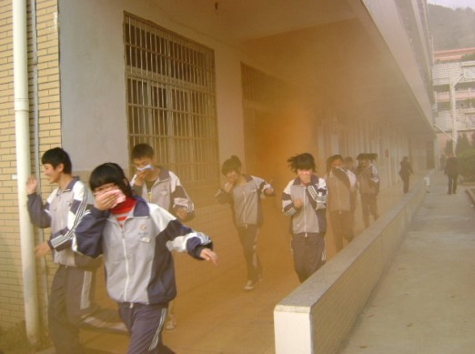
Work in groups. Choose an accident from the list
in Activity 8 and give instructions about what to do.

Slide 20
Exercises
1. — Sorry for being late again.
— _____ here on time next time, or
you’ll be punished.
A. Be B. Being C. To be D. Been
2. — May I listen to the music here, Mr. White?
— Sorry, you’d better _____ it like that.
A. not to do B. not do
C. don’t do D. not do to
A
B

Slide 21
3. Boys and girls, ______ up your hands if you want to take part in the summer camp (夏令营).
A. putting B. to put C. put
4. When someone is in trouble, we must help him _______ trouble.
A. in B. out of C. into
C
B

Slide 22
中 考 链 接
1. — My brother won the first prize in speech competition.
— Congratulations! You ____ be excited about that! 【2012湖北宜昌】
A. need B. must C. would D. can
2. The lady in this photo _____ be over fifty! She looks so young! 【2012江苏无锡】
mustn’t B. must C. can’t D. can
B
C

Slide 23
A
3. This toy Mickey Mouse ______ be Amy’s. She’s the only kid at the picnic. 【2012山东济宁】
A. must B. can C. need D. can’t
4. — You ____ be excited that you’re going back to your hometown soon.
— Yes, I can’t wait any longer. 【2012 内蒙古包头】
A. shall B. can C. need D. must
D

Slide 24
5. _____ get off the bus before it stops. 【2012湖南永州】
Don’t B. Doesn’t C. Didn’t
6. Don’t ______ up English. It’s very important. 【2012四川南充】
A. give B. hurry C. stay
A
A

Slide 25
本课小结
祈使句的用法。
情态动词 must, can, could 表示推测的用法。

Slide 26
Homework
你觉得你的校园生活安全吗？请你写一篇题为“How to keep safe in school”的短文，谈谈你的看法。
内容：
1. 描述一件发生在你身上或你身边的校园安全事件。
2. 提出解决的建议。（至少两条）
3. 呼吁每个学生注意校园安全。

Slide 27
Thank you!

