Slide 1
Let’s go to school.
第6课时
WWW.PPT818.COM

Slide 2
Let’s chant
A storybook!
A storybook!
What’s in the bag?
A marker!
A marker!
What’s in the pencil-box?
An English book!
An English book!
What’s on the desk?
A Chinese book!
A Chinese book!
What’s on the chair?

Slide 3
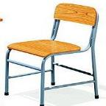
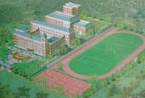
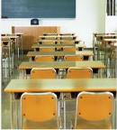
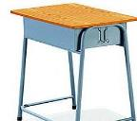
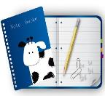
为下列图片选择正确的单词
a. English book b. desk c. school
d. notebook e. classroom f. Chinese book
g. chair h. exercise book i. storybook
j. textbook
Exercise 练习
c
e
f
g
a
j
h
b
d
i

Slide 4
box
What’s in the box?
A dog.

Slide 5
What’s on the desk?
桌子上有什么？
A book and an apple.

Slide 6
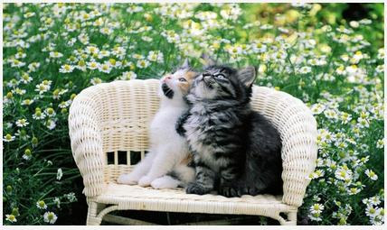
What’s on the chair?
椅子上有什么？
Two cats.

Slide 7
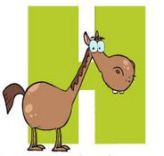
f
g
h
i
j

Slide 8
Read and act.
与同桌练习Fun story部分

Slide 9
Thank You.

