Slide 1
Unit 3 Birthday
When is your birthday?
WWW.PPT818.COM

Slide 2
Which month do you like? Why?
How many months?
Twelve.

Slide 3
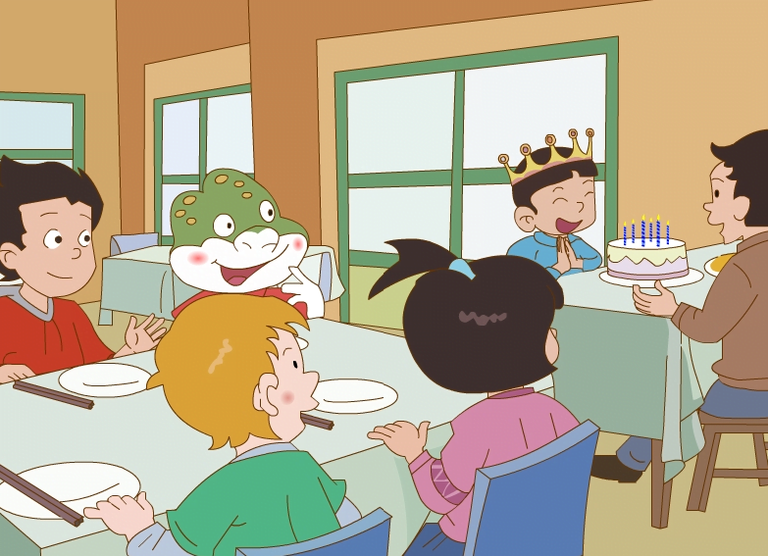
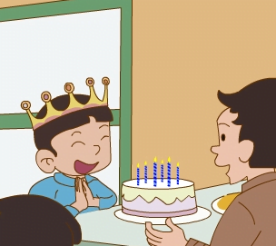
How
happy
they are!
They are having a birthday party.

Slide 4
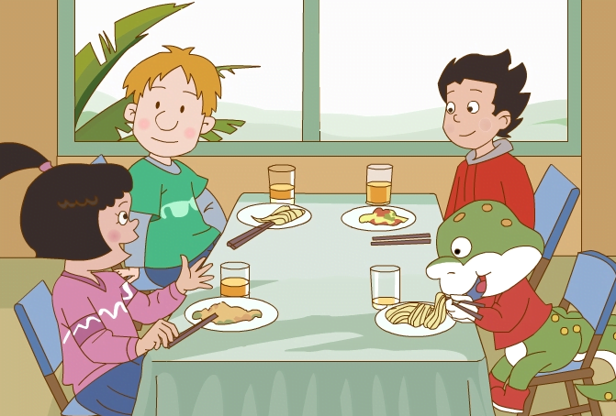
When is your birthday, Li Ming?
It’s in March.

Slide 5
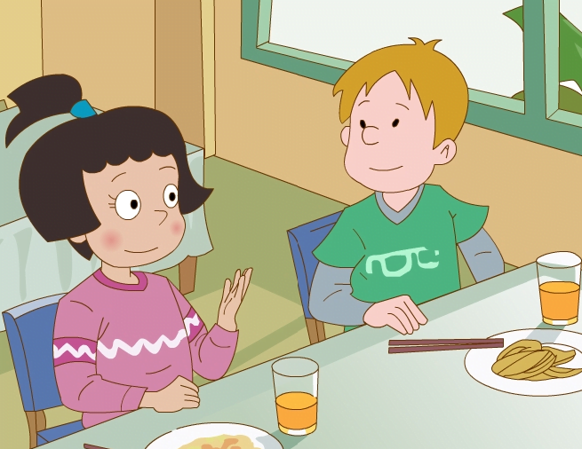
When is your birthday, Peter?
My birthday is in May.

Slide 6
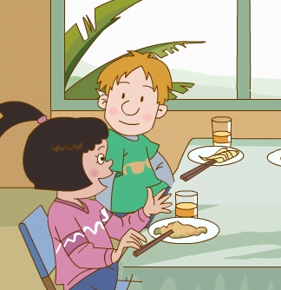
When is your birthday, Wang hong?
Is it in…?
Guess.
It’s October 7.

Slide 7
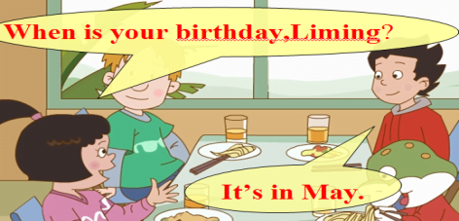
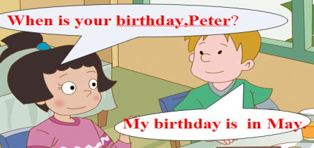
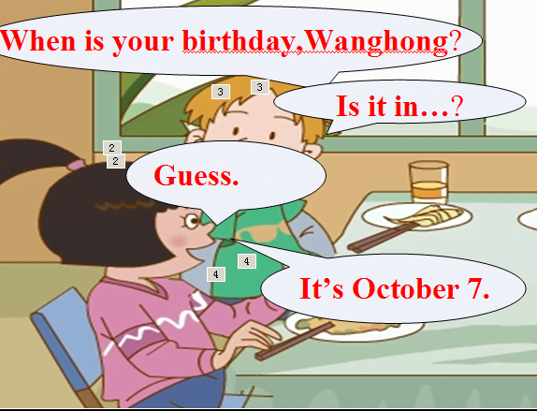
Practise in pairs.

Slide 8
Practise in groups.

Slide 9
Practise in groups.
Tips: 1. Read together. 小组齐读月份单词。
2. Read one by one. 组内一个个读月份词卡。
3. Preemptive answer. 抢答单词。
4. Make a dialogue. 对话问答，询问对方生日。
When is your birthday?
It’s in…

Slide 10
Read:
February
November
May
July
June
April
January
August
October
September
March
December

Slide 11
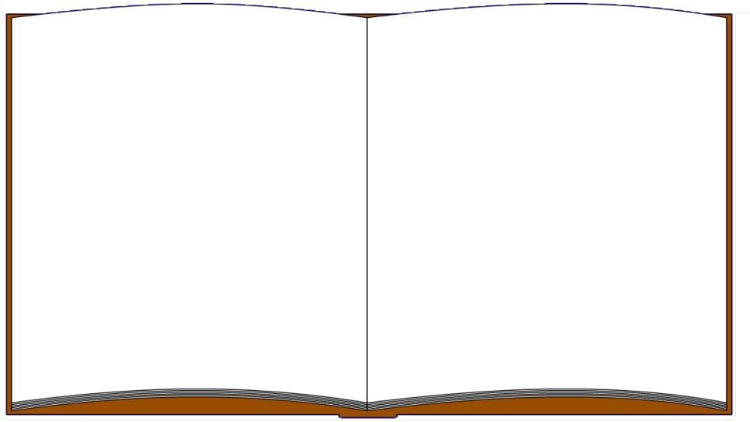
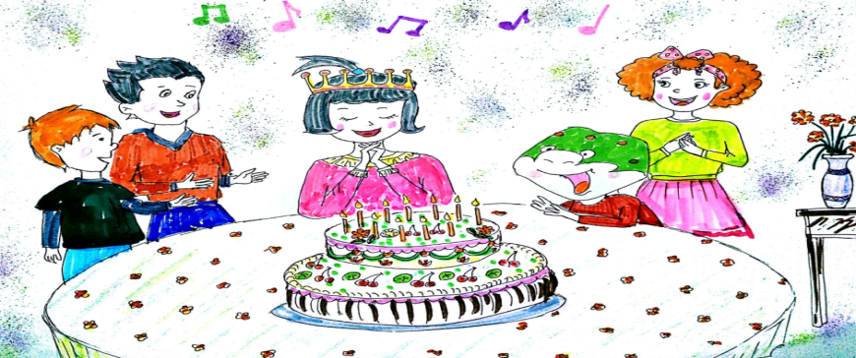
Yesterday was Wang Hong’s birthday.
They ate a big cake. They were happy.

Slide 12
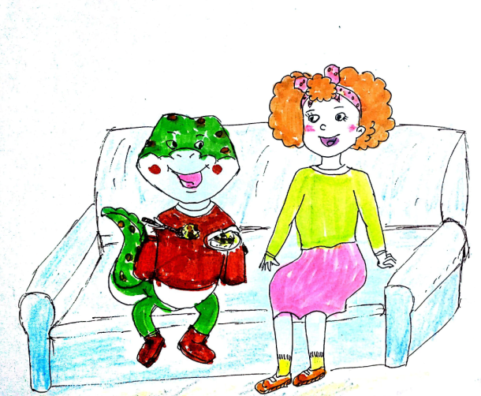
After the party
When is your birthday, Danny?

Slide 13
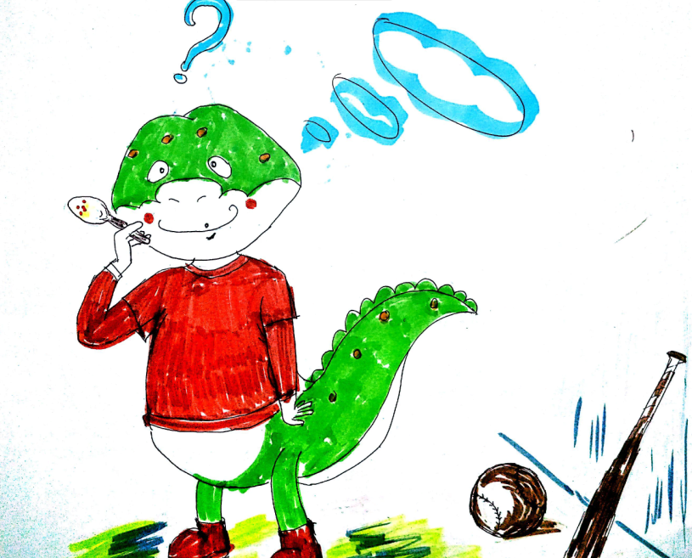
My birthday? Let me see!

Slide 14
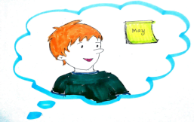
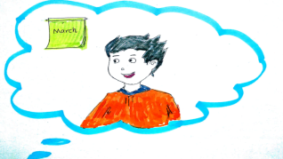
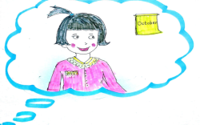
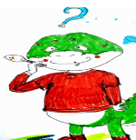
Peter’s birthday is in May .
Li Ming’s birthday is in March .
Wang Hong’s birthday is in October.

Slide 15
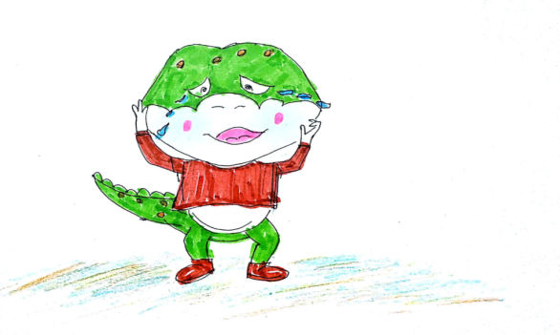
But when is my birthday?
I have not birthday.
I am sad.

Slide 16
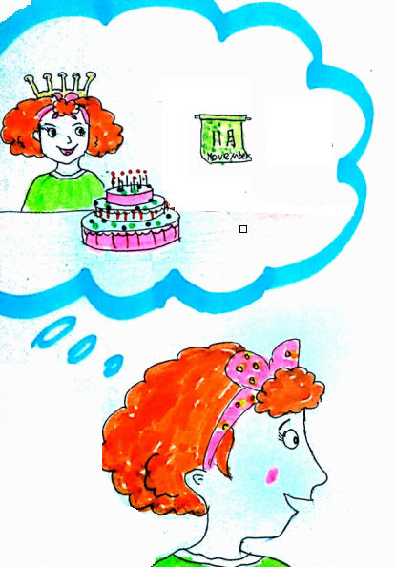
Don’t be sad, Danny.
My birthday is in November 10.

Slide 17
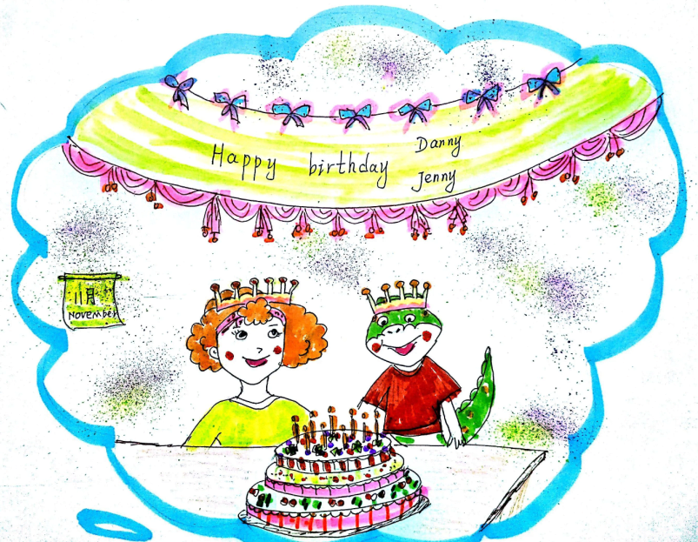
Let’s have a same birthday!

Slide 18
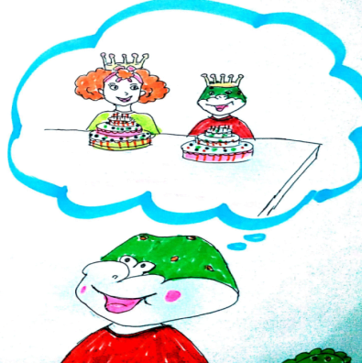
Great, I am so happy!
I will eat 2 cakes.
Haha...

Slide 19
1. Whose birthday is this?
A. Li Ming’s B. Jenny’s C. Wang Hong’s
2. When is Jenny’s birthday?
A. June 6 B. October 10 C. July 10

Slide 20
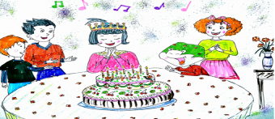

Slide 21
1. Whose birthday is this?
A. Li Ming’s B. Jenny’s C. Wang Hong’s
2. When is Jenny’s birthday?
A. June 6 B. October 10 C. July 10

Slide 22
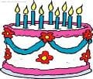
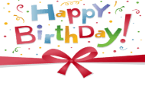
When is your birthday?
Is it in… ?

Slide 23
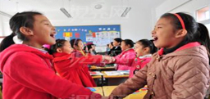
Find the birthday friends.（找相同生日朋友）
Hello, My birthday is in…
When is your birthday?
My birthday is in…
We are friends, come to my birthday party.
Great.

Slide 24
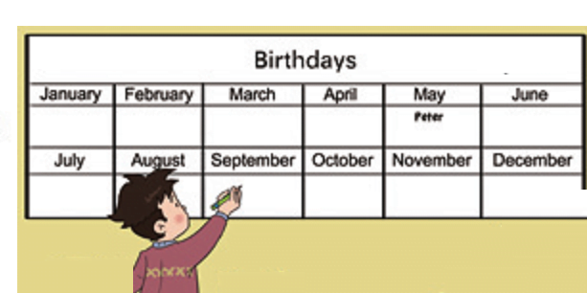
在对应月份下标记你的生日

Slide 25
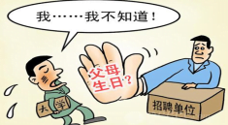
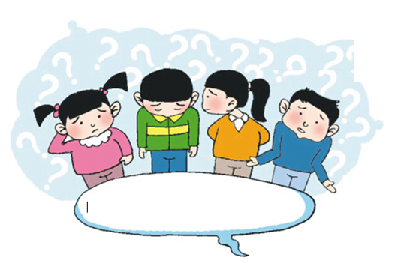
When is your father’s/
mother’s birthday?

Slide 26
Homework:
1. 跟读课文3遍。
2. 班级博客阅读关于生日的英语绘本故事。
3. 询问朋友或家人生日，完成练习。

Slide 27
Thank You

