Slide 1
Unit 2 Wildlife Protection
Section Ⅳ Discovering Useful Structures
WWW.PPT818.COM

Slide 2
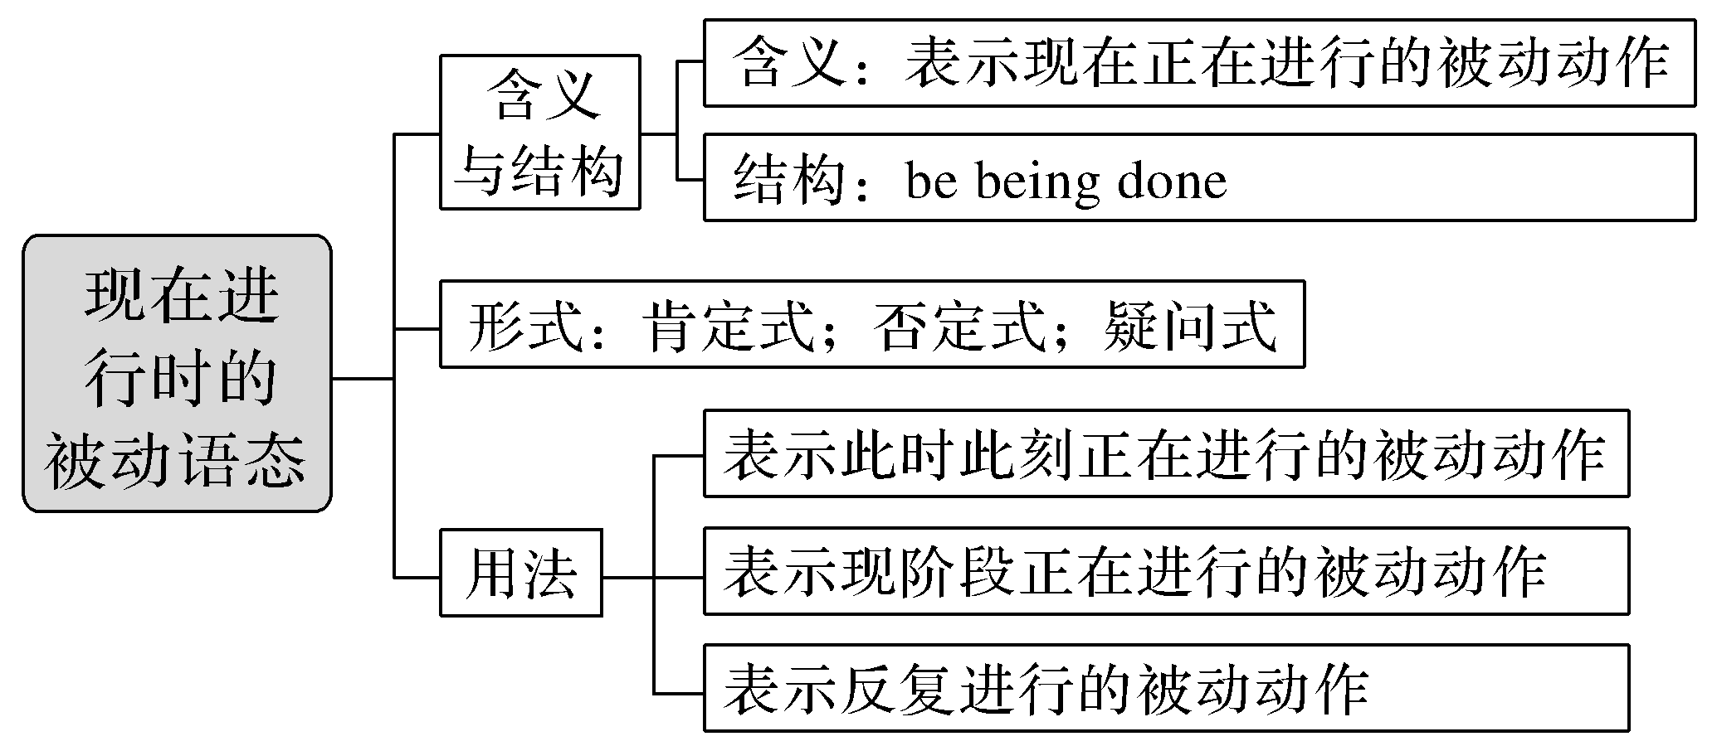
现在进行时的被动语态

Slide 3
现在进行时的被动语态是中学英语语法中的一种非常重要的英语时态，它属于现在时态。
African elephants are being hunted.非洲大象正在被猎杀。
What is being done to help them? 现在可以做些什么来帮助它们呢？
What measures are being taken to help them?
现在可以采取哪些措施来帮助它们呢？
一、含义与结构
[合作探究]

Slide 4
[自主发现1]
(1)现在进行时的被动语态表示说话人说话时或现阶段某事____________。
(2)现在进行时的被动语态的构成：
①be＋being＋done (____________)；②“be being done” 中的动词____________应随主语作相应的变化。
正在被做
过去分词
be
[名师提醒] 现在进行时的被动语态中不能漏掉“____________”。
being

Slide 5
二、形式
[合作探究]
We’re being killed for the wool beneath our stomachs.
我们因我们肚子底下的羊毛而正被杀害。
The tiger is not being set free at present.目前这只老虎没有被放出。
Are milu deer being sent to China from Britain? 麋鹿是从英国运到中国的吗？
What is being done for the milu deer? 现在为麋鹿正在做些什么呢？

Slide 6
[自主发现2]
现在进行时的被动语态的主要形式有：肯定式；否定式；疑问式。它们的具体构成如下：
(1)肯定式：主语＋____________＋____________
(2)否定式：主语＋____________＋____________＋____________
(3)疑问式：________疑问式[“Am/Is/Are＋(not)＋主语＋being done”]；________疑问式[“特殊疑问词＋am/is/are＋(not)＋being done”]。
am/is/are
being done
am/is/are
not
being done
一般
特殊

Slide 7
三、用法
1.基本用法
[合作探究]
She is being examined by the doctor now.她现在正在接受医生的检查。
Look! The children are being taken care of by their aunt.
看！孩子们正由他们的姑妈照顾。

Slide 8
[自主发现3]
[合作探究]
[自主发现4]
表示________正在进行或发生的被动动作，常与now, right now, at present, at the moment等时间状语词连用。
A new factory is being built.一座新的工厂正在建设中。
They are being taught English at present.目前他们正在被教学英语。
表示________或________________正在进行的被动动作，但这一被动动作在此时此刻不一定正在发生。
现在
现阶段
目前这段时间

Slide 9
[合作探究]
[自主发现5]
Tom is always being praised by the teacher.汤姆总是被老师表扬。
He is often being bullied by other boys.他经常被别的男孩子欺负。
表示一种________________的被动行为，常与always, often等词连用，往往带有赞扬、责备、厌烦或埋怨等感情色彩。
经常性或习惯性

Slide 10
2.特殊用法
[合作探究]
The problem is under discussion now.
＝ The problem is being discussed now.这个问题正在讨论中。
Some rock music is being played by them next.
下面将由他们演奏一些摇滚音乐。
John is not here.He must be being interviewed.
约翰不在这里，他一定正在接受采访。

Slide 11
[自主发现6]
(1)“___________________”的结构可以表示现在进行时的被动语态的含义。
(2)少数及物动词的进行时的被动语态表示某物________________将要承受某个动作。
(3)含情态动词的现在进行时的被动语态表示对现在正在发生的被动行为的________。
be＋under/in/on＋n.
按计划、安排
推测

Slide 12
[巩固内化1]
用所给词的适当形式填空
①An interesting experiment ______________(carry) out now.
②We can hear that the papers __________________(print) quickly on the fast-moving printing machines.
③What you ______________ (tell) is true.
④Some animals _____________________ (not protect) well enough.
is being carried
are being printed
are being told
are not being protected

Slide 13
[巩固内化2] 同义句转换
①They are studying the life of the panda at present.
→The life of the panda ________________ at present by them.
②The doctor is operating on the patient inside now.
→The patient ____________________ by the doctors inside now.
③Are they building the bridge at present?
→Is the bridge ________________ by them at present?
is being studied
is being operated on
being built

Slide 14
[巩固内化3]
单句语法填空/补全句子
①A lot of wild animals ________________ (kill) by hunters in Africa today.
②I have to go to work by taxi because my car ________________ (正在修理)at the garage.
③How many bridges ________________ (正在修建) in the village now?
④Look! The foreign guests ________________________ (正在被带领参观) the factory by Mr.Zhang.
are being killed
is being repaired
are being built
are being shown around

Slide 15
[巩固内化4]
补全句子/同义句转换/一句多译
①—Do you know what Smith is doing?
—He is ill.He _________________________________________by the doctor.
——你知道史密斯正在做什么吗？
——他病了。他可能正在接受医生的检查。
②Many new cars are on show.
→Many new cars _______________________________________.
may be being examined
are being shown

Slide 16
③今晚将要举办一场晚会。
___________________________________________________________________
＝_________________________________________________________________
＝_________________________________________________________________
A party will be held tonight.
A party is going to be held tonight.
A party is being held tonight.

