Slide 1
Unit2 There are forty students in our class.
人教精通版四年级下册
WWW.PPT818.COM

Slide 2
Lead-in
Game
Up and down

Slide 3
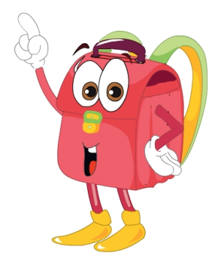
Presentation
Let’s learn
bag
book

Slide 4
Presentation
Think and say
How many bags do you have?
I have …
How many books do you have?
I have …

Slide 5
Presentation
Look and Think
Who are they?
Where are they?
What are they doing?

Slide 6
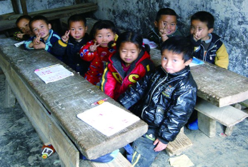
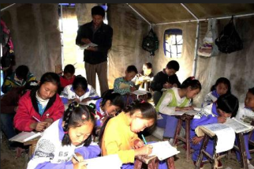
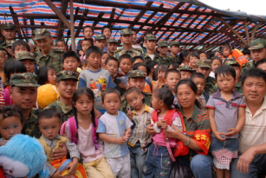
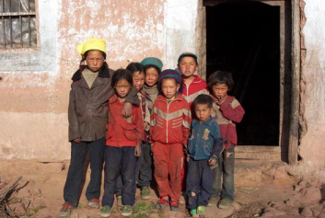
Presentation
Children in
need

Slide 7
Presentation
Look and say
What does Miss Liu want to know?
（单击图片可播放动画）

Slide 8
Presentation
Listen and say
How many bags do they have?
They have seventy bags.
How many books do they have?
They have eighty books.

Slide 9
Practice
Follow to read
录音 | 课文句子
Hello, everyone! Let’s help children in need!
How many bags do you have?
We have seventy bags.
How many books do you have?
We have eighty books.

Slide 10
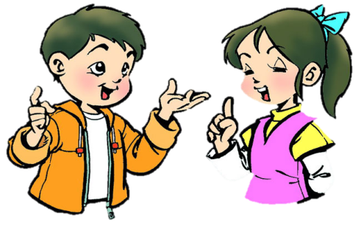
Practice
Role-play
分角色朗读出对话，注意模仿语音语调。
四人一组，试着表演出来吧。

Slide 11
Presentation
Let’s learn
seventy

Slide 12
Presentation
Let’s learn
eighty

Slide 13
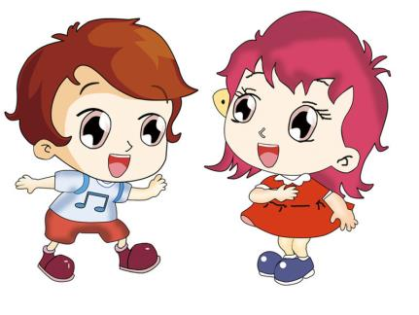
Practice
Ask and answer
How many … do you have?
I have …

Slide 14
Practice
活动
Do a survey
Books
How many books do you have?
storybooks
textbooks
(教科书)
workbooks
(练习册)

Slide 15
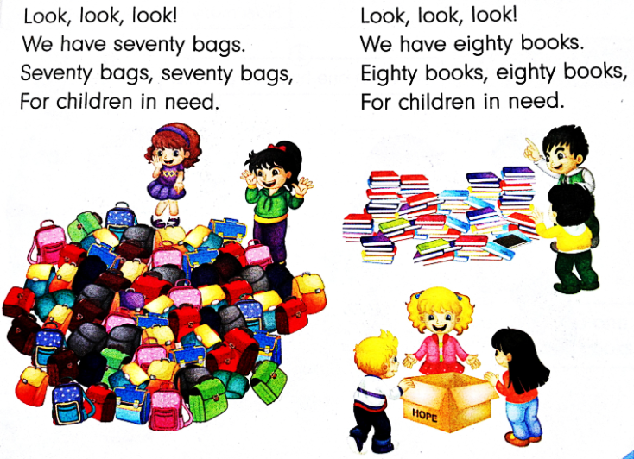
Practice
Let’s chant

Slide 16
Summary
1. 本课重点学习的单词是什么？
bag
book
seventy
eighty
2. 本课的重点句型是什么？
How many … do you have?
We have ...

Slide 17
Homework
1. 跟读课文Just talk部分的录音，注意语音、语调。
2. 调查同桌各种学习用品的数量，并绘制一张表格，要求用英文填写。
3. 预习Lesson11。
Close

