Slide 1
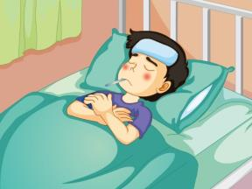
Unit 4 What’s wrong with you?
人教精通版五年级下册
WWW.PPT818.COM

Slide 2
>>Warm-up
动画说唱

Slide 3
>>Lead-in
Let’s review
1. I f___ much better today.
eel
2. I like ice cream and c_________.
hocolates
3. Thanks for your g______ card.
et-well
4. He will help me w___ my English.
ith
5. They b____ her a lot of things.
ring

Slide 4
>>Presentation
Just practise

Slide 5
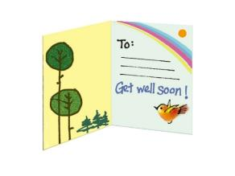
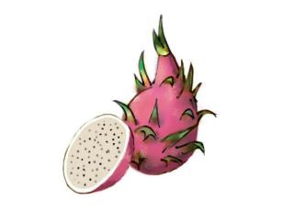
>>Presentation
chocolate
get-well card
dragon fruit

Slide 6
>>Presentation
Here is a get-well card for you.
Here are some chocolates for you.

Slide 7
>>Practice
are
flowers
1. Here ________ some ________ for you.
oranges
2. Here ________ some ________ for you.
are

Slide 8
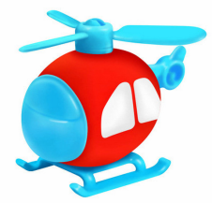
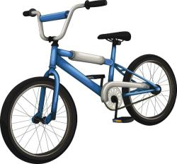
>>Practice
toy plane
1. Here ________ a _________ for you.
is
2. Here ________ a new ________ for you.
is
bike

Slide 9
>>Practice
Pair Work
How do you feel today?
I feel much better.
Here’s a get-well card for you.
Thank you.

Slide 10
>>Practice
Just write
bring
feel
带来
感觉
here
for
这里
为了…
get-well card
康复卡
Here is a get-well card for you.

Slide 11
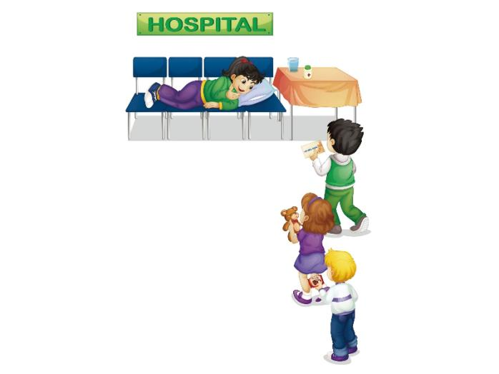
>>Practice
Let’s act
How do you feel today?
Here’s a get-well card for you.
I feel much better.
Here are some chocolates for you.
Here’s a teddy bear for you.

Slide 12
>>Presentation
Let’s chant

Slide 13
>>Summary
四会单词：
bring
feel
here
for
get-well card
如何询问对方今天怎么样？
--- How do you feel today?
--- I feel much better.
如何表达“这是给你的…”？
Here is/are … for you.

Slide 14
>>Homework
1. 观看课文动画，按照正确的语音、语调朗读课文。
2 . 熟读Let’s chant部分。
3 . 预习Revision。
close

