Slide 1
Unit 7 Sports and Good Health
You Are What Eat!
WWW.PPT818.COM

Slide 2
Learning Targets
Key words & phrases:
truth, decide, change, habit, usual, health, saying, awful, to tell you the truth, have a dream, as usual, be good for, wake up, have lunch
Key sentences:
1.To tell you the truth, I decided to change my eating habits.

Slide 3
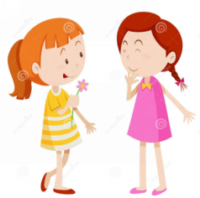
2.Yesterday evening, I ate ten donuts as usual.
3.It's not good for your health.
4.Do you know the saying: You are what you eat？
5. Later that night, I had a dream.
6. How Often?

Slide 4
Lead in
Look at the following pictures and
discuss with your deskmate:
What are healthy eating habits? What
are junk food and what are healthy
food?
PPT模板：www.1ppt.com/moban/ PPT素材：www.1ppt.com/sucai/
PPT背景：www.1ppt.com/beijing/ PPT图表：www.1ppt.com/tubiao/
PPT下载：www.1ppt.com/xiazai/ PPT教程： www.1ppt.com/powerpoint/
资料下载：www.1ppt.com/ziliao/ 范文下载：www.1ppt.com/fanwen/
试卷下载：www.1ppt.com/shiti/ 教案下载：www.1ppt.com/jiaoan/
PPT论坛：www.1ppt.cn PPT课件：www.1ppt.com/kejian/
语文课件：www.1ppt.com/kejian/yuwen/ 数学课件：www.1ppt.com/kejian/shuxue/
英语课件：www.1ppt.com/kejian/yingyu/ 美术课件：www.1ppt.com/kejian/meishu/
科学课件：www.1ppt.com/kejian/kexue/ 物理课件：www.1ppt.com/kejian/wuli/
化学课件：www.1ppt.com/kejian/huaxue/ 生物课件：www.1ppt.com/kejian/shengwu/
地理课件：www.1ppt.com/kejian/dili/ 历史课件：www.1ppt.com/kejian/lishi/

Slide 5
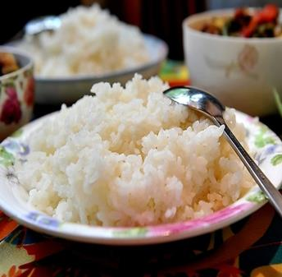
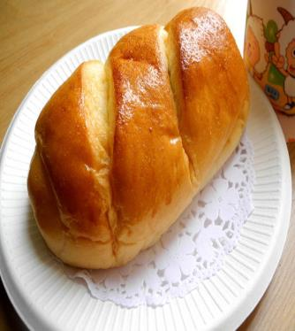
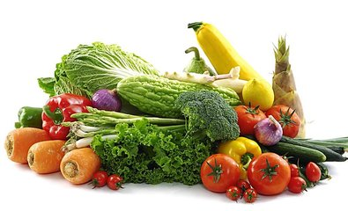
rice
bread
vegetables

Slide 6
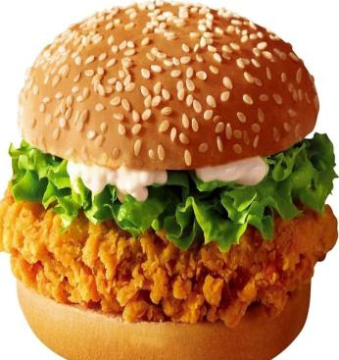
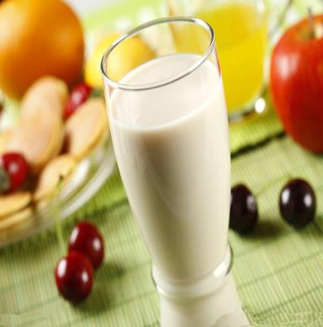
hamburger
milk
coke

Slide 7
Words and expressions
Words
truth
decide
change
habit
usual
health
saying
awful
n. 真相；真实
v. 决定；做出判断
v. & n. 改变
n. 习惯；行为
adj. 通常的
n. 健康；健康状态
n. 俗语；谚语
adj. 可怕的

Slide 8
to tell you the truth have a dream
as usual
be good for
wake up
have lunch
说实话
做梦
像往常一样
对……有益
醒来
吃午饭

Slide 9
Presentation
Let's Do It!
Listen and write true(T) or false(F).
1
( ) 1. Danny and Jenny are having lunch.
( ) 2. Danny is eating a salad.
( ) 3. Danny likes vegetables very much.
( ) 4. Danny decided to change his eating
habits.
T
T
F
T

Slide 10
2
Read the the lesson and answer the questions.
How many donuts did Danny eat yesterday evening?
2.What did Danny’s uncle say to him?
He ate ten donuts.
He said to him that he shouldn’t eat so many donuts. It's not good for your health.

Slide 11
3.What happened to Danny in his dream?
4.Why did Danny decide to change his eating habits?
He became a big donut and everyone tried to eat him.
Because he didn't want to be a donut./ Because he agreed with his uncle./
Because he was scared in his dream.

Slide 12
3
Fill in the blanks with the correct forms of the phrases in the box.
have lunch be good for to tell you the truth as usual wake up
is good for
1.Take a walk after supper! It _________your health.
2. The bus never comes on time. And today, the bus is late __________.
3. I don’t eat at school. I go home at 12 o’clock, and I ____________ with my family.
as usual
have lunch

Slide 13
4. A: Did you watch the movie last week?
B: Yes, but I didn’t like it. ______________ , it was very boring.
5. Jim _________late this morning, so he didn’t catch the school bus.
to tell you the truth
woke up

Slide 14
4
Work in groups.What are some of your favourite foods?How often do you eat these foods? Interview your classmates and fill in the table.Look at the results.Do they have good eating habits?
Name | Favourite Foods | How Often | Good Food | Junk Food | Eating Habits or
Li Weijie | apples | 3 times a week | √
 | choolate | once a week |  | √
 | carrots | twice a week | √

Slide 15
Language points
1. To tell you the truth, I decided to change my eating habits.
(1)truth作名词，意为“事实”。其形容词形式为true。短语to tell (you) the truth意为“说实话”，经常放在句首，作插入语，在句中不作任何成分。
如：To tell you the truth, I don't like chicken at all. 说实话，我一点儿也不喜欢吃鸡肉。

Slide 16
(2)decide作动词，意为“决定”。
常用结构：decide to do sth. 意为“决定做某事”；“decide＋疑问词＋动词不定式”意为“决定……”；“decide＋that从句”意为“决定……”。
如：I decided to call him.我决定给他打电话。Have you decided what to do next？
你们决定好下一步要做什么了吗？

Slide 17
(3)habit作名词，意为“习惯”。
常用词组：good habit 好习惯；bad habit 坏习惯；living habit 生活习惯；change the habit改变习惯；develop a habit养成习惯；eating habit饮食习惯。

Slide 18
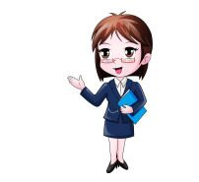
2.Yesterday evening, I ate ten donuts as usual.
as usual 意为“像往常一样”，常位于句首或句尾，作状语。其中usual作形容词，意为“通常的”，其副词形式为usually(通常)。
如：He came late as usual.
他像往常一样来得很晚。

Slide 19
3.It's not good for your health.
health作不可数名词，意为“健康，健康状况”。常用短语：in good health身体好；in bad/poor health身体不好。
如：His father is in bad health these days.
他爸爸这些天身体不好。

Slide 20
4.Do you know the saying: You are what you eat？
saying作可数名词，意为“谚语，俗语”。它是由“say＋­ing”构成的，相当于proverb。
如： “A close mouth catches no flies” is a saying.“病从口入，祸从口出”是一句谚语。

Slide 21
5.How Often？
how often引出的问句通常用来对动作发生的频率进行提问，常用always、usually、often、sometimes、every day、once a week、three times a month等进行回答。
如：—How often do you go to the library？你多久去一次图书馆？
—Almost every day.几乎每天都去。

Slide 22
Exercises
一、用所给词的适当形式填空。
1. Please tell me the ________ (true) of the matter.
2. —How can I keep ________ (health)?
—You should do more sports and eat more vegetables.
3. There ________ (be) many different books in the
library.
4. Bob decides ________ (visit) his friend.
5. You are too fat. You must change your ________ (eat) habits.
truth
healthy
are
to visit
eating

Slide 23
二、根据中文意思完成句子。
1. 做运动对我们有好处。
Doing exercise ____ ______ ______ us.
2. 我今天早晨在5: 30 醒来。
I ________ ________ at 5: 30 this morning.
3. 我和家人一起吃午餐。
I ________ ________ with my family together.
is good for
woke up
have lunch

Slide 24
4. 她像往常一样帮助我。
She helps me ________ ________ .
5. 我昨天晚上做了个可怕的梦。
I ________ an ________ ________ last night.
6.汤姆的身体好，因为他经常锻炼，吃许多健康的食物。
7.Tom is ________________, because he often exercises and eats a lot of healthy food.
as usual
had
awful dream
in good health

Slide 25
三 单项选择。
1.—How often do you have a meeting one
month?
—________.(甘肃兰州)
A. For one week B. One week ago
C. In one week D. Once a week
2.—Jack, why have you decided _____
Chinese folk music as a course?
—To learn more about Chinese culture.
A. take B. taken C. taking D. to take
D
D

Slide 26
B
3.Playing sports is good ____ us.
A. at B. for C. with D. to
4.My brother plays basketball well. He is
good ____ it.
A. to B. for C. with D. at
D

Slide 27
Summary
1. Learned some new words and phrases: truth, decide, change, habit, usual, health, saying, awful, to tell you the truth, have a dream, as usual, be good for, wake up, have lunch
2. Learned to talk about healthy eating
habits.

Slide 28
Homework
1. Review and recite the imporant
points of Lesson 37.
2. Try to interview your family and ask them what their favourite foods are.
3. Preview Lesson 38.

