Slide 1
Unit 3 Topic 1
English is widely spoken throughout the world.
Section D
WWW.PPT818.COM

Slide 2
Read through Section A-C and fill in the blanks with the correct words.
Let’s play a game!
2
1
3
4
7
5
6

Slide 3
1 point
What are they?
They are
cartoon characters.

Slide 4
Fill in the blanks. ( 2 points)
1. English is also spoken as a second _________
(语言) in many countries.
2. English is necessary for_________________ (交流) on the Internet.
3. I’m going to India on b________.
4. Is Spanish s________ to English ?
5. Disneyland is enjoyed by m ________ of people
around the world.
language
communication
usiness
imilar
illions

Slide 5
3 points
Phrase Collection
from now on
从现在开始
all over/throughout the world
遍及全世界
have a good chance to do
有做……的好机会
be pleased with
对……满意
have trouble (in) doing sth
做……有困难
as well as
……和，也
play an important part in
在……中起重要作用
……的广泛知识
a wide knowledge of

Slide 6
Functions
4 points
I can’t ______ to fly there.
Try your ______ and work much harder from now on.
________ a good trip. I ______ you success.
wait
best
Have
wish

Slide 7
5 points
Grammar
Disneyland ________ by millions of people from all over the world.
_______ English ________ as the official language in Cuba?
Of all these languages, English ____ the most widely _______.
is enjoyed
Is
spoken
is
used

Slide 8
6 points
Fill in the blanks using right forms of the words given. (6 points)
All the students __________(ask) to bring a kite with them last Sunday.
were asked
2. Must the old people ____________(speak) to
politely?
be spoken
3. A traffic accident __________ (happen) just now.
happened

Slide 9
7 points
Which language is the most widely used all over the world? Can you give us some examples?

Slide 10
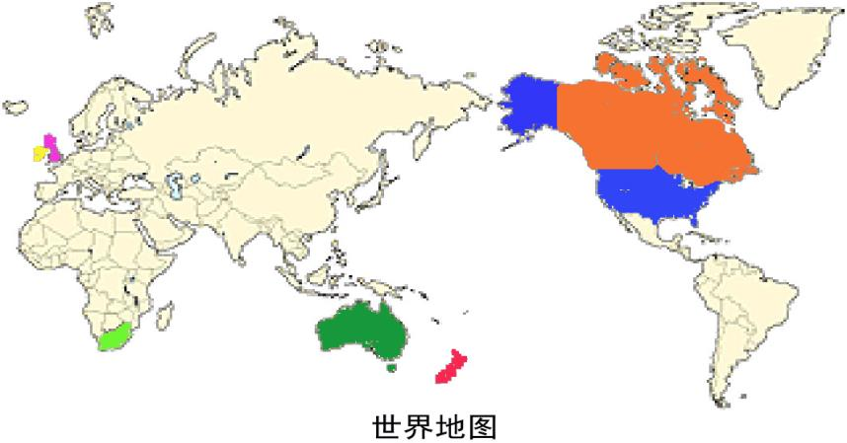
English, use, mother tongue, English-speaking countries
English is used as mother tongue in English-speaking countries like UK.
the United Kingdom
Canada
the U.S.A.
Ireland
Australia
New Zealand

Slide 11
English, second language, European countries
English is spoken as the second language in European countries.
European countries

Slide 12
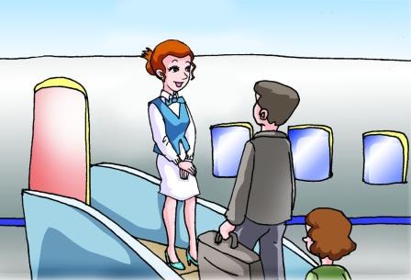
English, base language, world’s airlines, international business
English has become the base language for world’s airlines and international business.
welcome

Slide 13
Why has this happened?
Let’s find the answer from history.

Slide 14
1a Read the passage and complete the table on Page 62.
Why has English become so popular?
in the 19th century | Great Britain ________________________ English became _____________________
since the 1950s | The USA ______________________________ The internet _________________________
since the 1970s | China_______________________________
now | The study of English ___________________ ___________________________________
became a powerful country.
an international language.
has become more and more powerful.
has helped English to become much more popular.
has encouraged more people to learn English.
is regarded as a very
important industry.

Slide 15
Listen, read and follow.
1b Retell the passage in pairs
based on the table in 1a

Slide 16
Language points
1. In the nineteenth century, Great Britain became a powerful
country, so English became an international language. 19世纪
时，英国成为了一个十分强大的国家，因此英语也成为了国际性的语言。
in the nineteenth century 在19世纪
“in the +序数词+century”
e.g.
In the twenty-first century 在21世纪
在几世纪
在几世纪几十年代
in the +年份s
e.g.
In the 1880s 在19世纪80 年代
in the eleventh century
在十一世纪
在十八世纪二十年代
in the 1720s

Slide 17
Language points
2.China, a country with the largest population in the
world, has encouraged more people to learn English
since the 1970s. 中国作为世界上人口最多的国家，从20世纪70年代
开始鼓励越来越多的人学习英语。
encourage sb. to do sth. 鼓励某人干某事
e.g. Teachers __________us to ________________
to reduce the pollution. (鼓励我们做些有益的事）
encourage
do something useful

Slide 18
Language points
3.Now, students are required to learn English, and the study of English is regarded as a very important industry in China as well as in the rest of the world.现在，学生都被要求学英语，并且英语学习在中国乃至全世界都被看作是一个非常重要的产业。
n.
consider… as
regard… as
v.
=
think of … as
adj.
e.g. She regards me as her friend.
The rest of … ……中剩下的，做主语时，谓语动词单复数由of后名词决定。
e.g. The rest of the earth _________ (cover) by sea.
is covered

Slide 19
Project
Debating Which Language Will Be More Widely Used
The topic of the debate is “Which language will be more widely used, Chinese or English?”
Divide the class into two groups and each group holds different opinions.
Discuss in groups and list your opinions. The following information may help you.
4. Debate between two groups.
Importance | Advantage | Development | Conclusion

Slide 20
Exercises
Fill in the blanks.
1. English is changing _____ the _____________
(develop) of the world.
2. Since the 1950s, the American Internet has ______
(take) the ________ (lead) position in the world.
3. China has encouraged more people
________ (learn) English since the 1970s.
4. A celebrating party will be ______ (hold) in our
classroom.
5. The pollution _____________ (regard) as the most
serious problem now.
with development
taken
leading
to learn
held
is regarded

Slide 21
A. I want to be an interpreter when I grow up. B. You may go and ask your mother for help. C. Oh, dear, you can look it up in your dictionary. D. But you must study English harder than before. E. what does “interpreter” mean in English?
(A=Kangkang B=Dad C=Mom)
A: Dad, could you come and help me?
B: Sure, dear. What is it?
A: I don’t understand the meaning of “interpreter”.
B: ______
A: But I left my dictionary at school.
B: _____
A: Thanks, Dad, I will. Mom, ______
C: This word “interpreter” means a person who helps foreigners to
translate the language and explain the culture of the country.
A: I see. _____I want to help businessmen all over the world and help them
know China.
C: Good idea. _______
C
B
E
A
D

Slide 22
Summary
We learn:
Some words: Britain, powerful, leading, position
2. Some phrases: in the nineteenth century, since the
1950s, take the leading position,
encourage sb. to do sth., regard …as,
the rest of
3. Some sentences: The study of English is regarded as
a very important industry in China
as well as in the rest of the world.
We can:
1.Talk about the history of English.
2.Understand and use Passive Voice better.
Student are required to learn English.

Slide 23
Assignment:
Read 1a.
Review the useful expressions and key sentences which we learn in this topic .
Finish Section D in your workbook.
Preview Section A in Topic 2.

