Slide 1
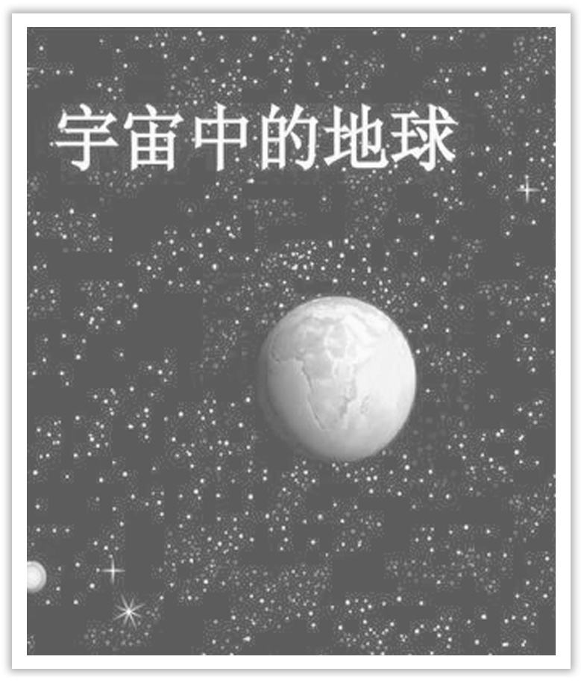
Unit 4 Space Exploration
Section Ⅶ Reading for Writing——关于太空探索的正反对比议论文
WWW.PPT818.COM

Slide 2
本单元的写作任务是读一篇关于太空探索的文章后，写一篇关于太空探索的正反对比议论文。

Slide 3
Ⅰ.Pre-writing
(Ⅰ)Learning to write after the model
IS EXPLORING SPACE
A WASTE OF TIME AND MONEY？
Countries around the globe are spending billions of dollars and lots of time on various space missions，whether to Mars or other planets much further away.Some people argue that we should stop wasting time and money exploring space.Instead，we should feed the world’s poor and find immediate solutions to other problems，such as pollution and fatal diseases.However，others feel this is a shallow view which fails to realise how exploring space helps us.

Slide 4
Firstly，exploring space has already made a difference in the fight against world hunger.It has directly resulted in the many satellites that now orbit Earth.A number of the satellites record data on land and weather patterns.Then the data is transmitted to scientists on Earth.After careful analysis，the scientists can provide useful recommendations and advice for farmers.As a result，space-based science has helped farming in its efforts to grow enough food to feed Earth’s increasing population.

Slide 5
Secondly，space exploration has already promoted technological improvements that benefit us all.High-end products around the world are made to a higher standard now because of advanced technology which was first created to meet their requirements for space exploration.For example，space technologies have helped the research and development of different types of new material.They have also helped companies make better heart monitors and other machines that doctors regularly use.Today，space technologies are widely used in all kinds of industries，and everyday products such as GPS，memory foam pillows，and smartphone cameras are changing our lives.

Slide 6
Finally，sending astronauts into space has helped people to think about the world’s problems and even to find ways to solve them.Seeing pictures of our planet as an island in a black sea made people realise that our planets’s resources are limited.In order to provide for such a rapidly increasing population，scientists are trying to find other planets that could one day be our new home.The greatest attention at present is on Mars because it is closer to Earth.In the future，humans may live on both planets.
In closing，exploring space provides the world with many different benefits.Therefore，it should continue so as to provide new and better solutions to people’s short-term and long-term problems.

Slide 7
篇章结构
Para.1：Advance an argument whether exploration space a waste of time and money.
Para.2：Exploring space has contributed great to the fight against world hunger.
Para.3：Space exploration has already promote technological improvement.
Para.4：Sending astronauts into space has furthered understanding of the world’s problems and figuring out ways to solve them.
Para.5：Draw a conclusion that exploring space is of great benefit.

Slide 9
(Ⅱ)Preparation for writing—words and phrases
①________________发射卫星
②____________收集数据
③____________探索太空
④_________________ 有很大影响
⑤____________ 导致
⑥____________ 从中受益
⑦_____________________先进的技术
launch a satellite
collect data
explore space
make a difference
result in
benefit from
advanced technology

Slide 10
⑧_______________________满足要求
⑨___________________改变我们的生活
⑩___________________ 有限的资源
⑪____________ 靠近；接近
⑫____________提供生活所需
⑬_________________________________促进技术改进
⑭____________________________ 提供解决问题的办法
meet the requirements
change our lives
limited resources
be close to
provide for
promote technological improvement
provide solutions to problems

Slide 11
Ⅱ.While-writing
最近，你班同学就“太空探索是否值得”这一话题展开了一场讨论。请你根据下表提供的信息，用英语写一篇短文介绍讨论的情况。
30%的同学认为： | 70%的同学认为：
1.不值得探索 2.离我们及我们的日常生活太遥远 3.浪费金钱。这些金钱本可用来解决地球上的饥饿、污染等问题 | 1.值得探索 2.已使用卫星进行通讯传播、天气预报 3.有望解决地球人口问题、地球能源短缺问题

Slide 12
Step 1 List the outline of the passage.
Paragraph 1：___________________________________________________________
_______________________________________________________________________
Paragraph 2：___________________________________________________________
Paragraph 3：___________________________________________________________
Recently，students in our class have had a discussion on whether space is worth exploring.
30% of us think space exploration is not worthwhile.
On the other hand，70% think space is worth exploring.

Slide 13
Step 2 List the words，phrases and sentences.
1.Words and phrases
①________________ 举行讨论
②_______________ 值得做
③____________ adj.值得的
④________________ 离……很远
⑤____________ 被用来做……
have a discussion
be worth doing
worthwhile
be far away from
be used to do

Slide 14
⑥__________________ 从……受益良多
⑦________________ n.交际
⑧________________ 天气预报
⑨________________ 能源短缺
benefit a lot from...
communication
weather forecast
energy shortages

Slide 15
2.Sentences
①用于太空探索的资金可以用来解决地球的饥饿和污染等问题。(过去分词作定语)
________________________________________________________________________
________________________________________________________________________
②70%的人认为太空值得探索，因为我们从中受益匪浅。(because)
________________________________________________________________________
And the money spent on space exploration can be used to solve the earth’s problems such as starvation and pollution.
70% think space is worth exploring because we have benefited a lot from it.

Slide 16
③总有一天，我们可以搬到其他星球去解决人口问题。(by doing)
________________________________________________________________________
④太空研究将使我们能够找到新的能源来解决地球上的能源短缺问题。(不定式作目的状语)
________________________________________________________________________
_______________________________________________________________________
We may solve the population problem by moving to other planets one day.
Space research will enable us to find new sources to solve the problem of energy shortages on the earth.

Slide 17
Step 3 Draft the passage by using the following words.
and，on the other hand，also，what’s more
Recently，students in our class have had a discussion on whether space is worth exploring.
30% of us think space exploration is not worthwhile.They think space is too far away from us and our daily life.And the money spent on space exploration can be used to solve the earth’s problems such as starvation and pollution.

Slide 18
On the other hand，70% think space is worth exploring because we have benefited a lot from it，such as using satellites for communication and weather forecast.What’s more，with further space research，we may solve the population problem by moving to other planets one day.Also，space research will enable us to find new sources to solve the problem of energy shortages on the earth.

Slide 19
Ⅲ.Post-writing—polishing the passage
Exchange your passage with your partner，and pay attention to the following points.
□1.Does the writer explain why he/she changed/wanted to change?
□2.Does the writer tell how the changes have improved or will improve his/her life?
□3.Is the text well-organised?
□4.Does the writer use words and expressions to show similarities and differences?
□5.Are there any grammar or spelling errors?
□6.Does the writer use correct punctuation？

Slide 20
常用词汇
have a discussion about，different opinions，on the one hand...on the other hand...，first/second/third...，what’s more，besides，in addition，however/but/though，to sum up/in a word/in conclusion/in short/above all/in general/generally speaking

Slide 21
亮点表达
1.Recently we have had a heated discussion on whether we can play computer games or not.最近我们就是否可以打电脑游戏举行了热烈的讨论。
2.According to a recent survey，four－million people die each year from diseases linked to smoking.
依照最近的一项调查，每年有4 000 000人死于与吸烟相关的疾病。
3.Opinions are divided on the question.
在这个问题上有意见分歧。
4.Some students are for the idea，while others think otherwise.
一些学生赞成这个想法，而另一些人则不这么认为。

Slide 22
5.However，there are a large number of people who hold a different view concerning this case. 然而，有很多人对这个事情持不同的看法。
6.It has more disadvantages than advantages.它弊大于利。
7.Some hold the view that doing sports can keep fit，while others think that it is a waste of time doing sports.
有些人认为做运动可以强身健体，然而有些人认为运动是浪费时间。
8.Therefore，we can draw the conclusion that the sharp decline of wildlife species resulted from the population growth.
因此，我们可以很自然的得出结论，即野生物种的急剧下降源于人口的增加。

Slide 23
写作技巧
正反对比类议论文是从正反两方面辩证地说明某个观点。此类议论文应注意以下几点：
1.此类文章的结构一般为：引语——正方观点——反方观点——结论。
2.文章要做到要点完整、条理清晰。各段之间层次清楚，以使文章显得有条理。从段落内部的层次上讲，每一段一般又分为三部分：主题句、扩展句和总结句。
3.常用一般现在时。

