Slide 1
Unit 1 Teachers' Day
He was young then.
WWW.PPT818.COM

Slide 2
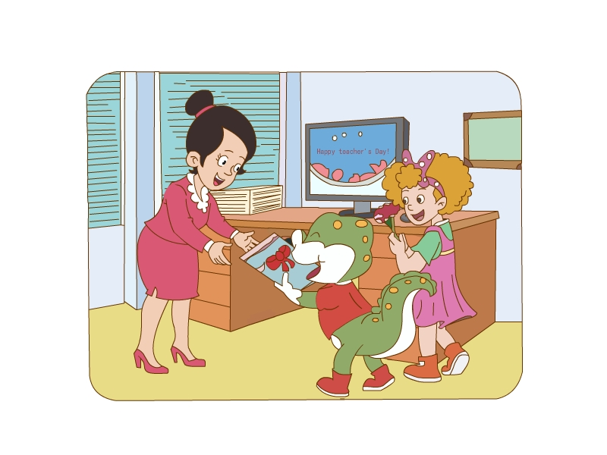
What's the date (日期)today?
It's September 10. It's Teachers' Day.

Slide 3
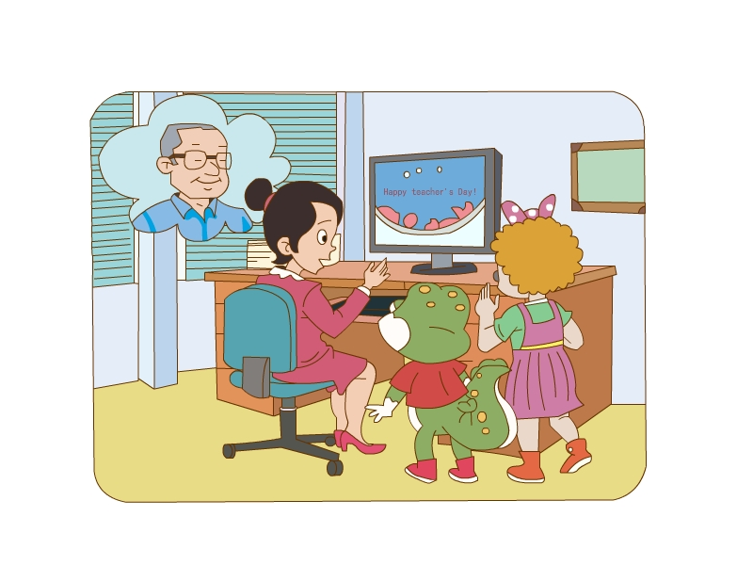
What’s Miss Zhang doing?
She’s making a card for her teacher, Mr. Wang.

Slide 4
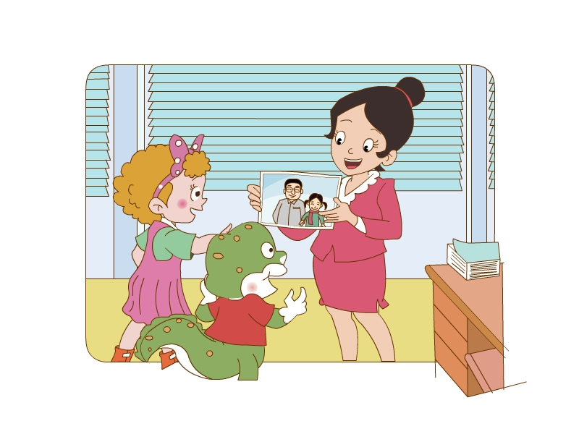
What was Mr Wang like then?
He was young. He was strong. His hair was black.

Slide 5
Was 是is的过去式。
表示过去发生的动作。
常与then（那个时候）连用。

Slide 6
Who’s this little girl? What was she like?(她是什么样子的？)
She’s Miss Zhang. She was nine then.
She was short and thin.

Slide 7
Group work: (小组合作)
小组内分角色表演课文，
并进行展示。

Slide 8
After-school Activities: (课后活动)
每位同学将自己各个年龄段的照片制成成长册。向同学或家长介绍自己不同年龄段的外貌及性格特征，下节课向全班同学展示。

