Slide 1
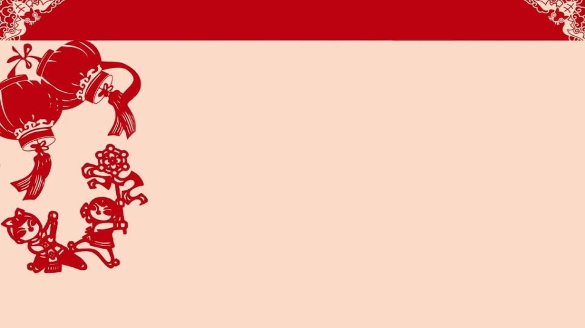
Module 10 Spring Festival
Unit 2 My mother’s cleaning our house and sweeping away bad luck.
WWW.PPT818.COM

Slide 2
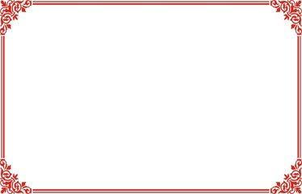
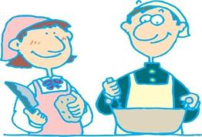
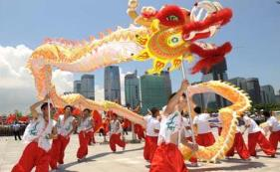
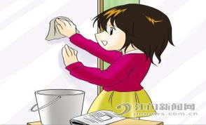
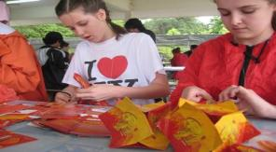
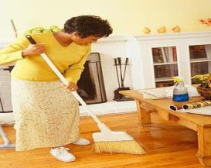
Revision: Ask and answer in pairs.
eat the meal
learn a lion dance
put things away
cook the meal
learn a dragon dance
clean the house
clean the window
make dumplings
sweep the floor
make lanterns

Slide 3
Studying aims（学习目标）
1.学习有关春节的词语及重点句子，能运用所学 知识描述春节活动。
2.掌握阅读技巧。
3.能写一篇关于春节的短文。
4.了解中国文化以及具有中国特色的物品，培养民族自豪感，传承本族文化。

Slide 4
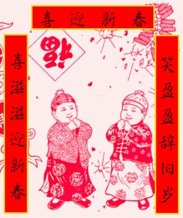
Let’s have a talk.
What festival is very important in our country?
Spring Festival
Spring Festival
is coming
Spring Festival is very important in our country.

Slide 5
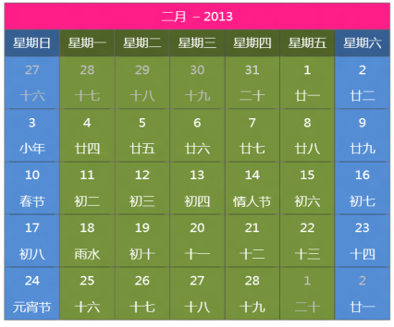
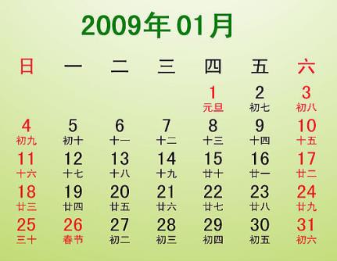
How often does Spring Festival happen?
every year,
but not on the same day.
It happens _____________________________
February
It usually comes in ________,
but sometimes it comes in __________.
January

Slide 6
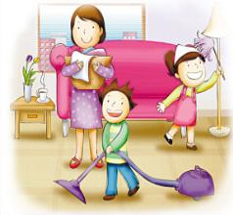
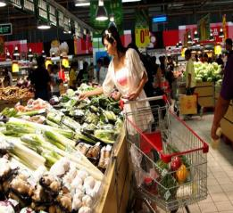
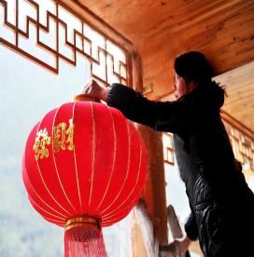
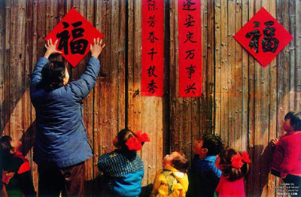
Before Spring Festival，
We usually . . . to celebrate Spring Festival.
clean the house
buy a lot of food
put up(挂) red lanterns
['kʌplɪts]
put up Chinese couplets

Slide 7
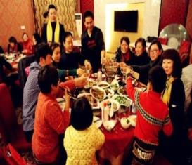
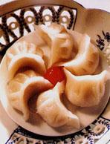
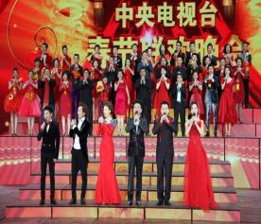
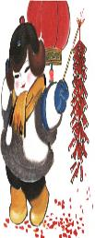
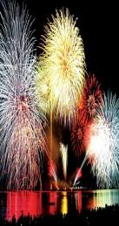
On the evening before Spring Festival,
We usually . . . to celebrate Spring Festival.
have a traditional family dinner
eat Jiaozi
watch a special
programme on TV
dumpling
set off firecrackers and fireworks

Slide 8
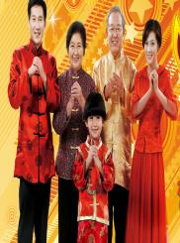
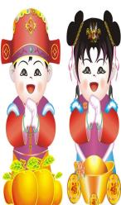
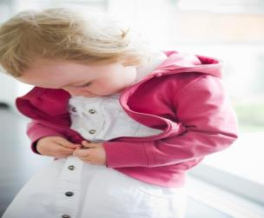
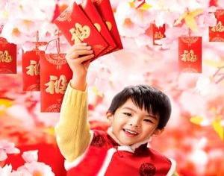
On Spring Festival,
We usually . . . to celebrate Spring Festival.
wear new sweaters and coats
visit friends and relatives(亲戚)
[ˈrelətɪvs]
get a hongbao from parents

Slide 9
Fast reading 快速阅读
Match
A. Spring Festival is very important in China.
B. On Spring Festival’s Eve
C. On Spring Festival
D. Before SpringFestival
Para. 1
Para. 2
Para. 3
Para. 4

Slide 10
Para.1
Careful reading 细节阅读
1. Spring Festival is very important in ______.
A. China B. America C. The UK
(T/F)2. It happens on the same day every year.
3. It usually comes in _________, but sometimes it comes in _______.
A
not
February
January

Slide 11
Para. 2
1. When is it in the first photo?
2. What’s Li Shan’s mother doing before Spring Festival?
3. What else(其他) do they do?
It’s a few days before Spring Festival.
She’s cleaning the house and sweeping
away bad luck.
They buy a lot of food.

Slide 12
Para. 3
What do they do to celebrate Spring Fes
tival?
They . . .
have a traditional family dinner
to celebrate
Spring Festival
dumpling
eat Jiaozi --- a kind of __________
watch a special programme
on TV

Slide 13
Para.4
(T/F)1. In this photo, Li Shan’s parents and she are visiting her grandparents.
(T/F)2. Hongbao means lucky money.
uncles and aunts

Slide 14
Complete the passage with the correct form of the words and expressions.
celebrate dumpling few luck mean programme sweep away traditional
We 1._________ Spring Festival in January or February. A 2.____ days before Spring Festival, we clean our homes and3._________ all the bad 4.____. On the evening before Spring Festival, we have a big family dinner.
celebrate
few
sweep away
luck

Slide 15
We eat lots of 5.________ food, such as jiaozi – a kind of 6. _______.We usually watch a special 7._________on television, and parents usually give their children a hongbao. It 8._____ lucky money.
traditional
dumpling
programme
means

Slide 16
Exercises
A. 根据汉语或首字母填空。
1.Spring Festival is very i________in China.
2.F______is the second month in a year.
3.A year begin with J_____.
4.”No parking” m____ ”Don’t stop cars here”.
5.What p________ (节目) do you like best?
6.They are c________ Spring Festival.
7.Before Spring Festival we often clean the house and
s____ away bad luck.
important
February
January
means
programme
celebrating
sweep

Slide 17
8.People in China like eating jiaozi---a kind of d______.
9.There are many t_______in China at Spring Festival.
10.Does hongbao mean ____(luck) money?
B.根据汉语意思完成句子，一空一词。
1.他妈妈每个月都要给他买几本书。
His mother buys him ___ ___ books every month.
2.那个男孩总是喝一种来自他家乡的牛奶。
The boy always drinks __ ___ __ milk from his home town.
dumpling
traditions
lucky
a few
a kind of

Slide 18
3. 格林先生要我扫去地上的纸片。
Mr Green asks me to ____ _____ the paper on the floor.
4.人们购置礼物并准备很多食物。
People go shopping for ______ and ____ lots of food ______.
sweep away
presents
get
ready

Slide 19
Retell the passage.
Suppose(假设) you’re Li Shan.
Here’s the first one. . . .
Key words(关键词):
a few days before Spring Festival,
clean our house,
sweep away bad luck,
buy a lot of food.

Slide 20
I love this photo . . .
Key words:
celebrate . . . with . . .
a traditional family dinner
eat jiaozi, dumpling
watch a special programme

Slide 21
In this photo, . . .
Key words:
visit my uncles and aunts
wear sweaters and coats
get a hongbao
lucky money

Slide 22

summary
clean the house
eat Jiaozi
dumpling
buy a lot of food
have a traditional family dinner
put up(挂) red lanterns
Before Spring Festival
watch a special
programme on TV
on Spring
Festival’s Eve
put up Chinese couplets
how to celebrate
Spring Festival
set off firecrackers and fireworks
On Spring Festival
visit friends and relatives(亲戚)
get a hongbao from parents
wear new sweaters and coats

Slide 23
Homework
1.Write a passage about Spring Festival .
(Part of the Ss)
2. Retell the passage .
(Part of the Ss)
3.Search for the information about Christmas Day.
(All the Ss)

Slide 24
Tips:
China is a great country with a long history.
We have many good festivals and traditions.
As the young,
we should study them,
carry on （传承）them and
develop （发展）them!

