Slide 1
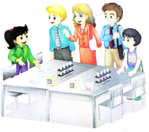
Unit1 Welcome to our school!
人教精通版五年级下册
WWW.PPT818.COM

Slide 2
>>Warm-up
Let’s review
（单击图片可播放动画）

Slide 3
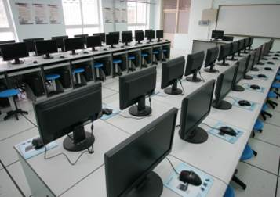
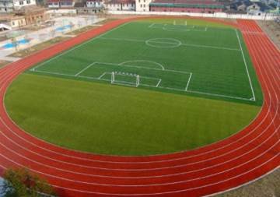
>>Lead-in
Free talk
This is our … We often …. in the …

Slide 4
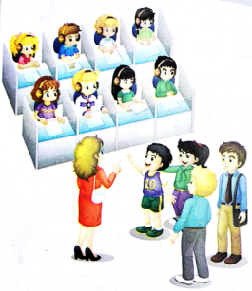
>>Presentation
Look and say
After visiting the library and the meeting room,
What other places do they visit?
Can you guess?

Slide 5
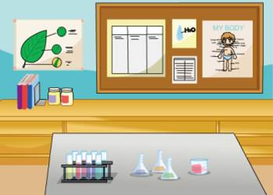
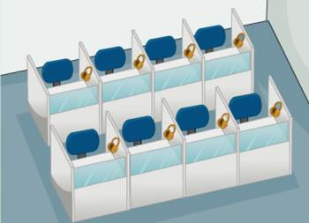
>>Presentation
Look and say
science lab
language lab

Slide 6
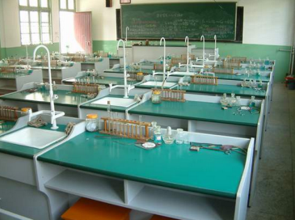
>>Presentation
Look and say
What lessons do we have in the science lab?
We often have science lessons in it.
This is our science lab.
We often ...

Slide 7
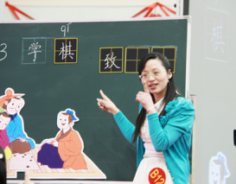
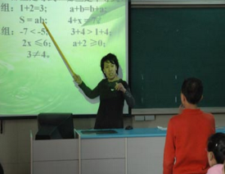
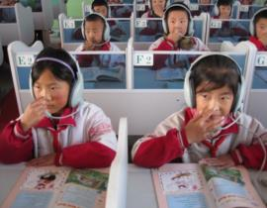
>>Presentation
Look and choose
What lessons do we have in the language lab?
We often have English lessons in it.

Slide 8
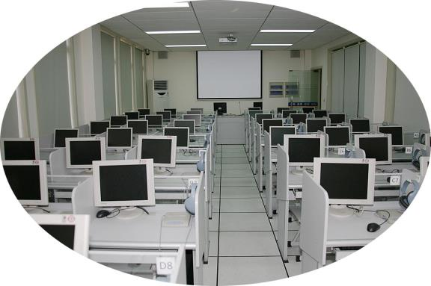
>>Presentation
Look and say
This is our language lab.
We often ...

Slide 9
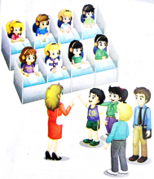
>>Presentation
Listen and say
How many science lessons do they have in a week?
We have two.
How many English lessons do they have
in a week?
We have three.

Slide 10
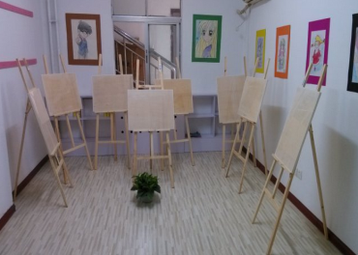
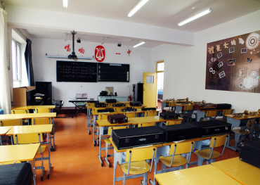
>>Practice
Ask and answer
What’s this? What do you often do in the …? How many…lessons do you have in a week?

Slide 11
>>Practice
Role play
三人一组，分角色表演对话。

Slide 12
>>Practice
Group work
创编新对话
Welcome to our school!
This is our …
We often … in the …
We have … lessons in a week.
We all like …

Slide 13
>>Summary
This is ... We often … in the …
How many … lessons do you have in a week?
We have ...

Slide 14
>>Homework
1.登录“优教同步学习网”，观看课文动画，按照正确的语音、语调朗读课文对话。
2.参考本课Just read and talk部分，编写一段新的对话（不少于6句）。

