Slide 1
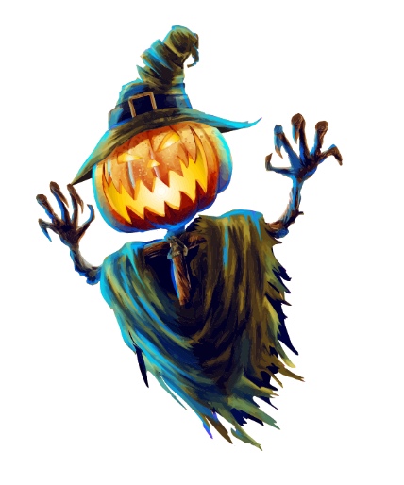
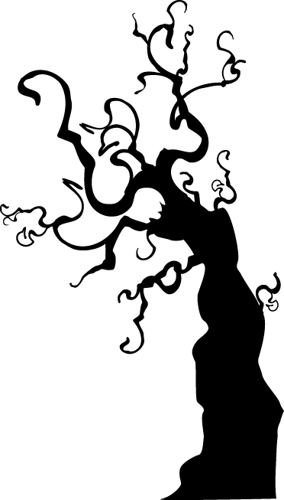
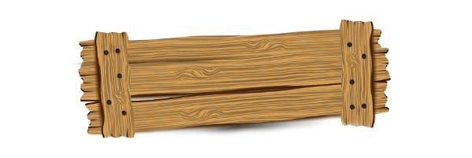
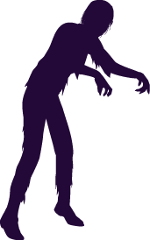
汇报人：
汇报时间：XX年XX月

Slide 2
目录
CONTENTS
点击此处添加标题
点击此处添加标题
点击此处添加标题
点击此处添加标题
点击此处添加标题

Slide 3
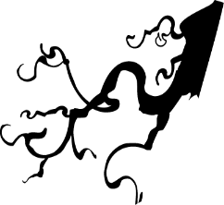
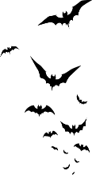
PART 01
点击此处添加标题

Slide 4
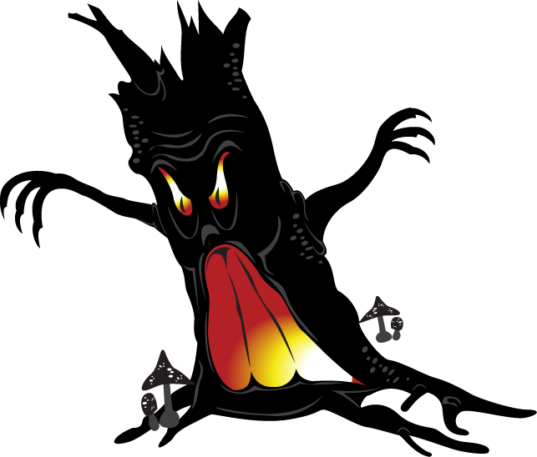
点击此处添加标题
Far far away, behind the word mountains, far from the countries Vokalia and Consonantia, there live the blind texts.
Separated they live in Bookmarksgrove right at the coast of the Semantics, a large language ocean.

Slide 5
点击此处添加标题
点击此处添加标题
Far far away, behind the word mountains, far from the countries Vokalia and Consonantia, there live the blind texts..
点击此处添加标题
Far far away, behind the word mountains, far from the countries Vokalia and Consonantia, there live the blind texts..
点击此处添加标题
Far far away, behind the word mountains, far from the countries Vokalia and Consonantia, there live the blind texts..

Slide 6
PART 02
点击此处添加标题

Slide 7
点击此处添加标题
点击此处添加标题
Far far away, behind the word mountains, far from the countries Vokalia and Consonantia, there live the blind texts
点击此处添加标题
Far far away, behind the word mountains, far from the countries Vokalia and Consonantia, there live the blind texts.
点击此处添加标题
Far far away, behind the word mountains, far from the countries Vokalia and Consonantia, there live the blind texts..

Slide 8
点击此处添加标题
点击此处添加标题
Far far away, behind the word mountains, far from the countries Vokalia and Consonantia, there live the blind texts..
点击此处添加标题
Far far away, behind the word mountains, far from the countries Vokalia and Consonantia, there live the blind texts..
TIMELINE
FINISH

Slide 9
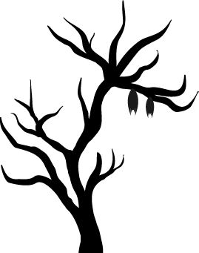
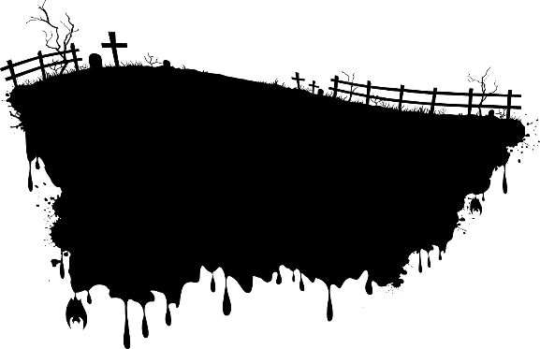
PART 03
点击此处添加标题

Slide 10
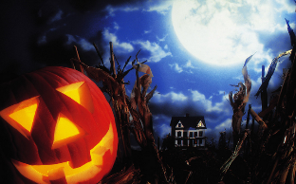
点击此处添加标题
点击此处添加标题
Far far away, behind the word mountains, far from the countries Vokalia and Consonantia, there live the blind texts..
点击此处添加标题
Far far away, behind the word mountains, far from the countries Vokalia and Consonantia, there live the blind texts..

Slide 11
点击此处添加标题
Far far away, behind the word mountains, far from the countries Vokalia and Consonantia, there live the blind texts.
Text
Text
Text
Far far away, behind the word mountains, far from the countries Vokalia and Consonantia, there live the blind texts.
Far far away, behind the word mountains, far from the countries Vokalia and Consonantia, there live the blind texts.
1
4
2
Text
3
Far far away, behind the word mountains, far from the countries Vokalia and Consonantia, there live the blind texts.

Slide 12
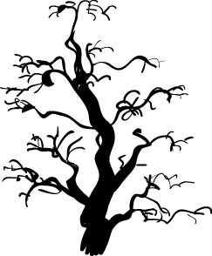
PART 04
点击此处添加标题

Slide 13
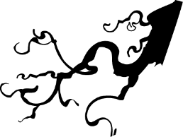
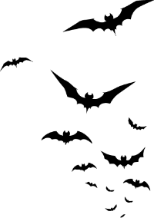
点击此处添加标题
点击此处添加标题
Far far away, behind the word mountains, far from the countries Vokalia and Consonantia, there live the blind texts.
点击此处添加标题
Far far away, behind the word mountains, far from the countries Vokalia and Consonantia, there live the blind texts.

Slide 14
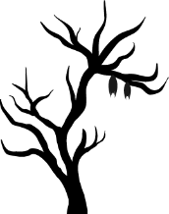
点击此处添加标题
点击此处添加标题
点击此处添加标题
点击此处添加标题
Far far away, behind the word mountains, far from the countries Vokalia and Consonantia, there live the blind texts.
Far far away, behind the word mountains, far from the countries Vokalia and Consonantia, there live the blind texts.
Far far away, behind the word mountains, far from the countries Vokalia and Consonantia, there live the blind texts.

Slide 15
PART 05
点击此处添加标题

Slide 16
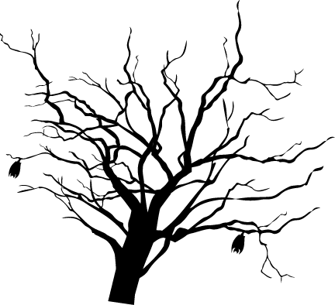
点击此处添加标题
点击此处添加标题
Far far away, behind the word mountains, far from the countries Vokalia and Consonantia, there live the blind texts. Far far away, behind the word mountains, far from the countries Vokalia and Consonantia, there live the blind texts.

Slide 17
点击此处添加标题
点击此处添加标题
Far far away, behind the word mountains, far from the countries Vokalia and Consonantia, there live the blind texts.
点击此处添加标题
Far far away, behind the word mountains, far from the countries Vokalia and Consonantia, there live the blind texts.
点击此处添加标题
Far far away, behind the word mountains, far from the countries Vokalia and Consonantia, there live the blind texts.

Slide 18
谢谢观看

