Slide 1
Unit5 Topic 2
A few students are running around the playground.
Section A
WWW.PPT818.COM

Slide 2
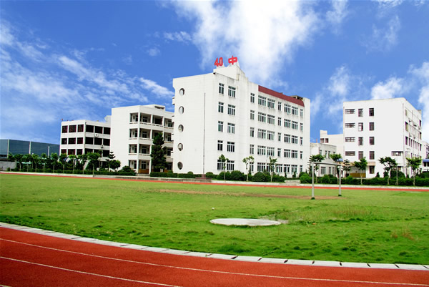
How do you like your school life?
福州四十中 www.fzssz.com

Slide 3
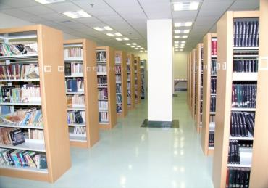
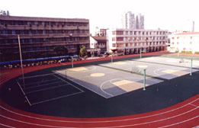
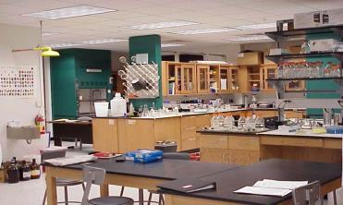
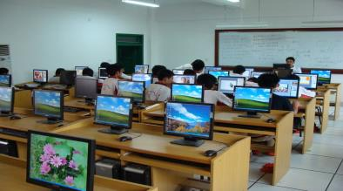
New Words
library
playground
lab = laboratory
computer room

Slide 4
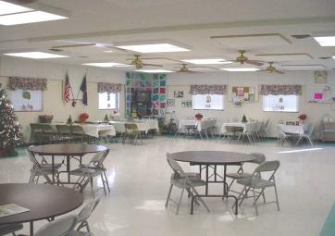
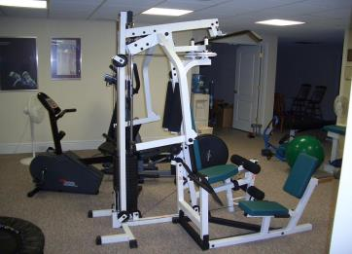
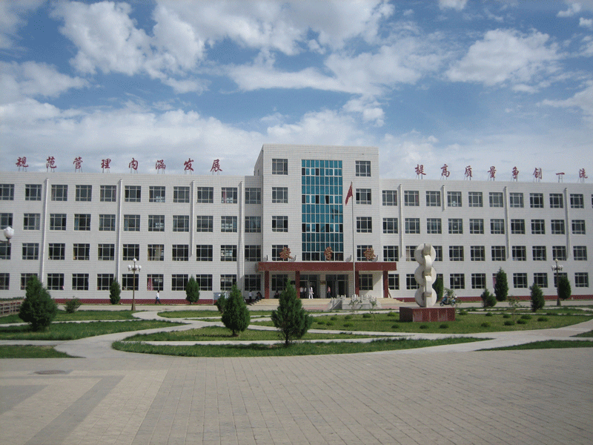
dining hall
teachers’ office
gym
classroom building

Slide 5
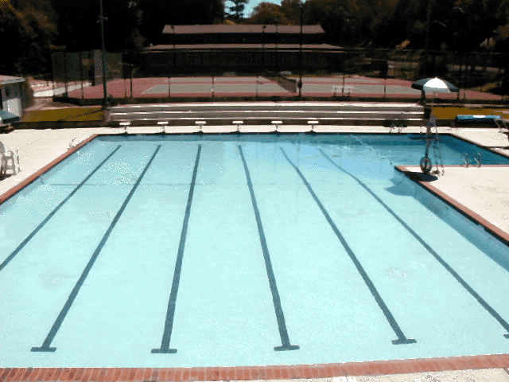
swimming pool

Slide 6
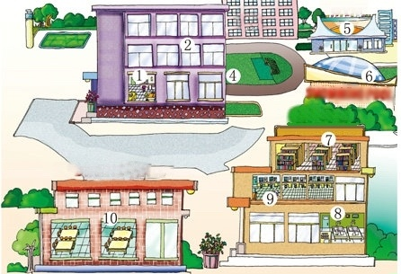
Look at the pictures and match them with the correct words or phrases.
（6）
library
B. playground
C. lab
D. computer room
E. dining hall
F. teachers’ office
G. gym
H. classroom building
I. swimming pool
（3）
4
（7）
2
（8）
1
3
5
（9）
（1）
6
（4）
（2）
8
7
9
（5）

Slide 7
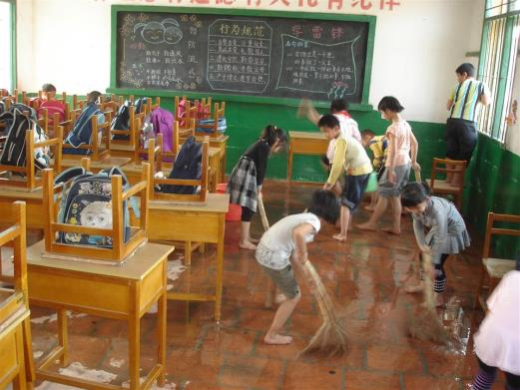
What are they doing?
They are cleaning the classroom.

Slide 8
A: What are you doing?
B: I am skating.
swimming
running
cycling
rowing
skating
skiing
dancing

Slide 9
Grammar
Present Continuous Tense (现在进行时） 现在进行时表示现在（说话瞬间）正在进行或发生的动作。
肯定句式: 主+ ___________________+其它。
be(am/is/are)+doing
否定句式: 主+am/ is/ are+ ___+doing+其它。
,not
Am/Is/Are
疑问句式：________+主+doing+其它？
特殊疑问形式：
am/ is/ are
What+ _________+主+ ______+其它？
doing

Slide 10
动词 v.-ing的构成形式
Grammar
wash
catch
make
ride
sit
get
washing
catching
making
riding
sitting
getting
一般在动词原形末尾加-ing
以不发音的e结尾的动词，先去掉e，再加-ing
以重读闭音节结尾的动词，如果末尾只有一个辅音字母，应先双写这个字母，再加-ing

Slide 11
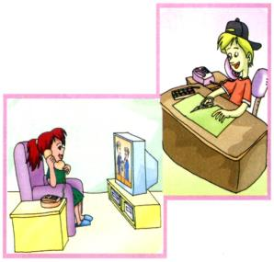
Listen and circle the correct answers.
1. Michael and Jane are talking _________________ (on the telephone, in the classroom).
2. Jane is _______________ (doing her homework, watching TV).
3. What is Michael doing? He is ______________ (playing cards, making cards).

Slide 12
Pair Work
Work in pairs and practice 1a. Then make up a new conversation with the following sentence structures.
What are you doing?
I’m…
Are you…?
Yes, … / No, …

Slide 13
Listen and match. Pay attention to the structure of Present Continuous.
Maria
Kangkang
Wang Li and Li Mei
Wang Wei and Lin Tao
are doing some cleaning
is reading
is running
are dancing
in the gym
on the playground
in the lab
in the library

Slide 14
Work in pairs. Make up conversations with the information in 3a.
Example:
A: ..., where is Maria?
B: She is ...
A: What is she doing now?
B: She is ...
A: Is Kangkang reading in the library, too?
B: No, he isn't. He is ...

Slide 15
Work in pairs. Make up conversations with the information in 3a.
Example:
A: Where are Wang Li and Li Mei?
B: They are ...
A: What are they doing?
B: They are ...
A: Are Wang Wei and Lin Tao dancing, too?
B: No, they aren't. They are ...

Slide 16
练习
用现在进行时完成下列句子:
1. What ______ you ________(do)?
2. I____________ (sing) an English song.
3. What _____she ____________(drink)?
4. He___________ (drive) a car.
5. _____ you _______(fly) a kite?
Yes, _______.
6. ____ she ________ (sit) in the boat?
7. ______you ________ (ask) questions?
8. We___________ (play) games now.
are
doing
am singing
is
drinking
is driving
Are
flying
I am
Is
sitting
Are
asking
are playing

Slide 17
Listen and read the sounds and words aloud.

Slide 19
Read aloud and compare the sounds of the colored letters.

Slide 20
summary
1. The names of school facilities.
2. Present continuous tense.
e.g. What are you/they doing?
I’m/They're reading.
Are you/they watching TV now?
Yes, I am/they are. /
No, I’m not /they aren't.
What is he/she doing?
He/She is making cards.
Is he/she running now?
Yes, he/she is. / No, he/she isn't.

Slide 21
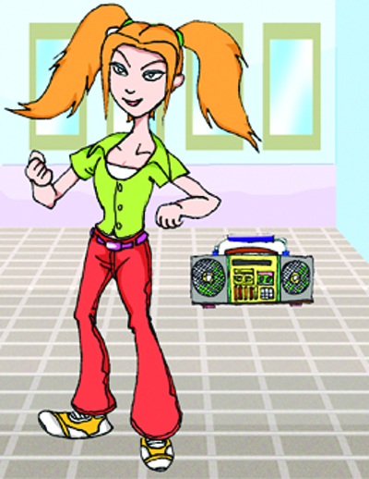
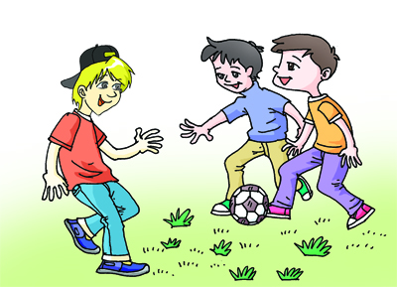
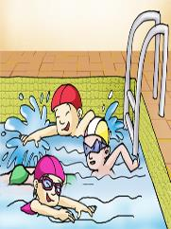
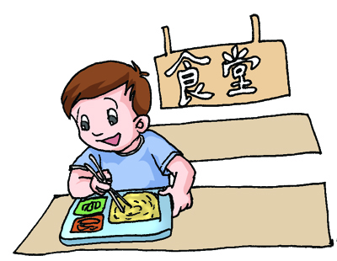
Homework
Look at the pictures and write about what they are doing now.

