Slide 1
Unit 8 Topic 1
We will have a class fashion show.
Section A
WWW.PPT818.COM

Slide 2
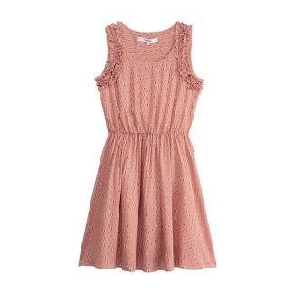
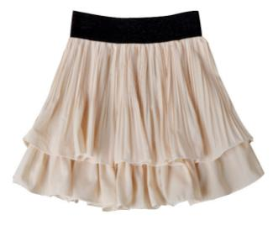
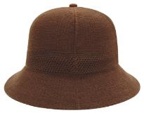
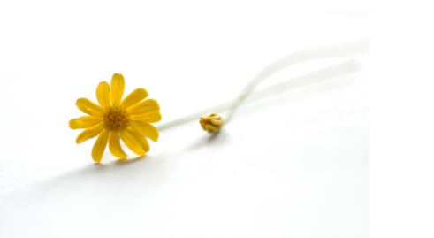
Speak out the names of these clothes.
skirt
dress
hat

Slide 3
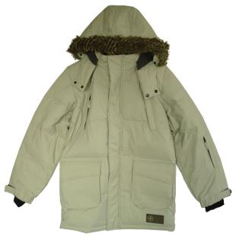
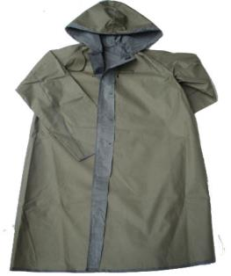
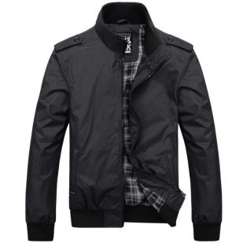
coat
raincoat
jacket

Slide 4
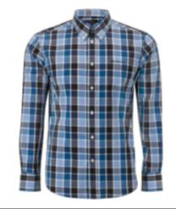
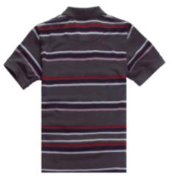
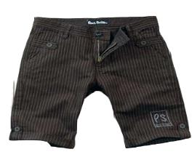
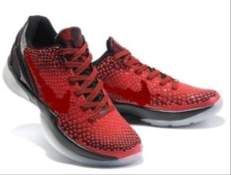
shirt
T-shirt
shorts
shoes

Slide 5
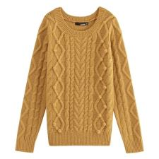
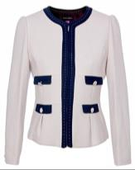
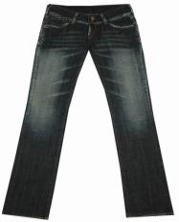
sweater
n.毛衣，厚运动衫
blouse
n.（妇女穿的）短上衣，衬衫
jeans
n.牛仔裤

Slide 6
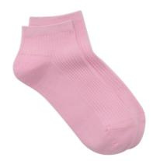
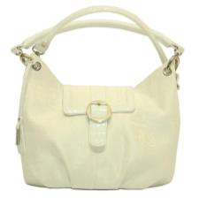
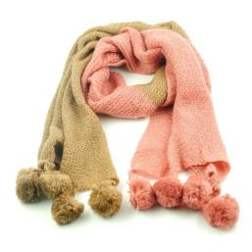
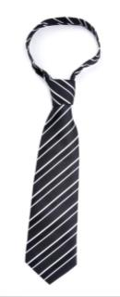
socks
n.短袜
handbag
n.女用皮包，手提包
tie
n.领带
scarf
n.围巾，领巾

Slide 7
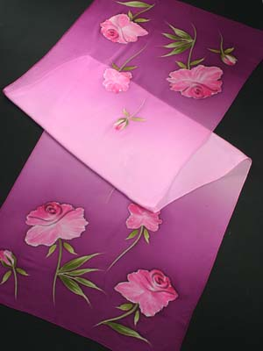
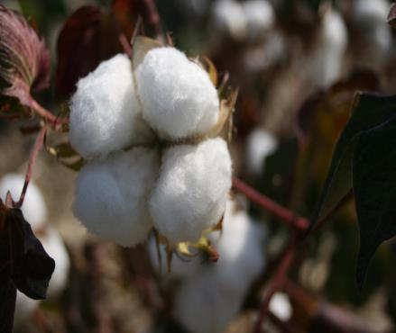
silk
n.(蚕)丝， 丝织品
cotton
n.棉布，棉花，棉制的

Slide 8
1b
Listen to 1a and circle True or False.
1. Jane has a nice coat.
2. Maria likes the Chinese Tang costume very much.
3.The new coat is a silk one.
4. Jane wants to buy some new skirts for the class
fashion show next Monday.
5. They will meet at the school gate at 8:00 a.m.
True False
True False
True False
True False
True False

Slide 9
Key points of 1a
1. My old coats are so short that I want to buy some new ones.
我的旧外套太短了，我想买些新的。
◆so ... that ... 如此......以至于...... ，that 引导的是结果状语从句，其结构是“so+形容词或副词+that从句”。
E.g:他跑得如此快以至于我们追不上他。
He ran so fast that we couldn't catch up with him.
天气太冷了，以至于我不想起床。
It is so cold that I don't want to get up.
◆ones 代替上文提到的同类复数事物，以避免重复。
2. fashion show 时装秀/时装展示

Slide 10
Read 1a aloud and act out.
Jane: Hi, Maria. You look great today. What a nice coat!
Maria: Thank you. My father says that it’s a Chinese Tang costume.
It feels quite soft and smooth. I liked it so much that my father
bought it for me.
Jane: Is it a cotton one?
Maria: No, it’s a silk one.
Jane: My old coats are so short that I want to buy some new ones.
And you know we will have a class fashion show next
Monday.
Maria: Well, do you have time tomorrow? Let’s go shopping together.
Jane: Good idea! Shall we meet at the school gate at 8:00 a.m.?
Maria: All right. See you tomorrow.

Slide 11
Key words of 1a
J:________.____look great___. ______nice___!
M:_______._____says ___________Chinese Tang costume.
____________soft and smooth._______so __that_______.
J:________cotton ______?
M:____,____silk____.
J:____________so short that_________________________.
And ____________ fashion show____________________.
M:____,_________time_______?______________together.
J:________!___________meet at_________at_______?
M:_______.__________.

Slide 12
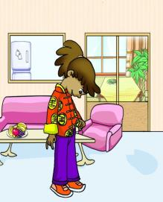
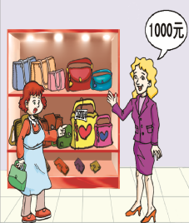
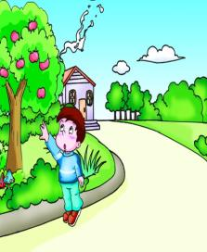
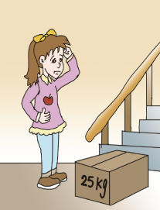
Read 1a and find the sentences with so…that… Then fill in the blanks according to the pictures.
1c
1.Maria's coat is ____ _____________ _____ she likes it very much.
2.The handbag is ___ _________ _____ the woman can't afford it.
3.The boy is ____ ________ ________ he can't get the apples.
4.The box is ____ ________ ________ the girl can't carry it.
so
nice/beautiful
that
so
expensive
that
v.买得起，能做
so
short
that
so
heavy
that

Slide 13
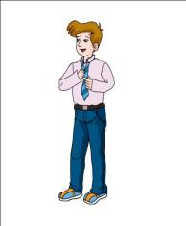
2
A.Look at the pictures and fill in the boxes with the words given.
tie skirt sweater shirt shorts raincoat sunglasses jacket dress
A
B
C
scarf
sweater
blouse
jacket
jeans
skirt
D
E
raincoat
F
sunglasses
tie
shirt
shorts
dress
B.Listen to the sentences and check the words. Then number the pictures.
D
C
B
A
E
F
①______② ______ ③______④_______⑤ ______ ⑥______

Slide 14
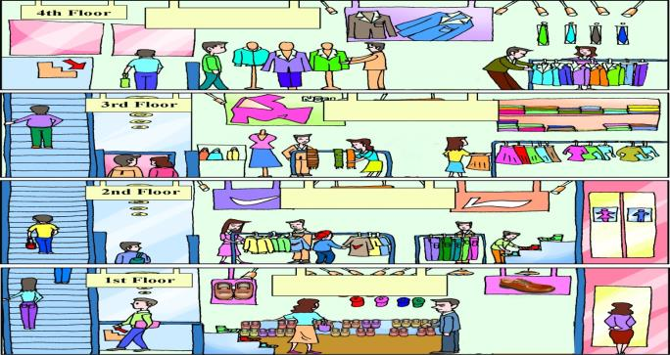
Project
3
Look at the pictures and make conversations.
Men's Wear Section
Women's Wear Section
Sports Wear Section
Shoes and Hats Section
You may begin like this:
Jane: Excuse me,could you tell me where to buy a scarf ?
Saleswoman: Sure! You can go to the Women's Wear Section on the third floor.
Jane: Thanks. And what about hats and socks ?
Saleswoman: They're in ...
n.部门，部分

Slide 15
Exercises in class
一、单项选择。
( ) 1. He was ____ tired ____ he fell asleep as soon as he lay down.
A. too; to B. so; that C. such; that D. enough; that
( ) 2. — Look, this is my new mobile phone.
— It’s very nice. Could you tell me____?
A. where to buy B. where to buy it
C. where will buy it D. where I will buy
二、根据句意、首字母或汉语提示完成句子。
1.Many women have a _________（手提包）with them.
2.This T-shirt is made of ______（棉花）.
3.The s____ around the girl’s neck makes her more beautiful.
4.The cowboys (牛仔 )in the U.S.A. like wearing j______.
5.The dolls are very beautiful. I want to buy some dolls for my daughter.(用so...that...合并成一句)
______________________________________________________
B
B
handbag
cotton
carf
eans
The dolls are so beautiful that I want to buy some for my daughter.

Slide 16
Summary
We learn:
1. Some new words and phrases:
costume,smooth,cotton,silk,fashion,handbag,afford,tie,sweater,
scarf,jeans,blouse,section,sock,fashion show,so...that...
2. The structure of “so …that…” :
I liked it so much that my father bought it for me.
My old coats are so short that I want to buy some new ones.
We can:
1.Ask for help:
Could you tell me where to buy a scarf?
Thanks. And what about hats and socks?
2.Make appointments:
Do you have time tomorrow?
Shall we meet at the school gate at 8 a.m.?

Slide 17
Homework
1. Prepare a family photo and describe
the clothes of the people.
2.Finish Section A in your workbook.
3.Preview Section B.

Slide 18
Thank you

