Slide 1
Module 9 Population
Unit 1 The population of China
is about 1.37 billion.
WWW.PPT818.COM

Slide 2
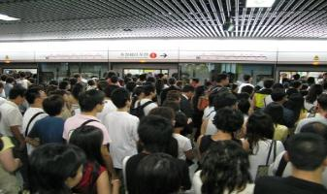
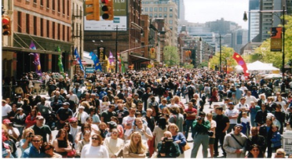

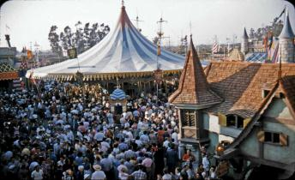
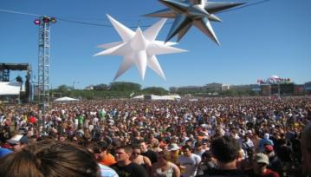
Lead-in
Look at the pictures .
We can see many people in the world.

Slide 3
Leaning aims
1.The new words: noise, prepare, notes, report ,huge, increase, problem, birth ,billion ,fifth, grow, hang on, prepare for, too much
2.The sentences:
What′s the population of Beijing?
That causes a lot of problems such as too much traffic and noise.
The population of China is about 1.37 billion.
Hang on a minute﹗
3.The grammar:初步了解冠词和数词的用法，运用所学句型谈论人口问题。

Slide 4
New words
noise
prepare
notes
report
huge
increase
problem
birth
billion
grow
噪声，杂音
准备；预备
笔记；随笔
报告，汇报
巨大的；庞大的
增大，增长
问题，麻烦
出生
十亿
增长，增大

Slide 5
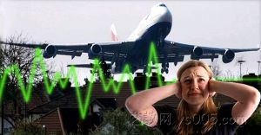
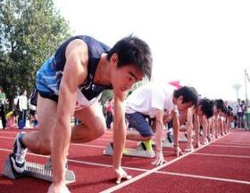
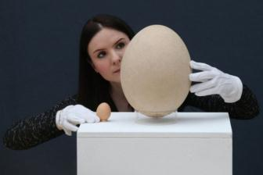

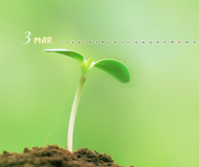
use a word to describe the pictures
noise
prepare
huge
grow

Slide 6

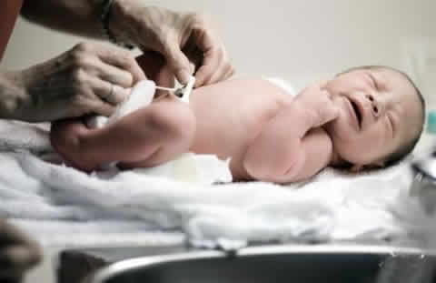
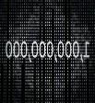
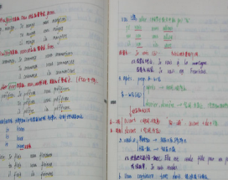
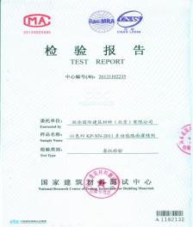

billion
problem
birth
notes
increase
report

Slide 7
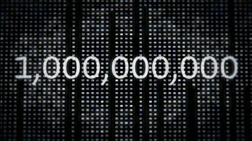
billion

Slide 8
Can you say these numbers?
1
2
3
4
5
6
7
8
9
10
11
12
13
20
21
30
60
80
90
100

Slide 9
1
2
3
4
5
6
7
8
9
10
Can you say these numbers?
one
two
three
four
five
six
seven
eight
nine
ten
11
12
13
20
21
eleven
twelve
thirteen
twenty
twenty-one
30
60
80
90
100
thirty
sixty
eighty
ninety
hundred

Slide 10
101
110
122
1,000
1,000,000
1,000,000,000
one hundred and one
one hundred and ten
one hundred and twenty-two
one thousand（千）
one million(百万）
one billion(十亿）

Slide 11
1, 000, 000, 000
注 意
comma
逗号
billion
million
thousand
one hundred and twenty-three
123
2,200
12,000
123,340
1,234,567
two thousand and two hundred
twelve thousand
one hundred and twenty-three thousand,
three hundred and forty
one million two hundred and thirty-four
thousand five hundred and sixty-seven

Slide 12
英语中四位数和四位数以上数字的读法：
从数字的右端向左端数起，每三位数加一个逗号“，”。从右开始，第一个“,”前的数字后添加 thousand，第二个“,”前面的数字后添加 million，第三个“,”前的数字后添加 billion。然后一节一节分别表示，两个逗号之间最大的数为百位数形式。

Slide 13
Let's practice
eight thousand ,seven hundred
and forty-two
8,742
1,370,000,000
2,000,030,000
one billion,three hundredand seventy million
two billion and thirty thousand

Slide 14

Listen and choose the correct answer.
What’s the population of Beijing?
a) About 11 million. c) About 20 million.
b) About 13 million.
2. What’s the population of Chongqing?
a) About 28 million. c) About 36 million.
b) More than 33 million.

Slide 15
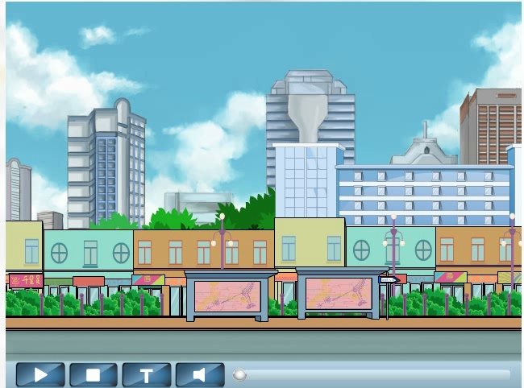
Listen to the dialogue and answer the questions.
1. How many babies are born every minute in the world?
Over 250
2. What′s the population of the world ?
Obout 7 billion

Slide 16
Read the conversation and complete the table.
People in the world
Babies born every minute
Babies born every year
Population of China
Population of the world
over 250
131.4 million
1.37 billion
7 billion

Slide 17
Read the sentences
精讲
1.What′s the population of Beijing?北京的人口是多少？
在询问人口时，要注意 population .通常用what来提问. 它是一个集体名词作主语时，若指一个整体人口谓语动词通常用单数；形容人口多与少时用large 和small. For example:
The population of China is about 1.37 billion.中国的人口大约是13.7亿。
Beijing is a huge city with a large population.北京是一个人口众多的大城市。

Slide 18
2.The population of China is almost one fifth of the world′s populatian.那几乎是世界人口的五分之一。
One fifth 分之一；分数的表示方式：分子是基数词，分母是序数词五；如果分子大于1，分母要用复数形式。two fifths 五分之二
3.I am preparing some notes for a report.我正在为一篇报告准备笔记
Prepare for为......做准备

Slide 19
4.The causes a lot of problems such as
too much traffic and noise.
那引起了许多问题，例如有太多的车辆和噪音。
too many太多后接可数名词复数，
too much太多后接不可数名词，
much too太后接形容词

Slide 20

Exercises
-What are you preparing _____ your
party?
-I’m thinking about who I’ll invite.
A. at B. for C. with
2. There are _____ people in the little room.
A. too much B. too many C. very much
B
B

Slide 21
C
3. _ of the world’s population is in China.
A. One five B. One fifths C. One fifth
4. The population of Beijing___ about 20 million
A. is B. are C. be
A

Slide 22
5. How do you read 131,000,000? ____.
A. One hundred and thirty-one million
B. One hundred thirty one million
C. One hundred and thirty one million
A

Slide 23
Fill in the blanks.
too many, too much和much too
too many
1. You have ________ shoes.
2. Sometimes I eat _________ noodles.
3. The work is __________ hard for us.
4. She drank _________ water.
5. Among ourselves, that young man's hair is _________ long.
too many
much too
too much
much too

Slide 24
Work in pairs.
Ask and answer:
A:What's the population of _____?(Beijing\Chongqing\
China \the world)
B:The population is__________ ?(about 20 million\
about 33 miillion\over 250\about 7billion)

Slide 25
拓展
Work in pairs.
Work in groups and discuss your answers.
Topic: The increasing population is the biggest problem in the world.人口增长是世界上最大的问题。讨论它带来的影响。
A: We think there are many traffic on the road.
B: I hate the noise of the traffic in big cities.
It is not easy to find a parking space in big cities 。Too much rubbish causes terrible pollution and we will not enough water to drink and so on.

Slide 26


Slide 27
Thank you!

