Slide 1
Unit 5 Topic 3
Many things can affect our feelings
Section A
WWW.PPT818.COM

Slide 2
Choose the right words and use the proper forms to complete the passage.
accept, alone, exciting, joke, lonely, refuse, usual
Last Sunday, we visited an old soldier who fought against the Japanese over 70 years ago. He lives _______, and he feels _______ sometimes. He was very _______ to see us. We helped him do the cleaning and cooking as _______.
After that, we chatted with him. We told him some _______ and that made him happy. We wanted to give the old man some money but he didn’t ________ it. He _______ our help in that way.
alone
lonely
excited
usual
jokes
accept
refused

Slide 3
How do you feel when you
have a party with friends
win the first place in the 1500-meter race
meet a big dog on the way home
have nothing to do at home
miss a wonderful game on TV
help others in trouble
fall ill
will take an important test
fail the exam
exam

Slide 4
New words
speech 演讲
She is giving a speech.
How is she feeling now?
She is feeling nervous.

Slide 5
Which of the following situations make you sad (S), happy (H), worried (W) or afraid (A)? Discuss your feelings in groups.
4a
W
Your father is ill in bed.
Your team won a basketball game again.
Your friend fell off her bike.
Your father bought you a new computer.
You see a snake lying on the road.
There is so much homework on the weekend.
H
S
H
A
W

Slide 6
Study the following sentence structures. Then match them with the sentences in 4a.
4b
a. S + V + IO + DO ( )
4
b. There be… ( )
6
c. S + V ( )
3
d. S + V + O ( )
2
e. S + V + P ( )
1
f. S + V + O +OC ( )
5

Slide 7
Read and find out the structures of the following sentences.
He feels disappointed.
I love operas.
She always tells me jokes.
The children cried and shouted every day.
The smiling faces of his children made him happy again.
She is quiet and shy.
My father bought me a useful dictionary.
Mrs. Von Trapp died.
She taught the children to sing lively songs and perform short and funny plays to cheer them up.
You may become unhappy sometimes.
S + V + P
S + V + O
S + V + IO + DO
S + V
S + V + O +OC
S + V + P
S + V + IO + DO
S + V
S + V + IO + DO
S + V + P

Slide 8
Read the following questions first. Then listen and answer.
What are Kangkang and Michael doing?
How does Michael feel? Why?
What’s Kangkang’s suggestion?
How does Michael feel after the talk with Kangkang?
What does Michael think of Kangkang?
Listen to a CD about giving speeches and practice.
He is worried because he will give a speech.
He really is a good friend.
He feels more relaxed.
They are talking over the phone.

Slide 9
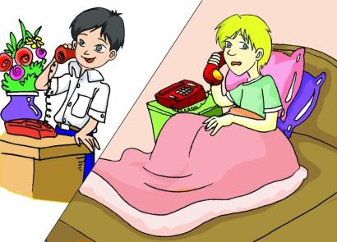
Listen and follow.
Michael: Hello, Kangkang! This is Michael speaking.
Kangkang: Hello, Michael! Is there anything wrong?
Michael: I’m worried. We’ll have a test tomorrow and I always get nervous before a test.
Kangkang: Relax, Michael. I am sure you will do well.
Michael: But Kangkang, the test is a speech. I get so nervous when I give a speech.
Kangkang: I will help you, Michael. I have a CD about giving speeches. We can listen to it at my house. Then you can practice.
Michael: Kangkang, I feel more relaxed now because of your help. You really are a good friend. Thank you so much.

Slide 10
Read 1a and complete the passage.
1c
Michael is _________ because he will give a _______ tomorrow. Kangkang asks him to ______ and believes Michael can do _______. Kangkang also asks Michael to listen to a CD about _________ speeches at Kangkang’s house. Michael feels _________ because of Kangkang’s help. He thinks Kangkang is a good _______.
worried
speech
relax
well
giving
relaxed
friend

Slide 11
1. Read and act 1a out.
2. Find out and learn the key points in 1a.
3. Retell 1a according to the key words: speaking, wrong, test, nervous, relax, speech, get … when, CD, practice, relaxed, really

Slide 12
Work in groups and discuss the following questions.
2
How do you feel when
you give a speech?
2. If your friend is worried about his / her speech, how will you help him / her to relax?
Giving a prepared talk will help you for real–life speech in English.

Slide 13
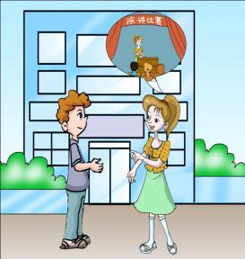
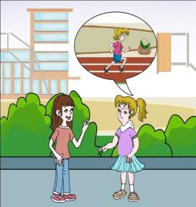
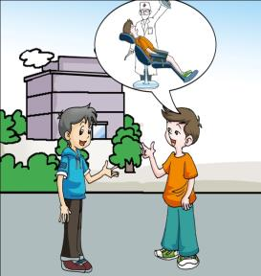
A. Listen to the conversations and number the pictures.
3
2
3
1

Slide 14
B. Listen again and match the problems with the people. Then complete the suggestions for them.
Maria Jane Kangkang Mike Lucy
1.
I’m worried. I always get frightened when I have to go to the dentist.
______________
Mike
Relax
follow
Suggestion: __________ and just _________ the dentist’s advice.
2.
I always get nervous and feel shy when I speak English in public.
______________
Jane
brave
practice
Suggestion: Just be___________and ___________often.
3.
I’m getting fat.
Lucy
______________
Take it easy
rich
exercise
Suggestion: ___________! Why not eat less _____ food and do more _______.

Slide 15
Fill in the table according to the conversations in 3 B.
Name | Feeling | Reason | Advice
Mike |  |  | Follow the dentist’s advice.
Jane | Not good.
Lucy |  | Getting fat.
Worried &
frightened
Go to the dentist
Will make a speech
Be brave and practice
Eat less rich food and do more exercise
Unhappy

Slide 16
Summary
We learn
Words and phrases:
test, nervous, speech, have a test, give a speech, get so nervous,
2. Six structures of simple sentences.
We can
Describe our feelings:
I’m worried. I always get nervous before a test.
I feel more relaxed now because of your help.
Comfort others:
Relax, Michael. I am sure you will do well.
Don’t worry! Just be brave.

Slide 17
Survey your classmates’ bad feelings and try to give your advice to comfort them.
Project
Name | Feeling | Advice
…
…
…

Slide 18
Homework
Review the key points in Section A.
Try to collect more sentences with the six simple sentence structures.
Make conversations to comfort your friends when they are feeling bad.
Preview Section B.

