Slide 1
Section Ⅰ Starting out & Understanding ideas
WWW.PPT818.COM

Slide 12
教材原句
Have you ever asked yourself why people often have trouble learning English？你曾问过自己为什么人们学英语经常那么困难吗？
句式解构
have trouble (in) doing sth.“做某事有困难”。
佳句背诵
If you have trouble doing this, you can turn to Professor Li for advice.如果在这方面遇到困难，你可以向李教授寻求建议。

Slide 13
教材原句
I hadn't, until one day my five­year­old son asked me whether there was ham in a hamburger.我从没问过我自己，直到有一天我五岁的儿子问我汉堡里是否有火腿。
句式解构
not ... until ...“直到……才……”。
佳句背诵
You're not going out until you've finished this.
你要做完这个才可以出去。

Slide 14
教材原句
Neither is there pine nor apple in pineapple.
在菠萝里既没有松树也没有苹果。
句式解构
neither ... nor ...“既不……也不……”，neither放在句首时其后的句子用部分倒装。
佳句背诵
Neither is it cold nor hot.
天气既不冷也不热。

Slide 15
教材原句
This got me thinking how English can be a crazy language to learn.
这让我想到英语是一门多么棒的语言啊。
句式解构
get sb.doing sth.“使某人做某事”。
佳句背诵
It is hard to get him doing his homework before dinner every day.
想要让他每天晚饭前做作业是很难的。

Slide 16
教材原句
And speaking of home, why aren't homework and housework the same thing?
提到“home”，为什么“homework”和“housework”不是指同一件事情呢？
句式解构
现在分词作评注性状语。
佳句背诵
Generally speaking, most people enjoy fast food.
一般说来，大部分人喜欢快餐。

Slide 18
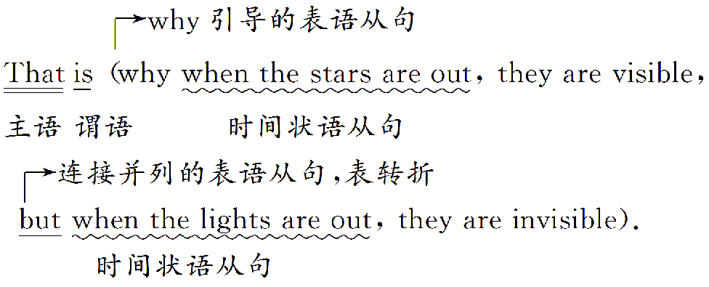

Slide 19
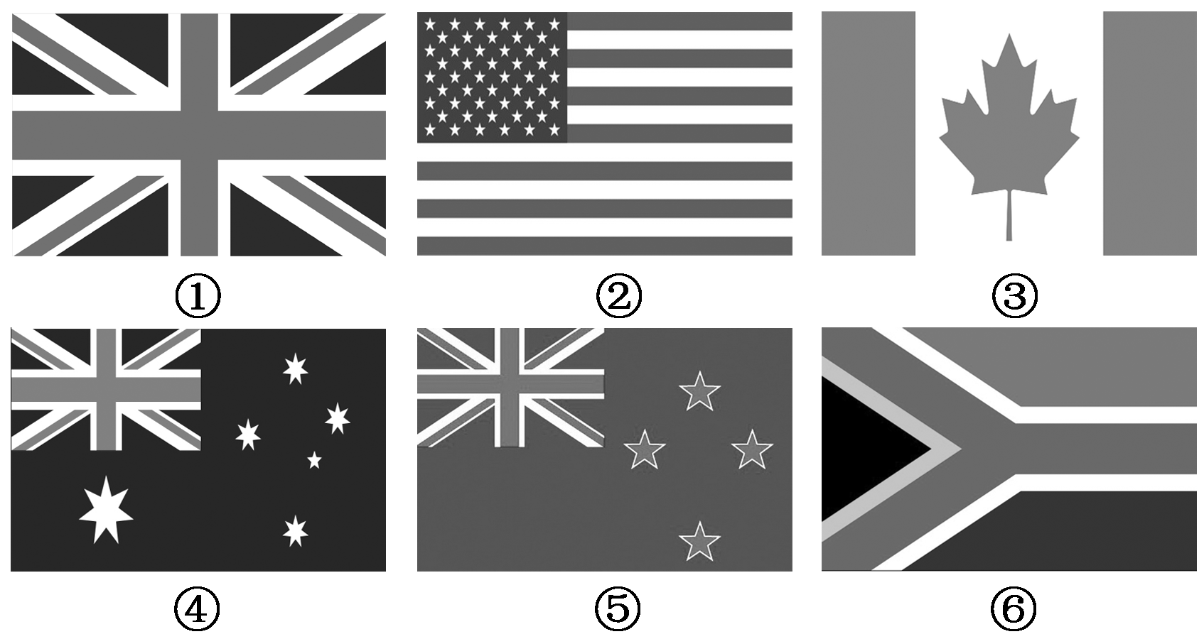

Slide 24
Neither Pine nor Apple in Pineapple
The difficulties people have in learning English | ·One day my five­year­old son asked me whether there was 1._____in a hamburger. ·This got me thinking how English can be a 2._______________to learn.
Some examples about confusion | ·We can sculpt a sculpture and paint a painting, but we 3. a photo. ·We can get seasick at sea, airsick in the air and carsick in a car, but we 4.___________ __________ when we get back home. ·And speaking of home, why aren't 5. the same thing？
 | ·Why are “hardly” and “softly” not an 6. pair? ·Why are shameless and shameful behaviors 7. ?
ham
crazy language
take
don't get
homesick
homework and housework
opposing
the same

Slide 25
Neither Pine nor Apple in Pineapple
Some examples about confusion | When we see sunshine, we can't say “it's 8.____________”．
 | ·When you see the capitalized “WHO” in a medical report, do you read it 9. the “who” in “Who's that？” ·What about “IT” and 10. “ ” ？
 | ·A house can burn up as it 11. . ·You fill in a form by 12. . ·An alarm is only heard once it 13. .
The fact that English is created | English was created by people and it reflects the 14. of the human race. ·That is why when the stars are out, they are 15. , but when the lights are out, they are 16. . ·And that is why when I wind up my watch, it 17. , but when I wind up this passage, it 18. .
sunshining
as
US
burns down
filling it out
goes off
creativity
visible
invisible
starts
ends

Slide 55
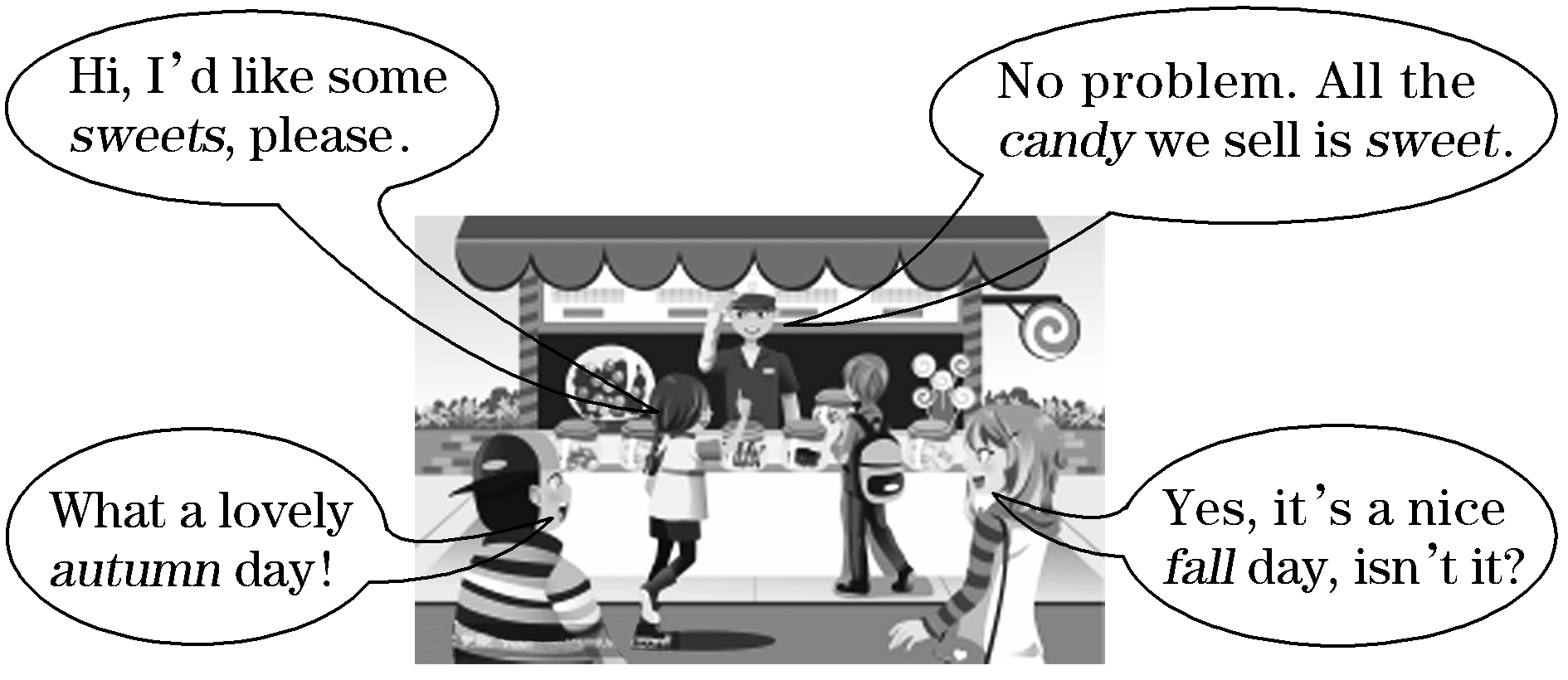

Slide 59
谢 谢 观 看

