Slide 1
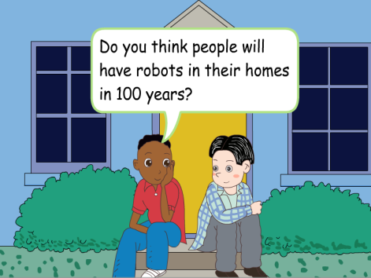
人教版八年级上册
Unit 7
Will people have robots?
Section B（第3课时）
WWW.PPT818.COM
0

Slide 2
1.能够理解并运用新单词：holiday，word 2.学会使用topic sentence, support sentences and conclude sentences 来描述将来的生活。 3.培养学生的发散思维，激发对未来生活的想象。 4.鼓励学生为更好的未来做准备。
学习目标

Slide 3
自学互研
新词自查
根据句意及汉语提示完成句子
1. We can visit my museums during (在······期间) the vacation.
to Beijing.
2. The girl probably (很可能) didn’t know who her father really
is.
3. The doctor says vegetables are good for (对······有好处) our
health.
4. In China,there are several special traditional holidays (假期).
5. Because of the pollution, there will be less and fresh water (
淡水) on the earth.
6. My grandpa likes to live in the countryside because there is
clean air (干净的空气).

Slide 4
Revision
1. 在工厂 ______________
2. 做简单工作_________________
4. 多次；反复地 ___________________
5. 许多；大量 ___________________
6. 看起来像人类 ________________
in factories
do simple jobs
over and over again
hundreds of
look like humans
wake up
7. 醒来 ________
8. 能够 _____________
9. 突然倒下；跌倒___________
10. 寻找；寻求 ______________
be able to
fall down
look for

Slide 5
Present
New words
1. probably adv. 很可能；大概 (=maybe)
e.g. The boys probably dress up as ghost.
这些男孩可能会装扮成鬼。
2. during prep. 在……期间
e.g. He swims every day during the summer.
他夏天每天游泳。
3. holiday n. 假期；假日
e.g. take a holiday 度假
the school holidays 学校假期
on summer holidays 暑假
4. word n. 单词；词
e.g. the meanings of words 单词的意思

Slide 6
3a Read Jill’s answers to the question “What will your life be like in the future?” Fill in the blanks with the words in the box.
meet work live look keep wear more less fewer take
In 20 years, I think I’ll be a newspaper reporter. I’ll _____ in Shanghai, because there will be ______ jobs in that city. As a reporter, I think I will _____ lots of interesting people, so I’ll have more friends. I’ll have ______ pets, though, because I’ll have _____ free time.
live
more
meet
fewer
less

Slide 7
And my apartment will be no good for pets because it’ll be too small.
So I’ll probably just _____ a bird. During the week, I’ll _______ smart clothes. On the weekend, I’ll _____ less smart but I’ll be more comfortable. In the future, people will ______ more so they’ll probably have fewer vacations, but I think I’ll _____ a holiday in HongKong when possible. One day I’ll even go to Australia.
keep
wear
look
work
take

Slide 8
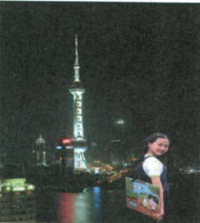
I’ll have _______ pets, though,
because I’ll have _______ free
time. And my apartment will
be no good for pets because it’ll
be too small. So I’ll probably just
____a bird. During the week, I’ll____ smart clothes. On the weekend, I’ll ____ less smart but I’ll be more comfortable. In the future, people will ____ more so they’ll probably have fewer vacations, but I think
I’ll _______ a holiday in Hong kong when possible. One day I’ll even go to Australia.
fewer
less
keep
wear
look
work
take

Slide 9
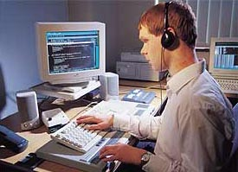
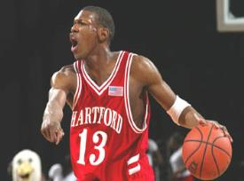
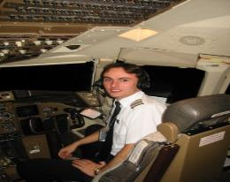
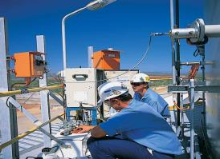
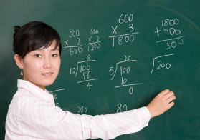
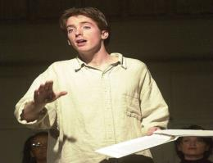
What will you be in 10 years ?
I will be a …
Where will you work? I will work in…..
computer
programmer
basketball player
airline pilot
engineer
teacher
actor

Slide 10
3b Complete the chart about your life 20 years from now. You can add more items.
What will your…be like?
job
home
free time activities
neighborhood
Super policeman
In America
attend a dancing party, travel
A famous singer

Slide 11
Make predictions:
How will you be different in the future?
Maybe 20 years from now?
I will be more beautiful.
I will have lots of money.
I won’t go to school.
I will have a big house.
……

Slide 12
3c Write about your life 20 years from now. Use 3a and 3b to help you.
Five years ago, I was in primary school, I played
football with classmates after class, and I had a dog.
Now I’m a middle school student, I like playing tennis.
I am good at English and I have good grades. In five
years, I will be a doctor, I will make much money,
and I will travel around the world. I will play the guitar.
I will have a car.
five years ago
now
in five years

Slide 13
One possible version：
In 20 years, I think I’ll be a super policeman. I’ll live in America, because there will be more joys in that city. As a super policeman, I think I will catch many bad guys(坏人), so I’ll help keep the city peaceful. And in my free time, I’ll attend all kinds of dancing balls,

Slide 14
so that I can make a lot of friends. In addition,（另外）I want to take a holiday to travel around the world. Every time when I get home, my neighborhood Coco will sing for me. I like this kind of life.

Slide 15
the topic sentence
My life in 20 years will be …
I will work as a ... and ...
I will also have much free time to travel ...
supporting sentences
My home will be...
My neighborhood will be...
the concluding sentence
My life in the future is beautiful…
I like this kind of life.

Slide 16
Group work
Discuss how you think a robot will help students
with schoolwork in the future. Write down your
group’s ideas and draw a picture of your robot.
1.I think students won’t need dictionaries
because a robot will tell them the meanings
of words.
____________________________________________________________________________________________________________________________________________________________________________________

Slide 17
Sample:
1. I think students won’t need to go to school, because their robots can teach them at home.
2. I think students won’t need to write their homework on paper but on computer, and robots will help students to correct the homework.
_________________________________________________________________________________________________________________________________________________________________________________________________________________________________________________________________________________

Slide 18
1. more后面可跟可数名词或不可数名词；
2. fewer后面跟可数名词；
3. less 后面跟不可数名词；
more/fewer | more/less
job, people,
robot， planet
car, city
building， tree
pollution, fresh water
paper, clean air,
free time， money

Slide 19
Fill in the blanks in the conversation.
Girl: Mom, what will the future _____ like?
Mom: Well, no one knows what the future will be _______.
Girl: But ______ I be beautiful like you? ______ I be a pilot? I want to fly up into the sky.
be
like
will
Will

Slide 20
Mom: You’re already beautiful. And
you should study hard. Then you
_____ be a pilot.
Girl: OK. I must study harder then.
Mom: But you should also remember that ______ will ____both good and bad things in life.
Girl: Oh, I’m not scared, Mom, because you ______ help me!
will
there
be
will

Slide 21
问题探究
▲ So I’ll probably just keep a bird.
keep: v. “保持; 维持; 喂养”
1) keep + sb. / sth. +形容词 “使某人/某物……”
e.g. The job kept them busy for a year.
2) keep +形容词 “保持”
e.g. The man ran up and down to keep warm.
3) keep + sb. / sth. doing “让某人/某物继续做某事”
e.g. She kept us waiting for her at the station for an hour.
4) keep + doing “继续做, 坚持做”
e.g. He kept running after her, trying to catch her.

Slide 22
▲one day 和some day
one day 表示“（过去或将来）某一天”，some day表示“（将来）总有一天，（日后）某天”。
导练：1）一天，一只小猴子在河边大树上玩。 One day a little monkey was playing in a tall tree by the river .
2) 我们输了100次，但总有一天我们会赢。
We have lost 100 times, but some day we shall win.
▲during 的用法
during意为“在…时间内，在…期间”，谓语动词常为持续性的动作或状态，时间段前常有限定词（the，this，that，these，those和物主代词等），表特指。如：
during the winter；during that time；during my holidays.
导练（A）The twins lived there ____the years 1993 to 1995.
A during B between C in D at

Slide 23
课堂评价
一. 用一般将来时填空。(借助will)
1. I _________ (visit) my uncle this weekend.
2. There _______ (be) a sports meeting in our school
next week.
3. He __________ (help) you with your Chinese
this evening.
4. They _________(play) soccer if it doesn’t rain.
5. We _________ (have) a meeting tomorrow.
will visit
will be
will help
will play
will have

Slide 24
二. 翻译句子
1. 你认为人们的家里会有机器人吗?
Do ______ ______ there will be robots
_____ ___________ homes?
2. 人们将活到150岁。
People _____ _____ _____ ____ 150 years old.
3. 我认为她会当医生。
I think she ______ ____ a doctor.
you think
in people’s
will live to be
will be

Slide 25
4. 你住哪儿? 我住在北京。
______ _____ _____ ______? I live in Beijing.
5.他反复看她的来信。
He read her letter ____ ____ ____ _______.
6.等了很长一段时间后他厌烦了。
He _____ _______ after he waited for long.
Where do you live
over and over again
got bored

Slide 26
Homework
写作内容: 你想要拥有你自己的机器人，跟科学家描述一下你都要求你的机器人会什么技能！
Dear robot scientist,
I am a student from No.52 Middle School. ________
______________________________________________
_______________________________________________
_____________________________.
Yours

