Slide 1

U4 Do it yourself
Reading 1
WWW.PPT818.COM

Slide 2
My cousin and DIY
Andrew
Prediction:
What’s the article mainly about?

Slide 3

Article structure
Para. 1
Para. 2
Para. 3
Para. 4
Para. 5
Introduction of Andrew
Andrew’s DIY jobs
Advice from Suzy
What does Andrew love to do?
Is Andrew good at DIY?
What did Suzy advise him to do?

Slide 4
Millie’s notes
Suzy’s cousin loves doing DIY.
Suzy’s cousin failed to put in a new light in his bedroom.
Suzy’s cousin put a picture on a pipe.
Suzy’s cousin thought the cat was boring, so he painted it blue.
It took Suzy’s cousin only a few minutes to put up the shelf on the wall.
Suzy’s cousin wants to get better at DIY.
T
T
in his bedroom
F
living
room
F
5 hours
F
F

Slide 5




Putting up a picture
Putting in a brighter light
Problems Andrew caused
Putting in a brighter light:
_______________________________________
Putting up a picture:
_______________________________________
The whole house had a power cut.
He hit a pipe and filled the room with water.

Slide 6
Further thinking
1. Why did Andrew put in a brighter light?
2. What will you do when your house has such terrible problems?

Slide 7

Painting the living room
Now the living room has not only
blue walls but also a blue ceiling
and floor. Even his cat is blue
now!

Slide 8

Further thinking
If you were Andrew, how would you paint the living room?
If you were Andrew’s mum, what would you do?

Slide 9
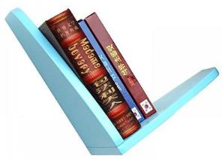

Suzy: I want a shelf … my bed.
Andrew: No … !
( half a day later)
Suzy: Wow, how long did you do it?
Andrew: I spent … putting up the shelf. Isn’t it great?
Suzy: Whoops! The books can’t stay there because … of the shelf is … than …!
…
Putting up a shelf

Slide 10




Think about the ways to
solve this problem.
Solution

Slide 11

put in a brighter light
make a mistake
have a power cut
put up a picture
hit a pipe
fill the room with water
is crazy about DIY
love to repair things
decorate his house
Advice
books about DIY
take a course
angry
instead
paint the living room blue
not only have blue walls
but also a blue ceiling
and floor
spend 5 hours putting
up the shelf
books couldn’t stay
one end was much higher

Slide 12
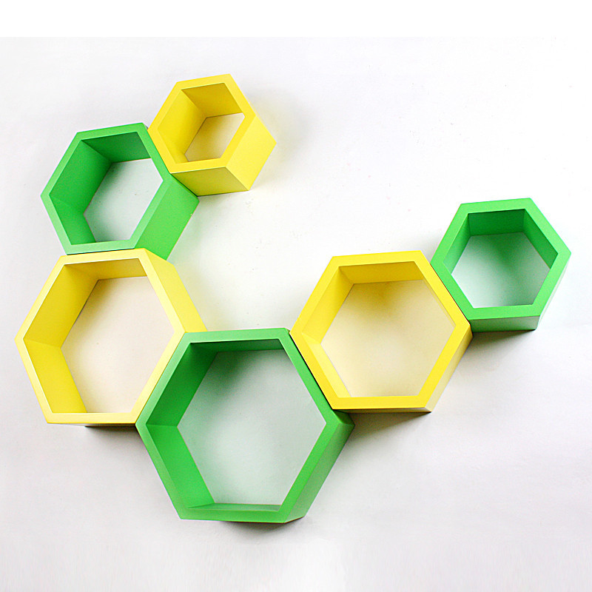
Further thinking
1. What should we do when we do DIY jobs?
2. What do you think of Andrew?
crazy about DIY
never give up DIY
not really good at DIY
stubborn (固执的)
…

Slide 13


Homework
Write about your own DIY stories. Let’s share them next class.

