Slide 1
Module 8 Story time
Unit 1 Once upon a time…
WWW.PPT818.COM

Slide 2

学习目标
1. New words and phrases:
hair, gold, forest, once, upon, once upon a time, decide, go for a walk, basket, notice, all alone, dark, pick, pick up, soon, lost, around, little, towards, knock, door, answer, push, enter, bowl, hungry, right, finish
2. New sentences:
①And soon she was lost.
②She looked around her.
③It was open.

Slide 3
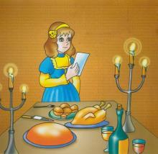
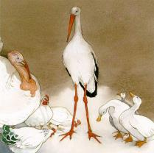
新课导入
Look at the pictures. Do you know
what they are? Now talk about the stories in groups.

Slide 4


hair
gold
forest
once
upon
once upon a time
decide
basket
dark
pick
soon
n.头发
n.金色；黄金
n.森林
adv.一次；一回
prep.在……上；到……上
从前
v.决定
n.篮子
adj.黑暗的
v.采；摘
adv.立刻；不久

Slide 5
around
little
towards
knock
door
answer
push
enter
bowl
hungry
right
finish
prep.环绕着；围绕
adj. 小的
prep.往；向；朝……方向
v.敲
n.门
v.应门；回答
v.推
v.进入
n.碗
adj.感到饿的；饥饿的
adj. 合适的；恰当的
v. 吃完；喝完；用尽

Slide 6
Listen and check （√）the true sentences.
1. The story is Goldilocks and the Three Bears.
2. The story begins: Once upon a time…
3. Goldilocks was a girl with hair of gold.
4. Goldilocks lived in the forest.
5. She decided to go for a walk in the park with her basket.
√
√
√
×
×

Slide 7
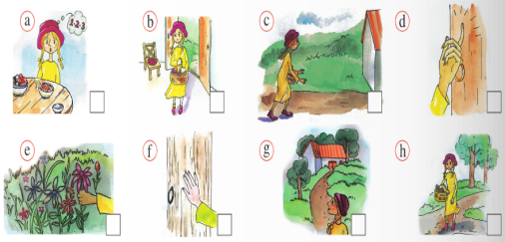
Look at the pictures and answer the questions.
1. Who was Goldilocks?
2. Where was she?
3. What did Goldilocks notice?
Goldilocks was a girl with hair of gold.
She was in the forest.
I think she noticed a house.

Slide 8
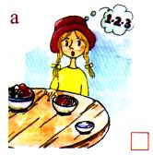
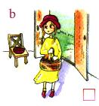
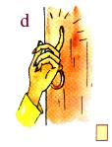
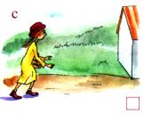
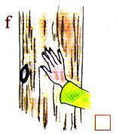

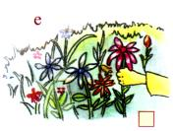
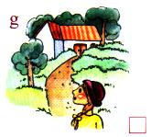
Listen to Activity 3 and number the pictures in the correct order.
8
7
4
5
1
6
3
2

Slide 9

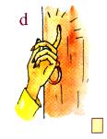
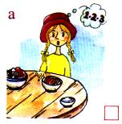
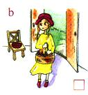




Read Activity 3 and match these words with the pictures .
be lost count enter hurry knock notice pick push
count
enter
hurry
knock
pick
push
notice
be lost

Slide 10
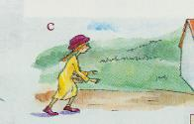
Match the sentences with the pictures according to Activity 3 .
There were three bowls
with some nice food in them.
She entered the house.
She hurried to the house.
She knocked on/at the door.

Slide 11
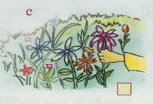
She picked some flowers.
She pushed the door.
She noticed a little house.
She was lost in the forest.

Slide 12

Read Activity 3 and answer the questions.
1. Did she pick any flowers in the forest?
2. Did she notice a big tree in the forest?
3. Was the door open?
4. Was there food in the bowls?
5. Did she want to eat the food?
6. Did she like the big bowl?
Yes, she did.
No, she didn’t.
Yes, it was.
Yes, there was.
Yes, she did.
No, she didn’t.

Slide 13
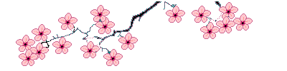
Summarize useful phrases
1. once upon a time
2. look around
3. hurry to do sth.
4. knock on/at the door
5. pick up
6. go for a walk
从前
环顾
赶快做某事
敲门
捡起
去散步

Slide 14
Language points
1. decide to do sth. 决定做某事
e.g. I decided to make friends with him. 我决定和他交朋友。
decide not to do sth. 决定不做某事
She decided not to play with Dave. 她决定不和戴夫玩。
2. be lost 迷路 (= get lost / be missing)
e.g. The boy was lost and his parents looked for him everywhere. 这个男孩迷路了，他的父母到处找他。
3. look around 环顾四周
e.g. The boy looked around, but he didn’t see anybody.
这个男孩环顾四周，但是他没有看到任何人。

Slide 15
4. hurry to 匆匆忙忙去…… = go to…in a hurry
e.g. Li Ming hurried to the room with no word.
=Li Ming went to the room in a hurry with no word.
李明一言不发地赶到房间。
5. knock on / at 敲……
e.g. Don’t knock on the table. It’s impolite.
不要敲桌子，那不礼貌。
6. maybe 可能
可以和may 替换, 但maybe常用于句首, 而may be常用于句中。
e.g. Maybe he is at home. = He may be at home. 他可能在家。

Slide 16
7. pick up 捡起, 拿起
e.g. Please pick up the books for me. 请帮我把书捡起来。
8. all (两个以上)都; both(两个)都 两者在句中的位置相同
e.g. All the students are listening to the teacher. (adj.)
=All of the students are listening to the teacher. (pron.)
所有的学生正在听老师讲课。
The students are all listening to the teacher. (adv.)
学生都在听老师讲课。
Not all the students are listening to the teacher. (部分否定)
并不是所有的学生都在听老师讲课。

Slide 17
5 Complete the passage with the
correct form of the words from the box.
around bowl dark enter knock nobody pick push towards
One day Goldilocks walked into the forest and______ some flowers. It was very ______ and soon she was lost. She looked ______ her, and saw a little house, and she walked ______ it. Then she ______ on the door, but there was ______ in. She ______ the door and ______ the house. There were three ______ on the table, a small one, a big one and a very big one.
picked
dark
around
towards
knocked
nobody
pushed
entered
bowls

Slide 18
6 Listen and notice the different ways the speaker says the words.
/t/ finished knocked liked noticed
picked pushed stopped
/d/ answered entered hurried lived
/Id/ decided
Now listen again and repeat.

Slide 19
Summarize the regular simple past verb
① 一般动词原形末尾加-ed。如：
look → looked, stay→ stayed ;
② 以e结尾的动词只加-d。如：
hope →hoped, live→ lived;
③ 末尾只有一个辅音字母结尾的重读闭音
节的动词, 应先双写这个辅音字母, 再
加-ed. 如: stop → stopped
④ 结尾是“辅音字母+y”的动词, 先将y改
为i,再加-ed. 如: study → studied

Slide 20
7 Listen and repeat
1. Goldilocks walked into the forest.
2. She noticed a little house.
3. She knocked on the door.
4. She liked the food.

Slide 21
8 Work in pairs. Tell the story.
—How does the story begin?
—Once upon a time, there was a little girl called
Goldilocks. She lived near a big forest. She had
hair of gold……

Slide 22
当堂小练
一、根据句意和汉语提示，用单词的适当形式填空。
1.Jenny p_________ some beautiful flowers for her mother in a forest last week.
2.My grandma often goes to buy vegetables with a b_________.
3.I’m very sorry.I can’t a______ your questions.
4.Once u_________ a time there was an old man.
5.He was walking t_________ you.
6.She was very h_________,so she ate all the food.
icked
asket
nswer
pon
owards
ungry

Slide 23
当堂小练
二、根据句意用括号内所给单词的适当形式填空。
1.I decided _________ (walk) to the park.
2.Mother _________ (not do) housework yesterday.
3.Linda _________ (hurry) to school and wasn’t late for class.
4.She _________ (push) the door and _________ (enter) the room at last.
5.We noticed our new teacher _________ (walk) into the dining hall and _____(walk) out in a few minutes.
to walk
didn’t do
hurried
pushed
entered
walk
walk

Slide 24
当堂小练
三、单项填空。
( )1.Tom was very _________.He would like someone to play
with him.
A.tired B.hungry C.little D.lonely
( )2.The little boy walked in the crowded city and soon he was
_________.
A.lost B.lose C.losing D.to lose
( )3.Listen!Someone _________ the door.
A.knocks on B.is knocking
C.is knocking on D.knocks
D
A
C

Slide 25
当堂小练
( )4._________ Alan have a party last week?
A.Was B.Were C.Do D.Did
( )5.They finished _________ the passage soon.
A.read B.to read C.reading D.to reading
( )6.There is a purse on the floor.Please _________.
A.pick up it B.pick it up
C.pick them up D.pick up them
D
C
B

Slide 26
课堂小结
Unit 1 Once upon a time...
1.New words:
hair, gold, forest, once, upon, once upon a time, decide, go for a walk, basket, notice, all alone, dark, pick, pick up, soon, lost, around, little, towards, knock, door, answer, push, enter, bowl, hungry, right, finish
2.Structures:
①And soon she was lost.
②She looked around her.
③It was open.
归 纳

