Slide 1
Unit7 Enjoy Your Hobby
Hobbies Are Fun!
WWW.PPT818.COM

Slide 2
学习目标：
1.能用恰当的词语表达自己的爱好
2.了解爱好的类型
3 掌握单词及短语：postcard, outdoor, not only…but also, take up,too…to,

Slide 3
Can you guess?
It is something you enjoy doing
It is not a job or a school subject
It’s just something you like to do in your spare time
It can build your cinfidence and make your life more colourful
hobby

Slide 4
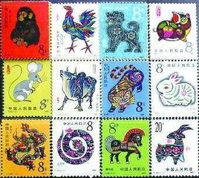
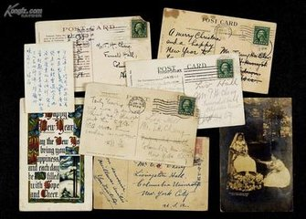
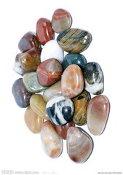
collections
.
postcards
stamps
stones

Slide 5
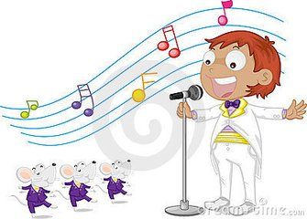
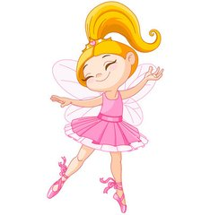
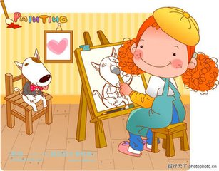
arts
.
Singing
dancing
drawing

Slide 6
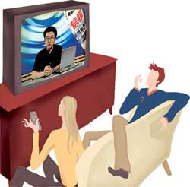
Talk about hobbies
Watching TV

Slide 7
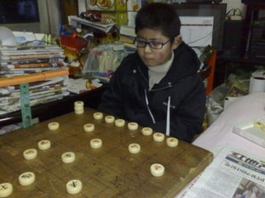
games

Slide 8
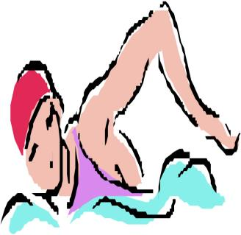
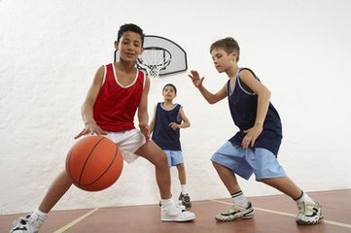
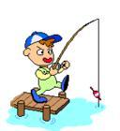
Outdoor avtivities
.

Slide 9
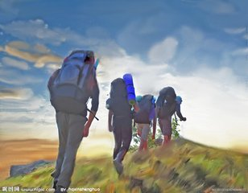
others
gardening
Go hiking

Slide 10
Let’s do it
Read the lesson and follow the insructions
1.
A happy child has a hobby
There are many different types of hobbies
Collecting painted eggs
cooking

Slide 11
Learn some important sentences.
1.A hobby is not only fun but also useful.
2.There are many different types of hobbies.
3.A lot of people enjoy gardening, travelling, skiing and other such activities.
4.People usually take up their first hobby when they are kids, but hobbies are fun for all ages.
5.It's never too late to learn something new.

Slide 12
Read the text again

Slide 13
Let’s do it
2.Listen to the statements and match the names with the hobbies
Jim
I enjoy collecting sports cards
I really love singing.Singing is a big part of my life
wanglin
Jack
When I have free time,I read storybooks
Kate
I’m interested in learning about my family history
SunYang
I like playing chess in my spare time

Slide 14
Language points:
1. not only…but also “不但…而且…”,用来连接两个并列成分。
当连接两个并列主语时，谓语动词要和but also 后面的主语保持一致（就近原则）
2.take up “开始做某事”，开始某事
还可以意为“占据”
3.too…to.. “太…..而不能……”

Slide 15
Let’s do it
Read the lesson again and organize the hobbies into the following groups
Hobbies
others
Collections
Out door activities
Games
arts

Slide 16
Reading
Hobbies
People like to do interesting things in their spare time . When they are free, people usually do what they like . They keep pets, play sports, dance to music, play computer games or chat on the internet. They also paint pictures or collect things such as coins, dolls or stamps.
People have hobbies because hobbies can bring them happiness, friendship and knowledge .Hobbies help people relax after their diary work. When people become old , Hobbies can keep them healthy. When people are sick , hobbies can help them get well soon.

Slide 17
Reading
Help: spare adj. 空闲的
Pet n. 宠物
Coin n. 硬币
chat v. 聊天
Question: Why do people have hobbies?

Slide 18
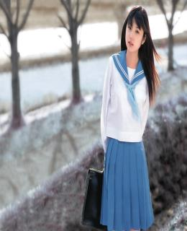
Homework
根据下面的提示写一篇文章介绍你的朋友，不少于70词。
name: Mary
age: 15
school: No.5 Middle School
favorite subjects: English, math
hobbies: singing, playing the guitar, playing basketball

