Slide 1
Unit 5 Country Life
There is a river near the village
WWW.PPT818.COM

Slide 2
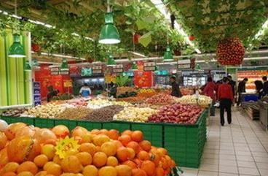
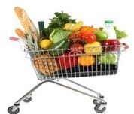
你能用There is或There are来描述下面的图片吗？
There is a supermarket.

Slide 3
你能用There is或There are来描述下面的图片吗？
There is a bookshop.

Slide 4
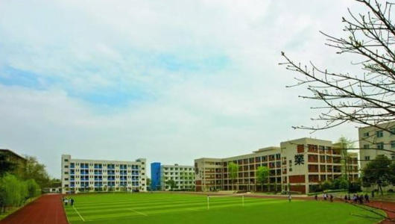
你能用There is或There are来描述下面的图片吗？
There is a school.

Slide 5
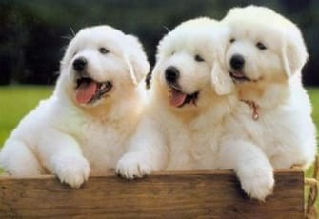
你能用There is或There are来描述下面的图片吗？
There are three dogs.

Slide 6
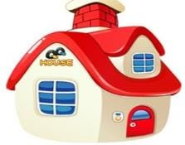
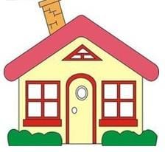
你能用There is或There are来描述下面的图片吗？
There are five houses.

Slide 7
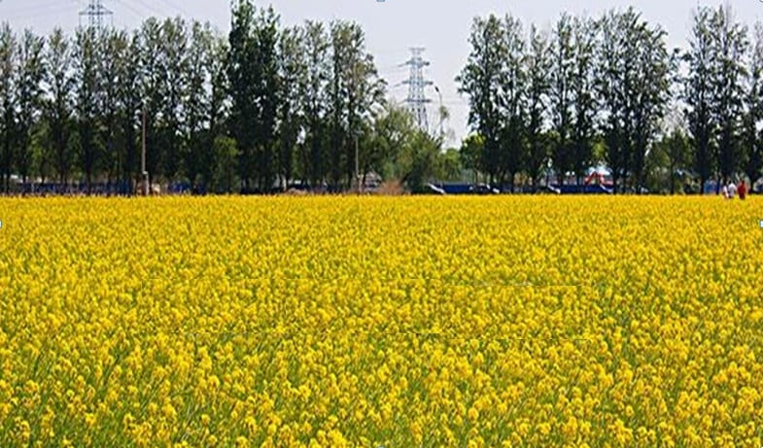
你能用There is或There are来描述下面的图片吗？
There are many trees and flowers.

Slide 8
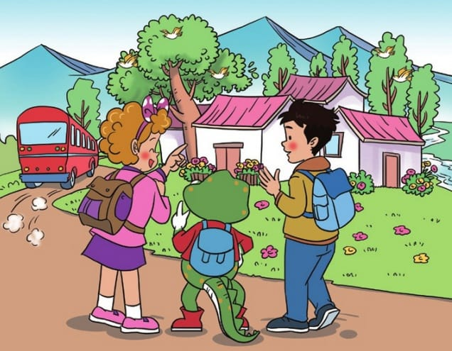
Jenny, Danny and Guo Yang are visiting a beautiful place at the weekend.
Where is it?

Slide 9
Where is it?
A. It’s in Guo Yang’s grandparents’ village.
village
B. It’s in Guo Yang’s grandparents’ city.

Slide 10
What’s in the village?

Slide 11
What’s in the tree?
birds
There are many _____ in the trees.
They are singing happily.

Slide 12
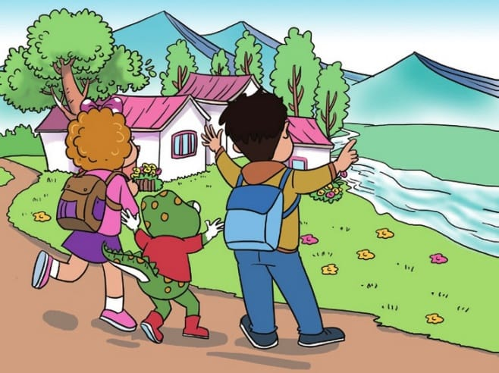
What’s near the village?
There is a ______ near the village.
river

Slide 13
Are there any fish in it?
Yes, there are lots of fish.

Slide 14
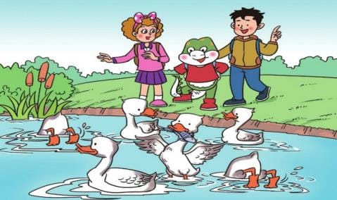
What’s in the river?
ducks
There are some ______ in the river.
They are catching fish.

Slide 15
village
This is Guo Yang’s grandparents’ ________.
There ____ many new and beautiful houses. There are many ______ in the trees. They are singing _______.
There is a _______ near the village. There ___ lots of fish in it. There are some ______ in the river, too. Look! The ducks are _______ fish.
are
birds
happily
river
are
ducks
catching

Slide 16
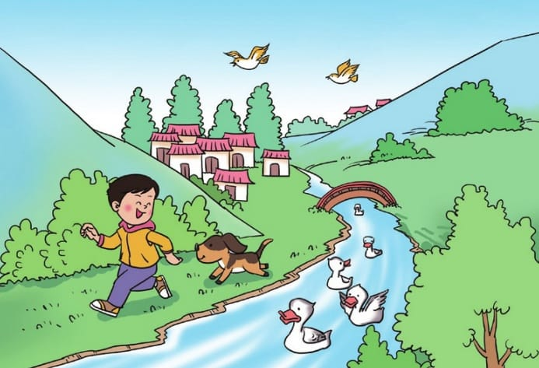
Talk about the village

Slide 17
Homework
读 read.
预习 Preview.
准备 Prepare the oral English test.

