Slide 1
Unit 2
What time do you go to school?
R 七年级下册
第1课时
WWW.PPT818.COM

Slide 2
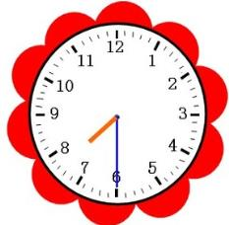
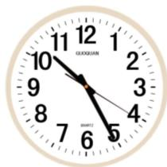
Lead-in
What time is it?
10:25
It is ten twenty-five
7:30
It is seven thirty.

Slide 3
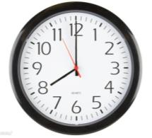
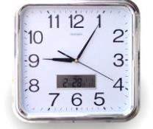
8:00
It is eight (o’clock).
9:05
It is nine o five.

Slide 4
It is seven fifteen.
It is nine thirty.

Slide 5
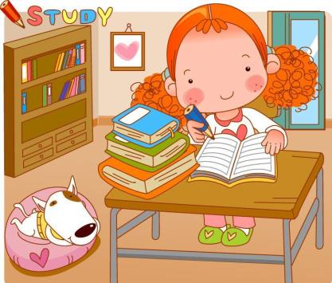

Slide 6
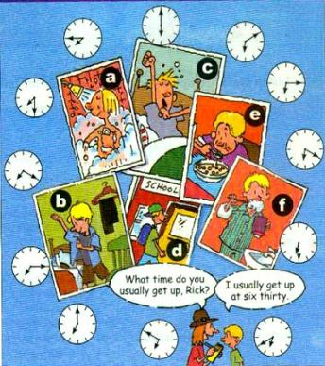
1a
Match the activities with the pictures.
1. get up ____
2. go to school ____
3. get dressed ____
4. brush teeth ____
5. eat breakfast ____
6. take a shower ____
c
d
b
f
e
a

Slide 7
Listen and match the times with the actions.
draw lines from the clocks to the pictures.
1b

Slide 8
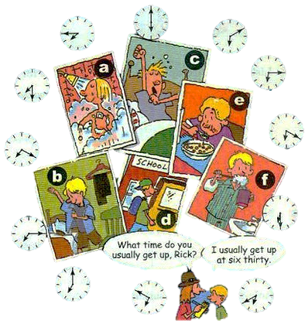
1b

Slide 9
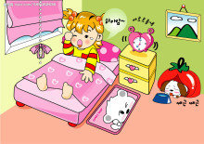
Students A is the interviewer. Students B is Rick. Ask and answer questions about Rick’s day.
1c
A:What time do you usually get
up , Rick?
B:I usually get up at six thirty.

Slide 10
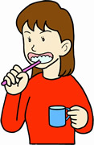
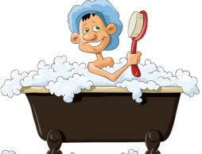
A:What time do you usually take a shower and brush
teeth , Rick?
B:I take a shower and brush teeth at six forty.

Slide 11
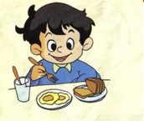
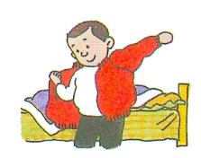
A:What time do you usually eat
breakfast?
B:I usually eat breakfast at seven
o’clock.
A:What time do you usually get
dressed?
B:I usually get dressed at seven
twenty.

Slide 12
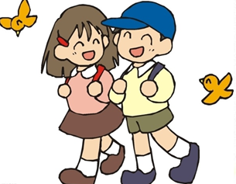
A: What time do you usually go to school?
B:I usually go to school at seven thirty.

Slide 13
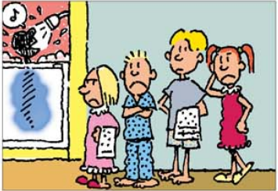
Listen to the conversation and complete the sentences.
2a
Jim has ____ brothers and ____ sisters. Jim’s family has ________ shower.
two
two
only one

Slide 14
Listen again. Complete the shower schedule for Jim’s family.
2b
Name
Bob
Mary
Jack
Jim
Anna
Time
5:30
5:50
6:15
6:30
6:45

Slide 15
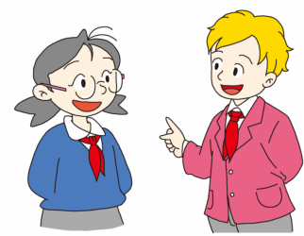
2c
Now talk about yourself.
I always get up at five fifty.
What time do you usually get up?
Wow! I never get up so early.

Slide 16
I always go to school at seven thirty.
How about you?
What time do you usually go to school?
I always go to school at seven twenty.

Slide 17
2d
Role-play the conversation.
Read the conversation, then answer the following
questions.
What time does Scott usually get up?
Does Scott exercise at ten?
I’m never late for work.(英译汉)
He usually get up at eight thirty at night.
No, he exercise at about ten twenty.
我上班从不迟到。

Slide 18
Interviewer: Scott has an interesting job. He works at a
radio station. Scott, what time is your radio
show?
Scott: From twelve o’clock at night to six o’clock
in the morning.
Interviewer: What time do you usually get up?
Scott: At eight thirty at night. Then I eat
breakfast at nine.
from…to…
从……到……从……至……
广播电视台
在夜晚；在夜里

Slide 19
Interviewer: That’s funny time for breakfast!
Scott: Yeah. After that, I usually exercise at about
ten twenty.
Interviewer: When do you go to work?
Scott: At eleven o’clock, so I’m never late for work.
be late for
迟到

Slide 20
Language points
1. What time do you usually get up, Rick?里克，你通常几点起床？
What time“什么时候”，用来提问具体的时间点。
例：—你几点吃早饭？ —7 点 。
— What time do you eat breakfast?
— At 7：00.

Slide 21
辨析：what time与when
（1）what time只用于询问具体的时间点，表示的时间比较精确。
（2）when既可问时间点，也可问时间段，询问年、月及日期。

Slide 22
2. I always get up at five fifty. 我总是五点五十起床。
at作为介词，意为“在……”，用来表示时间。其后一般跟表示钟点的词。
例：at 3:00 在3点 at 9:15 在9点15

Slide 23
辨析：at, in 与 on
（1）介词at常用于时刻前或一些固定的习惯用语中。
例：at half past ten 在10点半
在夜晚 在中午
at night
at noon
（2）介词in用在月份、季节、年份等前面，也可以表示在上午/下午/晚上。
例：在上午/下午/晚上
in the morning/afternoon/evening

Slide 24
（3）介词on用在日期、星期几、节日前,也用来表示具体某一天的上午、下午或晚上。
例：on November 1st 在11月1日
on Children’s Day 在儿童节
on Tuesday evening 在星期二晚上
on the afternoon of July 5th 在7月5日的下午
Notes:
24

Slide 25
3. That’s a funny time for breakfast!
那个时间吃早饭真有意思！
time for…表示“做……的时间”。
time是名词，意为“时间”。
常用结构：
It’s time for sth. 是做某事的时间。
It’s time(for sb.)to do sth. 是某人做某事的时间。
相关短语：at times 有时； in time 及时；
on time 按时；准时。

Slide 26
Exercise
1. 我早上六点起床。
I ______ ______ ______ six in the morning.
2. 他的爸爸晚上九点洗澡。
His father ______ ______ ______ ______ nine in the
evening.
3. 你姐姐几点刷牙？
______ ______ ______ your sister brush teeth?
get up at
takes a shower at
What time does

Slide 27
in at on
_____ 7 o’clock _____ April _____ noon
_____ 2011 _____ summer _____ Monday
_____ five thirty _____ the morning of May 12th
_____ the morning ______ Tuesday afternoon
at
in
at
in
in
in
at
on
in
on

Slide 28
1. 一When did the terrible earthquake happen in Ya’an
Sichuan?
—It happened _____ 8:02 _____ the morning of April
20th,2013.
A. on；in B. at；on
C. at；in D. on；on
B

Slide 29
2. He is a bus driver. He _____ in the bus _____ .
A. stays；station B. works；station
C. worker；stop D. work；stop
3. Some workers in that factory have to work _____
night.
A. at B. for C. with D. among
B
A
C
4. It’s _____ school. Let’s go to school.
A. Time B. time to C. time for D. times on

