Slide 1
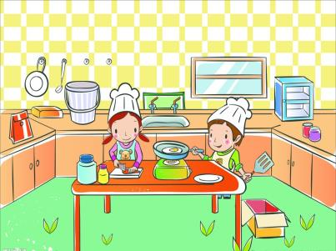
Unit 6
In the kitchen
第一课时
WWW.PPT818.COM

Slide 2
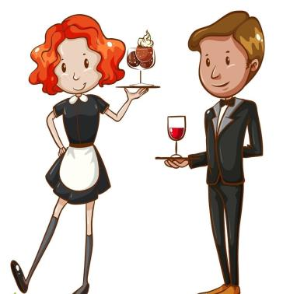
Introduce
--Is there any...
--Yes, it is. / No, it isn’t.
--How is...?
--It’s Yummy / nice.

Slide 3
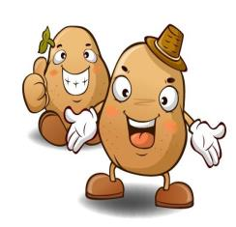
Words
some [sʌm, səm]
形容词，修饰名词，意为“一些”。
eg： There is some milk in the fridge.
小练习：汉译英： 一些土豆 _________
句型转换：There are some oranges on the tree.（改为一般疑问句）
___________________________
some potatoes
Are there any oranges on the tree?

Slide 4
Words
ready [ˈredi]
形容词，意为“准备好”be ready for..意为“为...做准备”。
eg： They are ready for the meeting. 他们为会议做准备。
小练习：单项选择：
He is ready____the cooking.
A. for B. to
A

Slide 5
Words
love [lʌv]
名词，意为“爱”。love to do sth. / love doing sth.都意为“爱做某事”。
eg： He loves listening to the song. 他爱听歌。
小练习：用所给词的适当形式填空：
My little dog loves_____（eat）bones.
eating

Slide 6
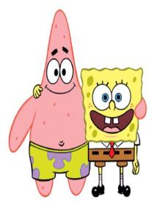
Words
great [ɡreit]
形容词，意为“太好了，很棒”。
eg： We had a great time in Pairs. 我们在巴黎玩得很愉快。
小练习：汉译英：
一个很棒的主意。 ____________
a great idea

Slide 7
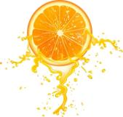
Expressions
Is there any juice in the fridge? 冰箱里有一些果汁吗？
此句为there be的一般疑问句，当名词为可数名词复数时。
其句式结构为Are+there+复数名词+其他？
肯定回答：Yes, there are. 否定回答：No, there aren’t.
eg： Is there any water in the bottle? 在瓶子里有一些水吗？
小练习：句型转换：
There are some eggs on the table.（改成一般疑问句）
____________________________________
Are there any eggs on the table ?

Slide 8
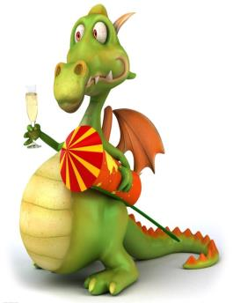
Expressions
Here’s some orange juice. 有一些橘子汁。
此句给对方指出位置，或者是将物体给对方使用。
这句的原形为：Some orange juice is here.
eg： Here is the book. 书在这里。
小练习：汉译英：
给你_________
Here you are.

Slide 9
Expressions
How’s the meat, Taotao? 肉做的怎么样，涛涛？
此句为询问句型，可做评价用语。意为“...味道怎么样？”
eg： How is the soup? 汤做得怎么样？
小练习：句型转化：
The apple is sweet.（对划线部分提问）
___________________________
How is the apple.

Slide 10
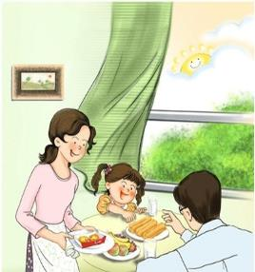
Dialogue
Dinner is ready, LiuTao is eating the meat.
晚饭做好了，刘涛正在吃肉。
Mr Liu: How’s the meat, Taotao?
刘先生：肉做的怎么样，涛涛？
LiuTao: It’s Yummy, Dad! I love it! You’re a great cook!
刘涛：太好吃了，爸爸！我特喜欢它！你是一位很棒的厨师。
Mrs Liu: How’s my soup, Taotao?
刘太太：我的汤做得怎么样，涛涛？
Liutao: It’s nice, Mum. I love it too!
刘涛：它也很美味，妈妈，我也很喜欢你做得汤。

Slide 11
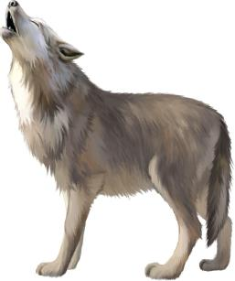
Expand
经典小故事
The Wolf and the Dog
There is a wolf. He is very hungry and has no strength to find food. As he lies under a large tree, a dog sees him. The dog sees the wolf is so thin and hungry, and he feels sorry for him and says, “You are so terrible! Are you hungry?”
“Yes,” says the wolf, “I’m hungry because you are guarding the sheep. Now I am so weak that I can’t find food. I think I will do.”

Slide 12
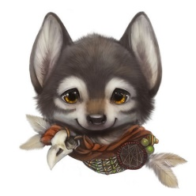
Expand
经典小故事
“Why not help me?” Asks the dog, “I work regularly and I eat regularly. You could do the same. You can help me guard the sleep. In that way, I will not worry about your stealing the sleep, and you will not worry about going hungry. It’s good for us.
The wolf thinks it over and thinks the dog is right. So they walk to the dog’s house. As they are walking, the wolf sees that only the hair of the dog’s neck is very thin. He is curious about this. So he asks the dog about it.

Slide 13
Expand
“Oh, don’t worry about that,” says the dog, “It’s the place where the collar ties on the neck. My master chains me up at night,”
“Chained up!” shouts the wolf, “Do you mean that you are chained up at night? If I come to live with you, will I be chained up at night, too?”
“That’s night,” says the dog, “But, you’ll get used to it.”
“But, if I am chained up, I won’t be free.” After saying this, the wolf turns round and runs away.
The dog shouts, “Wait! Come back! I’m not free, but I’m healthy. I have good food, and a warm place to sleep. I like enjoying life. In fact, I’m freer than you are.”

Slide 14
Expand
狼和狗
有一只狼，他非常饿，而且饿得没有力气去找吃的了。当他躺在一棵大树下时，一只狗看见了他。看到狼又饿又瘦，狗挺可怜他的：“你看上去真可怕。你很饿啊？“
“是的。”狼说，“我饿是因为你和你的伙伴看守着羊群。现在我弱得没法去找食物。我想我就快要死了。”
“为什么不帮我呢？”狗说，“我们按时工作，准时吃饭。你也行的。你可以帮我看羊群。那样我就不用担心你会来偷羊，你也不用担心挨饿了。这对我们都有好处。”
狼考虑了一下，觉得狗说的对，他们就一起朝狗的屋子走去了。正走着，狼看见狗脖子上的毛很少。他觉得好奇，就问狗怎么回事。
“啊，别担心，”狗说，“这是系狗项圈的地方，晚上主人会把我拴起来。”

Slide 15
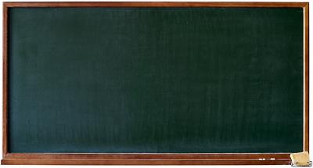
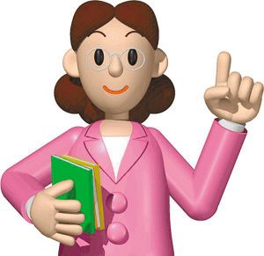
Summary
some
love
great
ready
Is there any juice in the fridge?

Slide 16
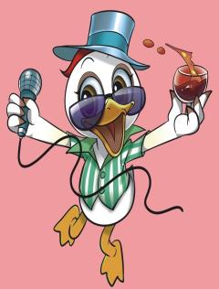
Exercise
汉译英
在冰箱里_________________________
一些橘子汁 ________________________
一位很棒的厨师___________________
吃肉_______________________________
in the fridge
some orange juice
a great cook
eat meat

Slide 17
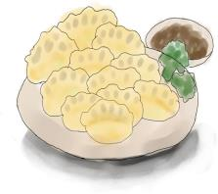
Exercise
用is, are , isn’t , aren’t填空。
1. There ______ a spoon (勺子) on the plate.
2. There ______ some coffee on the table . And there _______ any milk here .
3. There ______ some clouds in the sky. There ______ some boats on the river.
4. There ______ any knives in the box.
5. There ______ an ipad in the living room.
is
is
isn't
are
are
aren't
is

Slide 18
Homework
Talk about your favorite vegetables.

