Slide 1

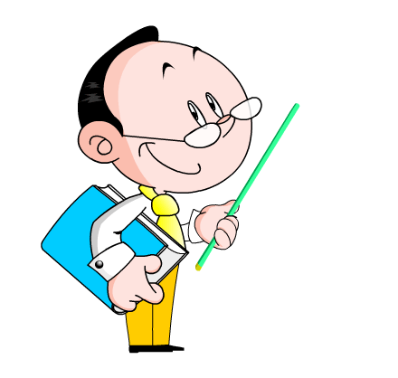
Unit 6 Go with Transportation
Life on Wheels
WWW.PPT818.COM

Slide 2
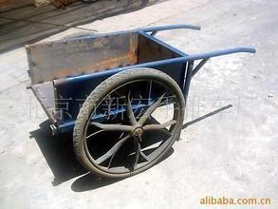
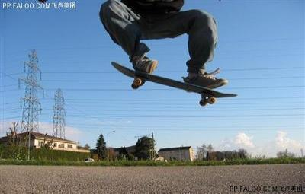
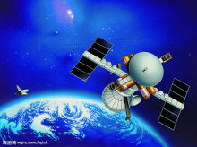

cart
skateboard
spaceship
wings

Slide 3
New words:
Jeremy 杰里米
pull 拉；拖 push（反）
able 能；能够
Power v.驱动;推动
n.能量;力量
machine 机器;机械
space 太空;空间;距离
imagine 想像;想到
environment 环境

Slide 4
一、认知学习目标
1.识记单词:
wing; pull; cart; skateboard; able; power; appear; machine; space ; spaceship; imagine; environment
2.掌握短语:
be able to; thousands of; be good for;
the beginning of;
3.理解并应用结构：
be always doing sth;
It seems that ... / sb seem(s) to do sth.

Slide 5
二、预习成果展示
in the 1700s
1.在18世纪________________
2. …...的开始___________________
3. 几千/数千_____________
4. 装满……_________________________
5. 对……有好处________________
6.be able to__________
7.It’s fun to do sth. ___________________
8.over 100 years ago _______________
9.my favourite type of transportation____________
10.be always doing sth. ________________________
the beginning of
thousands of
be full of / be filled with
be good for
能，会
做某事很有意思
100多年前
我最喜爱的交通方式
总是或一致做某事

Slide 6
三、课堂研讨助学
活动一： Read and Fill (Let’s do it NO.2)
活动二： Listen and choose (Let’s do it NO.1)
活动三：Read and label (Let’s do it NO.3)
活动四：Lanuage Points

Slide 7
活动四：Language Points
1. Everything seems to be getting faster, too.
一切也似乎变得更快了。
主语+seem to be +表语 Tom seems to be happy.
主语+seem +to do sth Lily doesn’t seem to like red.
It seems that+句子 It seems that Tom is happy.
1).那边那个人看上去像一位新老师。
2).这个年轻人看起来变化很大。
The young man have changed much.
The man over there seems to be like a new teacher.
seems to

Slide 8
2 . Then steam was able to power boats and cars.
那时蒸汽能给船舶和汽车提供动力。
be able to表示“能；能够”，后接动词原形 。
eg.Betty is able to sing.贝蒂会唱歌。
be able to | 强调具体事件中有能力，指“经过努力而成功地做某事” | 可用于各种时态，不与 can连用
can | 只是一般性的能力，指“有能力做某事” | 只有现在式和过去式两种形式

Slide 9
3. The world is always moving.
这个世界总是运动的。
be always doing sth “总是或一致做某事”，现在进行时与always连用，表示一个经常重复的动作或状态。常用来表达说话人的某种感情，如：赞叹、埋怨、厌烦等。
e.g. He is always talking. 他老是说话。
My mother is always saying I’m lazy.
我妈妈总是说我很懒。

Slide 10
4.Can you imagine future transportation?
imagine，动词，想像;想到
imagination是名词， 想象，想象力；
想象出来的事物
常用结构：
imagine doing sth. 想象做某事
use one’s imagination 发挥某人的想象力

Slide 11
四、反馈展示升华
Work in pairs. Imagine the transportation of the future. Then make up a dialogue.
Example:
A: What does it look like?
B: It looks like a bird. It has swings.
A: How will it help people?
B: …

Slide 12
五、当堂训练检测
beginning
1.At the ______ (begin) of class, Wang Yan gave a report.
2.There’re _________(thousand) of workers in that factory.
3. People invented the steam engine ______________(三千多年前).
4_________________(在二十世纪六十年代），people invented the computers.
5.If we change places, you will_____________(can/be able to)see better.
6.Can you imagine_____________(live) on the moon?
thousands
over three thousand years ago
In the 1960s
be able to
living

Slide 13
7.The man over there seems______________(be) a new teacher.
8. The girl is warm-hearted. She is always _____________(help) others.
9.箱子里面装满了书.
The box ________ _________ _________ books.
10.做眼保健操对你的眼睛有益。
Doing eye exercises ______ ______ _______ your eyes.
11.It seems that Mr. Brown will come again. (同义句)
Mr. Brown _________ _________ _________again.
to be
helping
is full of
is good for
seems to come

Slide 14
优胜小组：

Slide 15


