Slide 1
I have a ball.
第6课时
WWW.PPT818.COM

Slide 2
Can you remember these words?
doll
ball

Slide 3
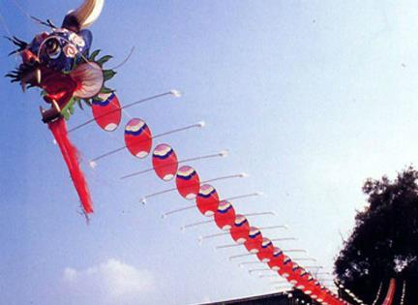
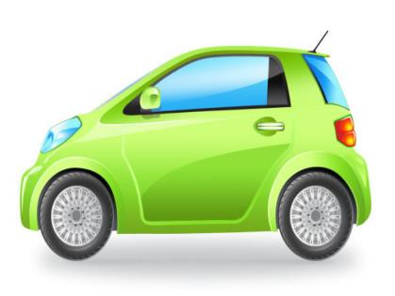
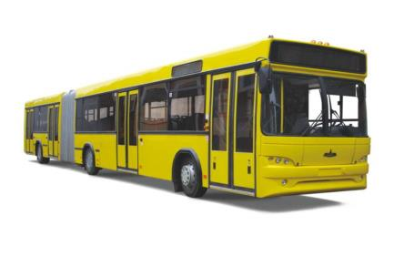
kite
balloon
car
bus

Slide 4
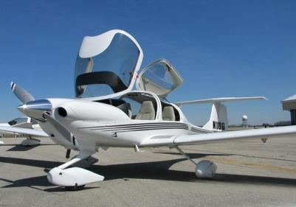
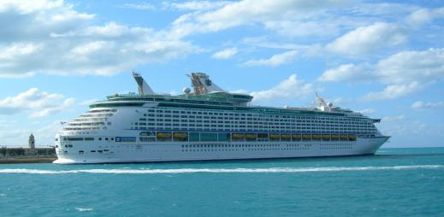
boat
plane
ship

Slide 5
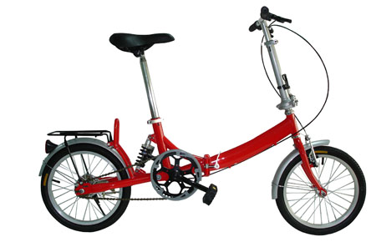
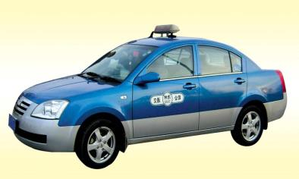
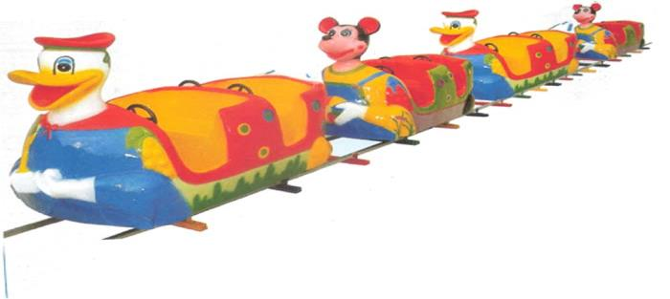
taxi
bike
train

Slide 6
Hi, I have a new bike.
Really? Can I see it?
Sure!

Slide 7
Look! I have a plane.
Can I see it?

Slide 8
Sure! Here you are.
Thank you!
You’re welcome.

Slide 9
Can you translate?
1. I have a plane.
2. I have a doll.
3. It’s Santa!
4. Merry Christmas!
5. Here you are.
6. You’re welcome!

Slide 10
Fun story
Read and act.
小组内扮演故事，然后展示给小伙伴。

Slide 11
Let’s check!
Finish:
Listen and number.
仔细听，然后找一找！

Slide 12
写出下列单词的汉语意思。
face plane arm taxi hand bike
eye car boat nose ship
foot train head bus leg

Slide 13
Homework
能背会本课的小故事。

