Slide 1
Unit5 What will you do this weekend?
WWW.PPT818.COM

Slide 2
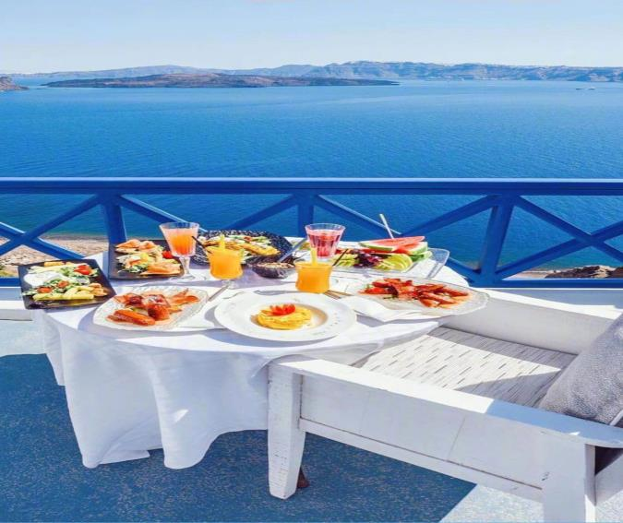
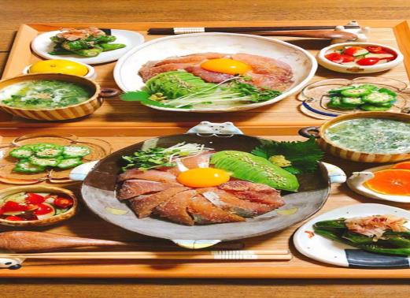
have a picnic
Shall we have a picnic?

Slide 3
a sausage

Slide 6
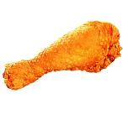
fill in the blanks 填空
I like ___________.
sausages
I have some__________.
cakes
bread
I'd like____________.
I don't like _________.
Coke
a cake
I'd like ___________and________.
sausages
I'd like ________ and _________ .
chicken
bananas

Slide 7
so many things
We have so many things for picnic.

Slide 8
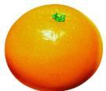
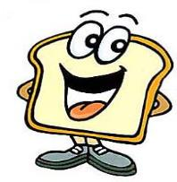
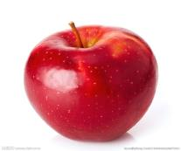
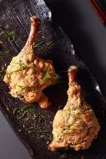
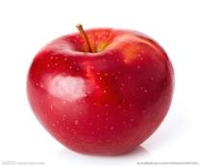
A:What would you like?
Pair work
B:I'd like…

Slide 9
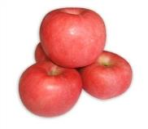
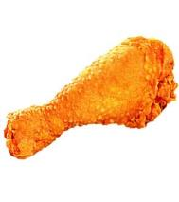
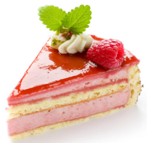
Game:
要求：当转盘停止，说出喜欢的食物.
(请注意单数和复数名词的表达）
I'd like…

Slide 10
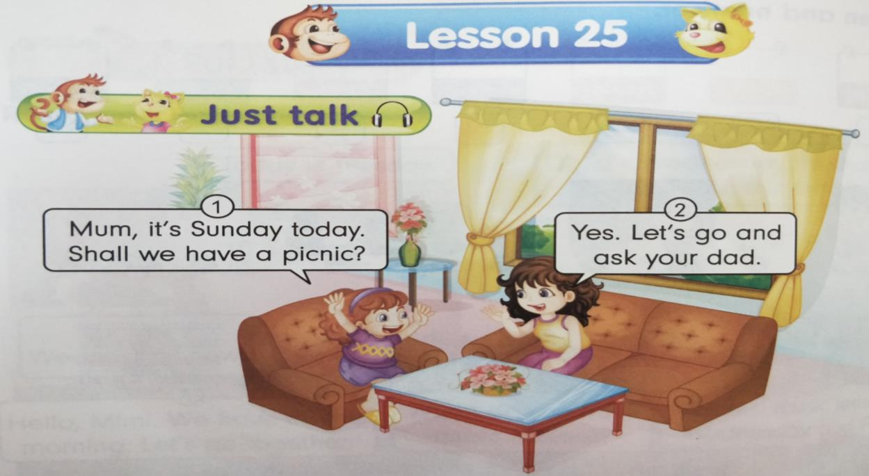
just read阅读课文 理解课文内容

Slide 11
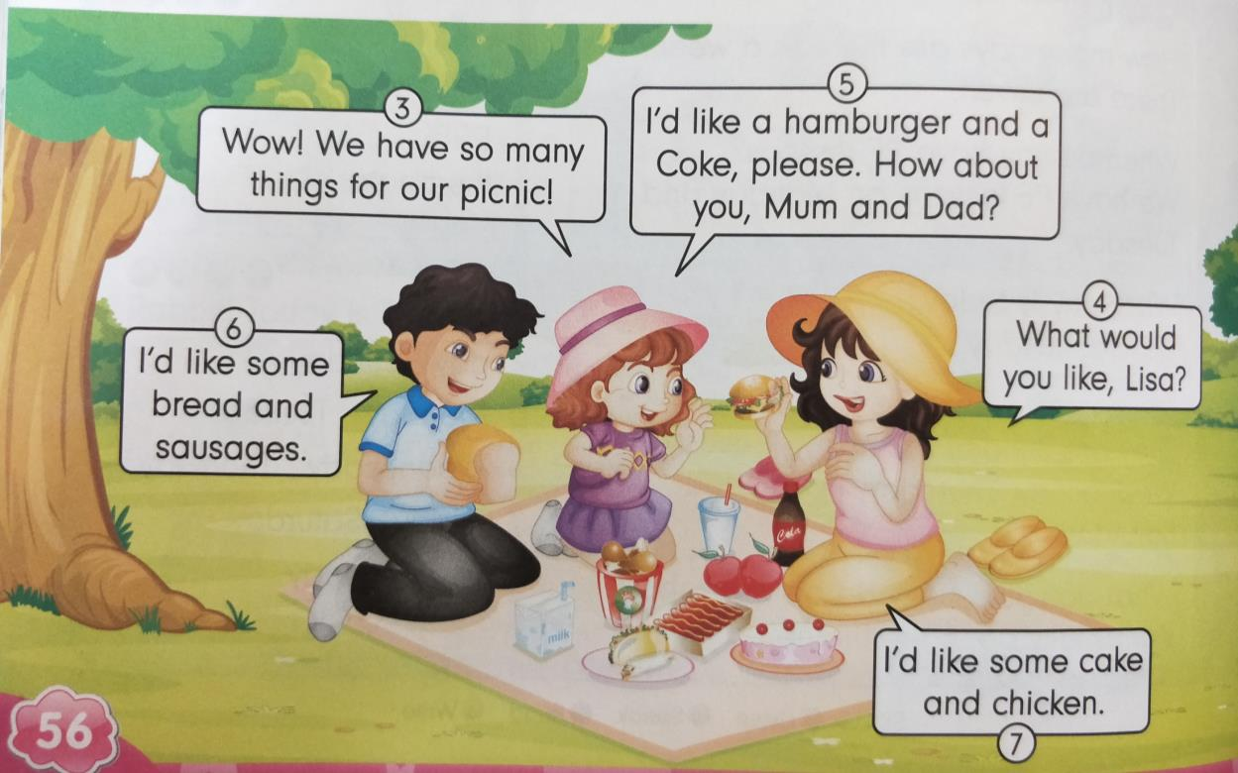
just read 阅读课文 理解课文内容

Slide 12
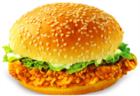
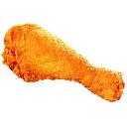
Answer the question按课文内容填空
a hamburger
Lisa would like _______________ and __________ .
a Coke
Father would like ______________and____________ .
sausages
some bread
some cake
chicken
Mother would like ______________and___________.

Slide 13
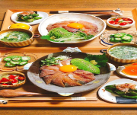
Homework
sausage
1).把本课所学单词写在作业本上，按照四线三格的格式正确书写。
2).利用所学句子跟同学进行简单的口语交流，表达出自己喜欢的食物，注意单复数的变化。

