Slide 1
Module 12 Western music
Vienna is the centre of European classical music.
WWW.PPT818.COM

Slide 2
生词书签

Slide 3
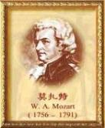
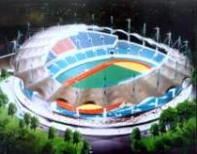
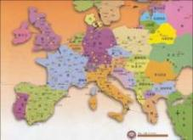
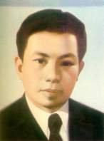
比一比，看谁能快速说出下面的单词。
musician n.
乐手；音乐家
centre
(Am E center) n.中心
European adj.欧洲的
composer n.作曲家
century n.世纪

Slide 4
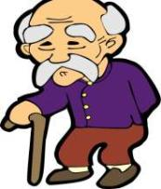
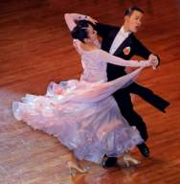
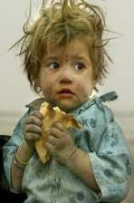
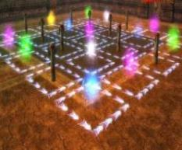
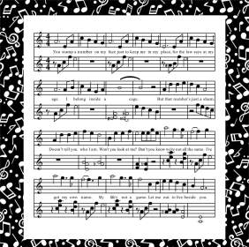
waltz n.
华尔兹舞(曲)
elder adj.年长的
poor adj.贫穷的
piece n. (写作、音乐或艺术的)作品
perfect adj.完美的

Slide 5
Leading in

Slide 6
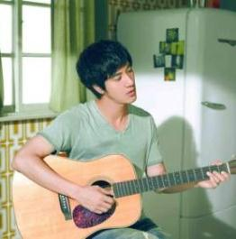
Do you like pop music? Do you know the two singers?

Slide 7
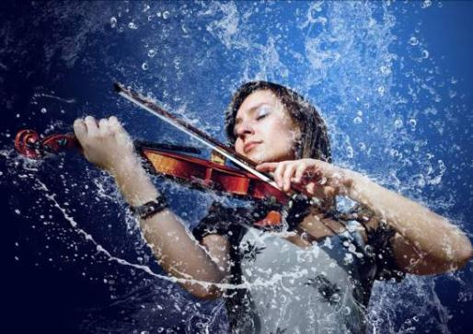
What is she doing? She is playing the violin.
Do you know anything about the violin?

Slide 8
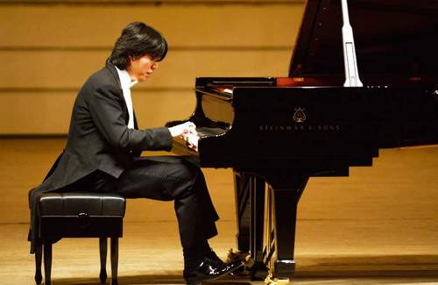
Can you play the piano?
Do you know anything about Li Yundi?

Slide 9
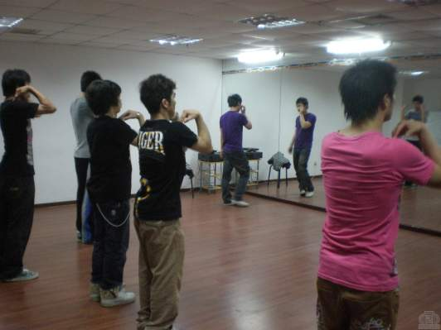
What are they doing? They are dancing.
I know some nice dance music, share with you.
舞曲
分享

Slide 10
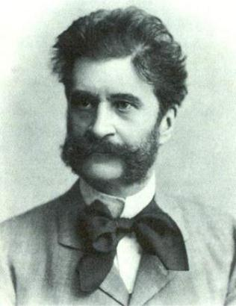
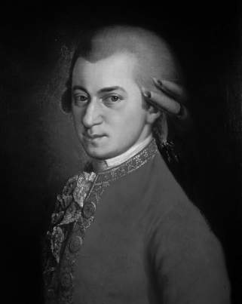
Strauss
Mozart
Do you know anything about them?

Slide 11
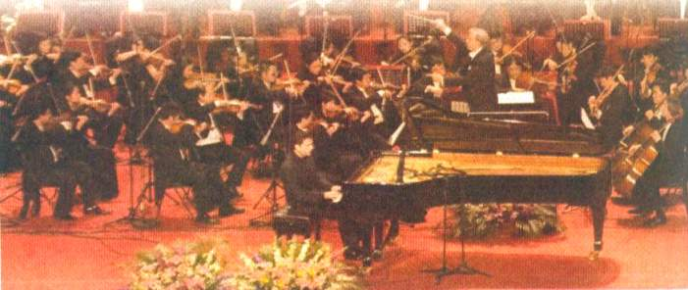
Describe the picture. Use the words from the box to help you.

Slide 12
Read the passage and check (√) the true sentences.
1. Many musicians came to study and work in Vienna.
2. Strauss the younger played the
piano, the violin and the drums at the age of six.
√

Slide 13
3. Mozart’s family took him around
Europe.
4. The father, Johann Strauss, died in 1791.
5. Mozart wrote The Blue Danube.
√

Slide 14
Answer the questions.
1. Where is Vienna?
It is in the centre of Europe.
2. What music did Johann Strauss the
elder write?
He wrote music for traditional dances, called the waltz.

Slide 15
3. How many waltzes did Johann
Strauss the younger write?
He wrote over 150 waltzes.
4. When was Mozart born?
He was born in 1756.
5. How old was Mozart when he died?
He was 35.

Slide 16
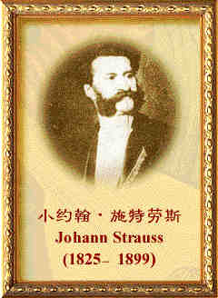
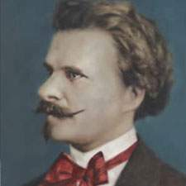
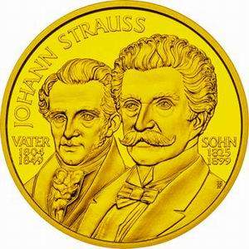
Complete the passage with the correct form of the words from the box.

Slide 17
Both Strauss the (1) ______ and Strauss
the younger wrote some very (2) _______
music. (3) _______ successful composer
from Vienna was Mozart, but he became
very (4) ______ and died at the age of
thirty-five. Many people think Mozart’s
music is (5) _______. All three were great
(6) _________ musicians.
elder
popular
Another
poor
perfect
European

Slide 18
你都选对了吗？

Slide 19
Writing
Use the notes to write a passage about the Chinese composer Xian Xinghai.
¤ Xian Xinghai
¤ famous for the song The Yellow River
¤ wrote it in 1939
¤ one of the great composers of
classical and traditional music

Slide 20
¤ born in Macao, China, 1905
¤ died young, 1945
¤ called the “People’s Musician”
¤ used traditional Chinese music
¤ studied in Paris
¤ songs are still popular today

Slide 21
Xian Xinghai is one of the great composers of classical and traditional music. He was born in ...

Slide 22
Learning to learn
When you write, choose your tenses carefully. Think about whether you are writing about something that is still true now or happened in the past.

Slide 23
New words
¤ musician 是名词，意为“乐手；音乐家”，
music 是名词，意为“音乐”。意义不同。
¤ European 是形容词，意为“欧洲的”，
它的名词形式是 Europe，意为“欧洲” 。
¤ century 是名词，意为“世纪”，即一百年
century = a / one hundred years

Slide 24
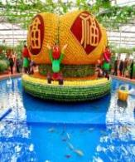
poor 是形容词，意思是“贫穷的”，
反义词是 rich “富裕的”。即：
poor — rich
贫穷的 反义词 富裕的
例如：
This girl is poor, she’s not rich at all.
这个女孩是贫穷的，她一点不富裕。

Slide 25
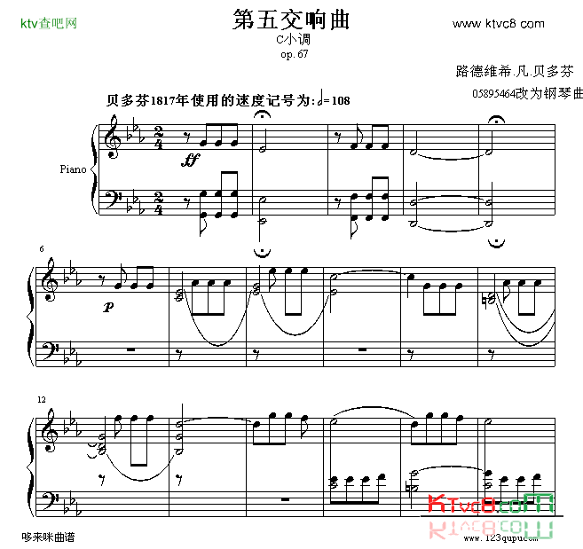
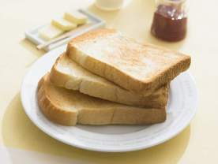
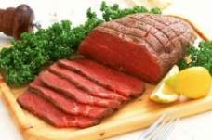
¤ piece 是名词, 意为“(写作、音乐或艺术的)作品”, 以前我们学过 piece 也是名词, 意为“块、片、段（等）”。意义不同。

Slide 26
Language points
1. Vienna is a beautiful old city on the River
Danube in the centre of Europe.
维也纳是欧洲中心多瑙河畔一座美丽而
古老的城市。
句中的 on the river...的意思是“坐落于......河畔”，例如：
His hometown is a small city on the Changjiang River.
他的家乡是位于长江河畔的一个小城。

Slide 27
2. Before he was six, he played not only
the piano but also the violin.
还不到六岁，他既会弹钢琴，又会拉小提琴。
句中的 not only...but also...的意思是“不仅......，而且......”，例如：
Shakespeare was not only a writer but also an actor.
莎士比亚不仅是作家，而且是演员。

Slide 28
3. Like Johann Strauss, father and son, he was a great European musician... 像施特劳斯父子一样，他是一位伟大的欧洲音乐家......
句中的 like 的意思不是“喜欢”，而是介词，意思是“像......一样”。

Slide 29
例如：
He moves and talks just like his father.
他的动作和说话方式就像他的父亲一样。
I’d love to be able to sing like Sarah Brightman.
我非常希望能像莎拉•布莱曼一样唱歌。

Slide 30
你都弄懂了吗？

Slide 31
Homework
1. Review and recite the important
points of Unit 2.
2. Try to write a passage about a
Chinese musician.

