Slide 1
Unit 3
Welcome to our school!
Task
WWW.PPT818.COM

Slide 2
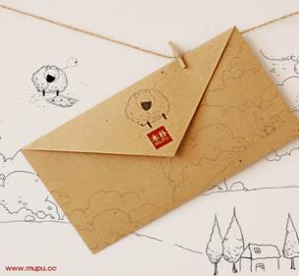
a letter
Millie’s penfriend, Liu Yi, writes this letter to her.
What does Liu Yi write about in the letter?
his school
He writes about
the buildings in his school
his teachers
the way(方法) he goes to school

Slide 3
Read and answer questions:
What’s the name of Liu Yi’s school?
2. Is his school big or small?
3. How many classrooms do they have?
4. Do they have a library?
5. What do they do in the reading room?
6. Where is the playground?
7. How does LiuYi go to school?
8. How long does it take LiuYi to get to school?
Hope Middle School.
It is small.
They only have a few classrooms.
No, they don’t.
They read books there.
It is in front of the classroom.
On foot
It takes him about half an hour to get to school.

Slide 4
Key points:
1. Thanks for sth.
= Thank you for sth.
为了某事感谢你
Thanks for doing sth.
感谢你做某事
练习： 感谢你帮助我。
感谢你和我一起打篮球。
Thanks for helping me.
Thanks for playing basketball with me.

Slide 5
2. a few 一些，少量
（修饰可数名词）
a little
（修饰不可数名词）
练习：There is __________ water in the glass.
There are __________ books on the desk.
a little
a few
3. kind
友好的，仁慈的
be kind to sb.
be friendly to sb.
be nice to sb.
4. like …very much

Slide 6
5. far (away) from…
反义：near
练习：我家离泰州远。
我家离学校不远。
My home is far away from Taizhou.
My home isn’t far away from the school.
6. all the best 一切如意，万事顺利

Slide 7
Useful expressions.
I study at…
There are …classrooms in…
We have/ don’t have a playground/ a library/ a hall…
It’s not…, but …
I live far away from / near the school.
I take a bus /walk to school.
I go to school by bus/ by bike/ on foot.
It takes me…to get to school.

