Slide 1
Unit 8 Summer Holiday Is Coming!
Li Ming’s Summer Holiday
WWW.PPT818.COM

Slide 2
Lead in
Do you know about the life in the countryside?
Have you ever been to the countryside?
What did you do there?

Slide 3
Presentation
camp

Slide 4
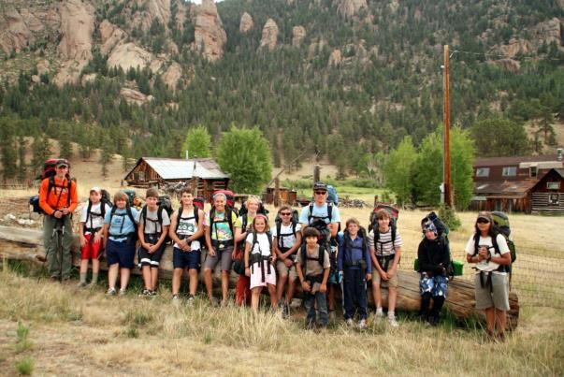
summer camp

Slide 5
Words and expressions
organize
camp
share
v. 组织
n. 露营；营地
v. 分享；合用

Slide 6
Phrases
1. a special two-week summer camp
一次特别的为期两周的夏令营
2. live in 住在
3. take part in 参加
4. experience a new life 体验一种新的生活
5. write down 写下
6. all of 所有
7. share sth. with sb. 与某人分享某物
PPT模板：www.1ppt.com/moban/ PPT素材：www.1ppt.com/sucai/
PPT背景：www.1ppt.com/beijing/ PPT图表：www.1ppt.com/tubiao/
PPT下载：www.1ppt.com/xiazai/ PPT教程： www.1ppt.com/powerpoint/
资料下载：www.1ppt.com/ziliao/ 范文下载：www.1ppt.com/fanwen/
试卷下载：www.1ppt.com/shiti/ 教案下载：www.1ppt.com/jiaoan/
PPT论坛：www.1ppt.cn PPT课件：www.1ppt.com/kejian/
语文课件：www.1ppt.com/kejian/yuwen/ 数学课件：www.1ppt.com/kejian/shuxue/
英语课件：www.1ppt.com/kejian/yingyu/ 美术课件：www.1ppt.com/kejian/meishu/
科学课件：www.1ppt.com/kejian/kexue/ 物理课件：www.1ppt.com/kejian/wuli/
化学课件：www.1ppt.com/kejian/huaxue/ 生物课件：www.1ppt.com/kejian/shengwu/
地理课件：www.1ppt.com/kejian/dili/ 历史课件：www.1ppt.com/kejian/lishi/

Slide 7
Language points
1. I’m going to read storybooks to young
children. 我打算给小孩们读故事。
read sth. to sb.=read sb. sth. 给某人读某物。注意翻译时与汉语的区别，“看书”不能用see，也不能用look at。类似的有：
read newspapers看报纸; read a map查阅地图; watch TV看电视; read a letter看信。

Slide 8
2. I want to keep learning.
我想一直学习。
keep doing sth.一直做某事。keep后跟动词时一定要用现在分词的形式，类似的有：
finish doing sth.做完某事；enjoy doing sth.享受做某事；practice doing sth.练习做某事；have fun doing sth.做某事快乐。

Slide 9
3. Ms. Liu never wants to stop learning.
刘老师从不想停止学习。
stop v. 停止; 终止
I’m tired. Let’s stop to have a rest.
我累了。让我们停下来休息一下。

Slide 10
【探究总结】stop的用法小结
(1) stop doing sth. 停止做（正在做的）某事
(2) stop to do sth. 停下来（现在的事）去做另一件事
(3) stop sb. (from) doing sth.
=keep sb. from doing sth.
=prevent sb. (from) doing sth.
阻止某人做某事
（注意keep短语中的from不能省略）

Slide 11
【学以致用】
①James, it’s nine o’clock. Don’t watch TV. Let’s stop _______.
A. go to bed B. to go to bed
C. going to bed D. goes to bed
②Stop _______. It’s time to go to sleep.
A. to talk B. talk
C. talking D. to talking
B
C

Slide 12
4. It’s important to keep learning.
坚持学习是重要的。
It’s+adj. +to do sth. 做某事是……的。
It’s difficult for me to solve the problem.
对我来说解决这个问题是困难的。
It’s very nice of you to help me.
你帮助我真好。

Slide 13
【探究总结】
(1)句型“It’s+adj. +to do sth. ”，其中it作形式主语，真正的主语是后面的动词不定式。
(2)注意句型It’s+adj. +for/of+sb. to do sth. 中介词for和of的不同。若形容词是与人的品质、性格等相关的词，如clever，foolish，kind等用of。若形容词是描述事物的性质、特征，如important，dangerous，difficult等，则用for。

Slide 14
【学以致用】
①It’s very kind _______ you. Thank you for your help.
A. of B. for C. to D. on
②解决这个问题对他来说是容易的。
It’s ______ ______ him ______ solve this problem.
A
easy for to

Slide 15
Exercises
Ⅰ. 用所给词的适当形式填空
1. Do you have any ________ (plan) for this summer?
2. I ___________ (volunteer) for three months if I have time.
plans
will volunteer

Slide 16
excited
3. We are all _______ (excite) about the news.
4. Please stop _________ (smoke) here. It’s not allowed.
5. It’s important to keep ________ (work).
smoking
working

Slide 17
Ⅱ. 单项选择
1. There is _______ university in our city.
A. a B. an C. the D. /
2. Keep _______ it, and you will succeed in the
end.
A. try B. to try C. trying D. tried
A
C

Slide 18
3. —What are we going to do on Sunday?
—How about ____?
A. to go bike riding B. going bike to ride
C. going to bike riding D. going bike riding
4. —Dad, why should I stop ____ computer games?
—For your eyes, my boy, I’m afraid you ____.
A. to play; must B. playing; have to
C. to play; can D. playing; may
D
B

Slide 19
B
5. —Is it important ____ me ____ English well, John?
—Yes, of course. English is widely used in the world.
A. for; learning B. for; to learn
C. of; learning D. of; to learn

Slide 20
Homework
Are you looking forward to the summer holiday?
What are you going to do for the summer?
Write down and share with your classmates.

Slide 21
Thank you!

