Slide 1
Unit 4 Where's my schoolbag?
Section A (1a～1c)
WWW.PPT818.COM

Slide 2
1．方位介词on，in，under的用法
on，in，under三者都是方位介词，后跟名词或代词构成介词短语，表示所处的不同位置。
(1)on“在……上”，指一物体在另一物体的表面上。
(2)in“在……里面”，指一物体在另一物体的内部。
(3)under“在……下”，指一物体在另一物体的正下方，两物体不接触。
表示某物或某人在某方位时，常用句型为：主语(人或物)＋am/is/are＋介词短语(表地点)。

Slide 3
2．Where's my schoolbag？我的书包在哪？
这是由where放在句首引导的特殊疑问句。where是特殊疑问词，意为“在哪儿，在哪里”，用来询问某人或某物所在的位置。句型结构为：Where＋is/are＋主语(人或物)？意为“某人或某物在哪儿？”回答时不用yes或no，应用句型：主语＋is/are＋表示地点的介词短语。主语一般用it(he，she)或they来代替问句中的单数或复数主语。

Slide 4
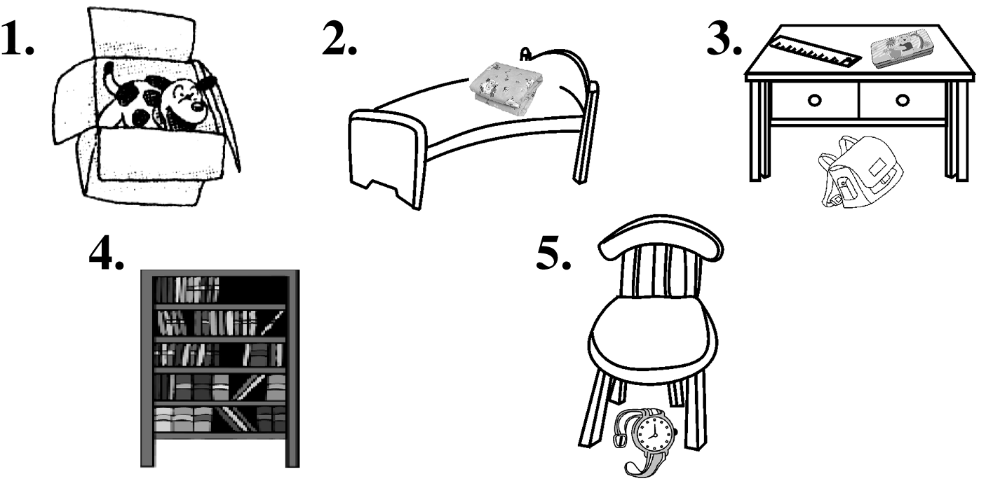
一、根据句意及图示，用恰当的介词填空。
1．The dog is _____the box.
2．The quilt is ____the bed.
3．Bob's pencil box is ___the desk and his schoolbag is ______the desk.
4．Her books are _____the bookcase.
5．Lily's watch is _______the chair.
in
on
on
under
in
under

Slide 5
二、单项选择。
6.—Where are your books?
—______ on the sofa.
A．It's B．They
C．They're D．It
7．—Are the erasers in the box?
—No，______．
A．it isn't B．it is
C．they aren't D．they are
C
C

Slide 6
8．—______ is my watch?
—It's on the desk.
A．How B．Where
C．Who D．What
9．—Where are her ______？
—______ are on the table.
A．key，It B．keys，They
C．keys，It D．key，They
B
B

Slide 7
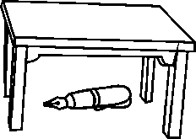
10.—Where is your pen?
—It's ______ the desk.
A．in B．of
C．under D．on
C

Slide 8
三、根据句意及汉语提示完成句子。
11．Is her dictionary _________________(在沙发下)?
12．—Where are my books?
—They're __________________(在课桌内)．
13．Your _____________(电脑游戏) is _______________(在书柜上)．
14．—Where's my pen?
—It's ________________(在椅子上)．
15．—Where is my schoolbag?
—It's ___________________(在床上)．
under the sofa
in the desk
computer game
on the bookcase
on the chair
on the bed

Slide 9
四、按要求完成句子。
16．The computer is on the table.(改为一般疑问句)
_____the computer ________the table?
17．His keys are in_the_bag．(对画线部分提问)
__________his keys?
18．The_key is on the table.(对画线部分提问)
___________on the table?
19．The ruler is in the pencil box.(改为一般疑问句)
___________in the pencil box?
20．Is it in your bag？(作否定回答)
________，it _______．
Is
on
Where are
What is
Is the ruler
No
isn't

Slide 10
A→Where
A→Excuse me
B→keys

Slide 11
C→your
C→sofa

