Slide 1
Unit 1 Past and Present
Integrated skills
WWW.PPT818.COM

Slide 2
Learning aims:
1. Learn to get some information about the changes to Starlight Town from listening.
2. Make some notes and finish the diary.
3. Learn to talk about the past and present.

Slide 3
Revision
写出下列动词的过去式和过去分词:
be
give
see
make
put
come
write
was/were been
gave given
saw seen
made made
put put
came come
wrote written

Slide 4


动 词 填 空：
1._____ you ________(clean) the room?
Yes, we __________(do) that already.
When _______ you ______(do) it?
We _______(do) it an hour ago.
2.______ he ______(see) this film yet? Yes.
When _____ he _____(see) it?
He ______ it last week.
3. How many times _____you______(be) there?
Have
cleaned
have done
did
do
did
Has
seen
did
see
saw
have
been
上一页
下一页

Slide 5

have read
4. I ________ (read) the novel twice. It’s interesting.
5. She _________(go) to Pairs, hasn’t she? Yes.
How ______ she _______(go) there?
She _______(go) there by air.
6. So far, many countries _______________(develop)
their software programs.
7.Mr Chen ______(give)up smoking last year.
8.Mr Chen __________(give) up smoking
since last year.
has gone
did
go
went
have developed
gave
has given
上一页
下一页

Slide 6

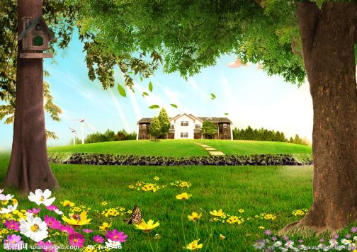
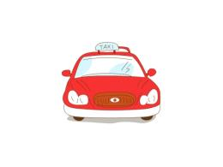
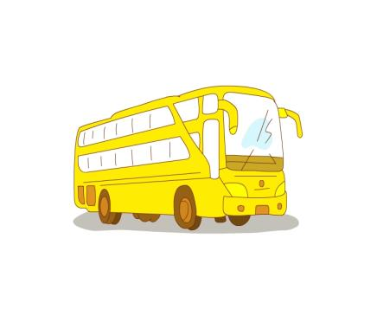
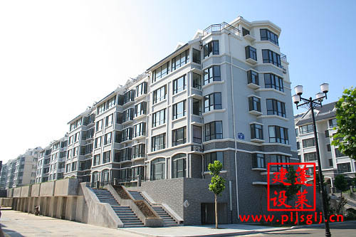
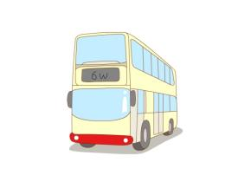
Lead-in
environment
move into new flats
living conditions
transport

Slide 7
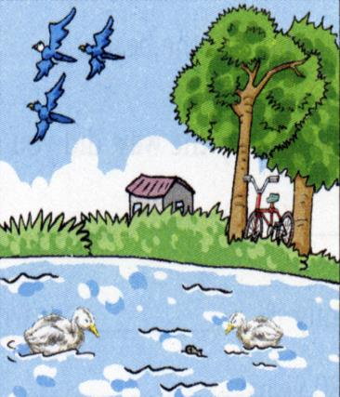
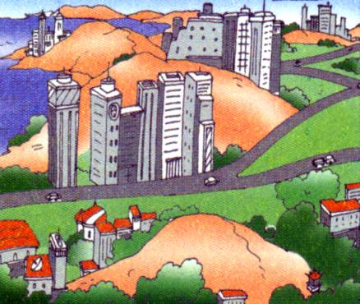
Changes in Starlight Town
Pre-task :
Look and say
Environment
Transport
Living conditions

Slide 8
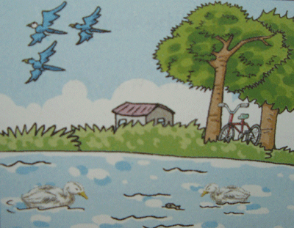
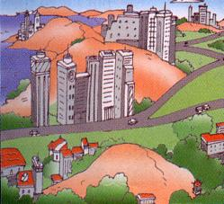
While –task
Task1: Listen and finishA1、A2
Past
1 Environment: green ____ clean and fresh ____, wild ____ near the lake
2 Transport: bus and ____
3 Living conditions: old _____
Present
1 Environment: smaller ____ , new ____ station, tall ____ and new roads.
2 Transport : bus, taxi and ____
3 Living conditions: new ____
Tip: Guess before listening

Slide 9
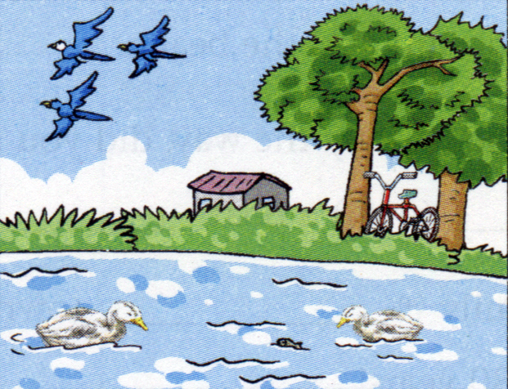
Past
hills
1 Environment: green ____ , clean and fresh ____, wild ____ near the lake
2 Transport: bus and ____
3 Living conditions: old ____
air
birds
bicycle
houses

Slide 10

Present
1 Environment: smaller ____ , new ____ station,
tall ____ and new
roads.
2 Transport : bus, taxi and ____
3 Living conditions: new ____
lakes
railway
buildings
train
flats

Slide 11
Task2: Ask and answer in pairs
A: What was the environment like in the past in Starlight Town?
B: There were green hills, clean and fresh air···what about the environment now?
A: Now the lakes become smaller, and there is a railway station, tall building and new flats.
B: Oh, it has changed a lot over the years/a lot of changes have taken place here.

Slide 12
Task3: Finish the exercises in A3.
Kitty is writing about Starlight Town in her diary. Complete her diary entry on the next page with the words in the box.
air bicycle birds buildings flats
hills houses modern railway taxi

Slide 13
Complete Kitty’s diary
13 February
Dear Diary,
Today, I borrowed a book about Starlight Town’s past and present. Starlight Town was very beautiful years ago. There were green _______ and wild _______ near the lake. The _______ was clean and fresh then.
Now it has become a _______ town. There is a new_______ station. There are some new roads
hills
birds
air
modern
railway

Slide 14
too. people can now travel to and from the town by bus ____, or train, but in the past, people could only travel by bus or ______. Another big change is the many tall _______ in the town. Local people used to live in old _______, but now, most of them have moved into new _______.
Starlight Town has changed a lot over the years. I hope I can visit it again.
taxi
bicycle
buildings
houses
flats
Read it loudly.

Slide 15
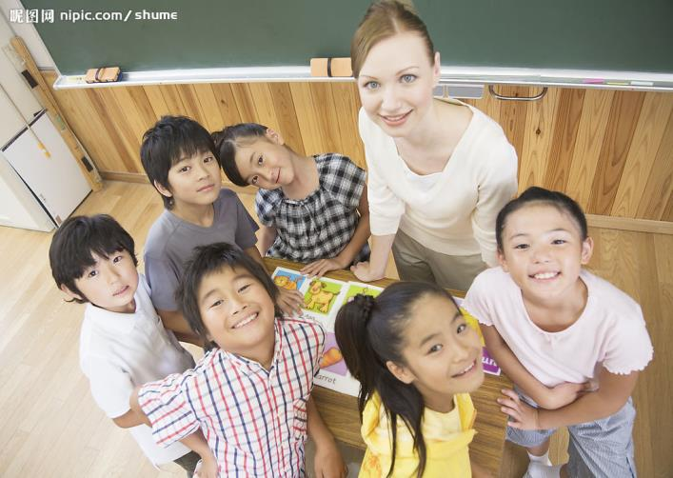
go abroad
Some of my classmates at primary school

Slide 16


Keep in touch with each other
Mainly communicate by email
The Internet makes communication easier

Slide 17
Task4: Listen and answer some questions.
1. Where has Becky just returned from?
2. When did they last see each other?
3. How do they keep in touch with each other?
And why?
She's just returned from the USA
Last week.
They mainly communicate by email.
Because the Internet makes communication
much easier.

Slide 18
Task 5:Discuss important phrases
return from the USA,
last saw each other,
go abroad,
since then,
at primary school,
keep in touch with each other,
mainly communicate by email,
make communication much easier,
exactly

Slide 19
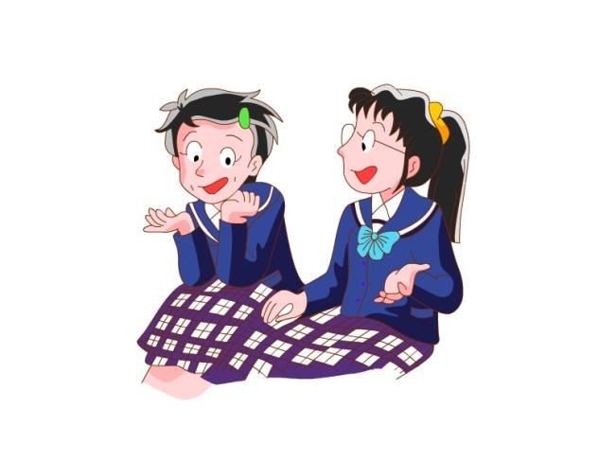
Task 6: Read and act
Read and act.

Slide 20
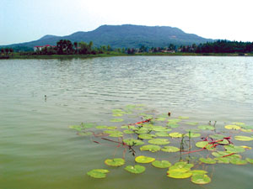









Task9: Group work:
Talk about the changes around us.
Watch and say
a place of natural beauty
wild birds
on foot,
by bike,bus,
by taxi, coach, plane, double decker, train
a new railway station
new buildings,
new flats
live a happy life

Slide 21
Step4:Post-task
Task 1: Exercises in class (Finish【课堂训练】
in the learning paper in 10 minutes)
Task2: Feedback what we have learnt today

Slide 22
一.1.fresh air
2.environmet and living conditions
3.live in a village
4.wild birds near the lake
5.move into new flats
6.new railway station
7.over these years 8.since then
9.return from the USA=come back from the USA
10.mainly communicate by email
11.at primary school
12.make communication easier
13. go abroad
14.keep in touch with each other

Slide 23
二.1. environment 2.return 3.condition 4.abroad
5.primary 6.impossible 7.northern 8.to have
9.pollution 10.amazing 11.has taught 12.live
13.to protect 14.to wait 15.has eaten
三.1. haven't changed
2. Has, finished, yet,has, hasn't
3.got married
4.used to play
5.How long have
6.haven't
7.has

Slide 24
Homework:
1.Finish off the homework left in the learning paper.
2.完成《学习与评价》第5课时。

Slide 25
ByeBye!

