Slide 1
Unit 9
What does he look like?
Section B 第2课时
WWW.PPT818.COM

Slide 2
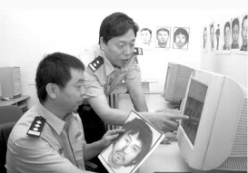
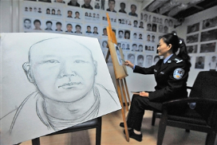
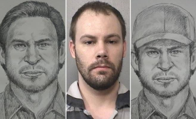
New
words
criminal
罪犯
police artist
警察画像师

Slide 3
put
each
way
describe
放
每个；各自
方式；路线
描述

Slide 4
differently
another
end
real
不同地
另一；又一
结尾；尽头
真正的；真实的

Slide 5
Lead-in
Introduce your friend and draw a picture of him/her.
(What does he / she look like?)

Slide 6
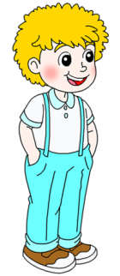
young
thin
of medium height
big eyes and round face
has curly blond hair
…

Slide 7
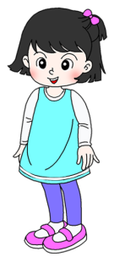
young
of medium build
of medium height
big eyes and small mouth
has straight black hair
…

Slide 8
Complete the chart with words of the opposite meaning.
2a
young
 | thin
tall
 | long
curly
old
heavy/ fat
short
short
straight

Slide 9
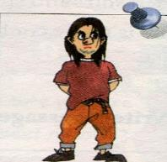
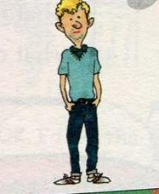
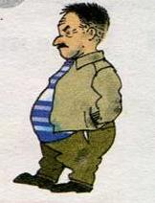
Fast Reading
Task 1
Who is the real criminal?
A
B
C
He’s the
real criminal.

Slide 10
Careful Reading
Task 2
Read the first paragraph
and fill in blanks.
interesting
1. Joe Brown has an __________ job.
2. He’s a______________ .
3. He draws_______________________.
police artist
pictures of criminals

Slide 11
Read the second paragraph and answer: What does the criminal look like?
Oh,
I forget!
A
B
C

Slide 12
What does the criminal look like?
He is of medium height and young.
He has long straight brown hair and big eyes.

Slide 13
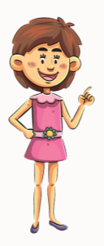
What does the criminal look like?
He is tall and thin, and he has curly blond hair. He’s about thirty years old.

Slide 14
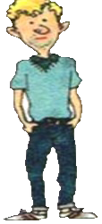
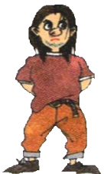
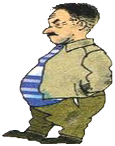
Task 3
Read the newspaper article. Which picture shows the real criminal?
2b

Slide 15
An Interesting Job
Joe Brown has a very interesting job. He is a police artist. Some people see crimes and then talk to Joe. They tell him what the criminal looks like. Then Joe draws a picture of the criminal, and the police put it in newspapers and on television to find him.
宾语从句
语序为陈述句
可数名词
罪犯
a picture of…
一幅……的画

Slide 16
He wants to draw a good picture of each criminal, but this job is sometimes difficult. Many people don’t always see things the same way so they may describe the same person differently. Also, they don’t always remember well. “The criminal is of medium height and young. He has long straight brown hair
因此，引导并列从句

Slide 17
and big eyes,” says one woman. Another woman says, “He is tall and thin, and he has curly blond hair. He’s about thirty years old.” In the end, the real criminal is a short and heavy old man, and he has short black hair!
大约

Slide 18
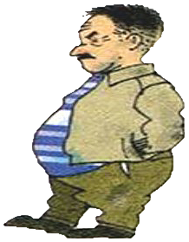
the real criminal
short
heavy old man
short black hair

Slide 19
Read the article carefully then answer the questions below.
Task 4
1. What does Joe Brown do?
He’s a police artist.
2. Is his work easy or difficult? Why?
Sometimes it’s difficult. Because many people don’t always see things the same way so they may describe the same person differently. Also, they don’t always remember well.

Slide 20
3. What do you think of Joe’s job?
It’s interesting, but sometimes it’s difficult.
4. Can you describe Joe’s job in other words?
It’s fun/boring/easy/good/cool/important/…
5. Do you want to be a police artist?
Yes, I do. / No, I don’t.

Slide 21
The best witness
Task 5
Suppose you have witnessed a thief robbing money from a bank. Now a policeman is asking you some questions about the features of the thief. How will you describe the thief?

Slide 22
Read the article again and write what the words in bold refer to.
2c
1. He =_________________________________
2. it = _________________________________
3. him = ________________________________
4. this = ________________________________
5. they =________________________________
________________________________
6. He = ________________________________
Joe Brown
the picture of the criminal
the criminal
drawing a good picture of each criminal
many people (who see and describe the criminals)
The criminal

Slide 23
Language points
1. Joe Brown has a very interesting job.
乔·布朗有一份非常有趣的工作。
interesting | fun
“有趣的”，强调事物本身“有趣”
“有趣的”，有“供人娱乐的、令人愉快的”意思
interesting
His hobby is very ___________.
I like monkeys best because they are very _____.
fun

Slide 24
2. Some people see crimes and then talk to Joe.
一些人目睹犯罪,然后跟乔描述。
talk to
talk with
talk about
“和……谈话”，强调一方说，另一方听，to 表示方向。
“和……谈话”，强调双向交流。
“谈论”，涉及谈话内容和具体情况。

Slide 25
talk to talk with talk about
1. She is sad. She wants to __________ her friend.
2. We don’t often __________ my teacher.
3. They are ____________ the film.
talk to
talk with
talking about

Slide 26
3. Many people don’t always see things the same way so
they may describe the same person differently.
人们并非总是以相同的方式看待事物，所以他们会
将同一个人描述得不一样。

Slide 27
same在此句中作形容词，意为“相同的，同一个的”, 用于名词前, same一般和the连用。
此句是一个由so连接的并列句,so在此句中作连词，意为“因此，所以”。
例:她觉得很累，因此她很早就上床睡觉了。
She felt very tired so she went to bed early.

Slide 28
way此处用作可数名词，意为“方式，方法”，
常与介词in连用。如果way前有 this, that等限定
词，介词in可省略；但放在句首时，介词in不
可省略。
常用短语: by the way
in the way
on the way
顺便说一下
挡路
在路上

Slide 29
4. In the end, the real criminal is a short and heavy old
man, and he has short black hair!
最后，真正的罪犯是一位又矮又胖的老年人，他留
着黑色的短发！
in the end:最后；终于 反义短语: at first
=at last / finally
at the end of… 在……的尽头，结尾

Slide 30
Exercise
1. —I really like to watch the TV program I AM A SINGER.
—Me, too. It’s one of the _____ TV programs I’ve ever
seen.
A. least boring B. least interesting
C. most boring D. most interesting

Slide 31
2.The man with _____ hair is a musician.
A. long curly brown B. long brown curly
C. curly long brown D. brown long curly
3.—Would you like _____ cake?
— I’m full, thank you.
A. other B. the other C. another D. others

Slide 32
4. If you have any problem, you can _______ me.
A. say B. speak C. talk to D. talk about
5. —Excuse me，could you please tell me ______？
—Sure. It’s about ten minutes’ walk.
A. how long it takes to go to the zoo
B. how far it is from here to the zoo
C. how far from here to the zoo
is it

Slide 33
6. Diana isn’t here，_______ leave a message on her desk.
A. or B. so C. and D. but
7. You can use _______ to learn English well as him.
A. different B. different ways
C. same way D. the same ways

