Slide 1
Unit2 This is my pencil.
人教精通版三年级上册
WWW.PPT818.COM

Slide 2
Review
I say you do
Show me your pen.

Slide 3
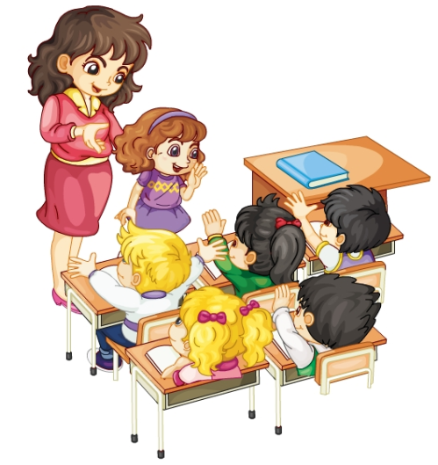
Review
Role-play
Good morning, boys and girls! This is Lisa.
Good morning!
Welcome!
Welcome!
Welcome!
Welcome!
Welcome!

Slide 4
Lead-in
Look and guess
What’s this?
It’s my English book.

Slide 5
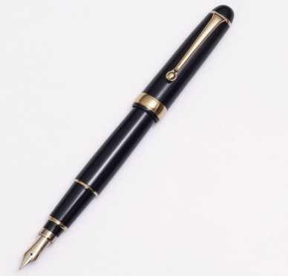
Lead-in
Look and guess
What’s this?
It’s my pen.

Slide 6
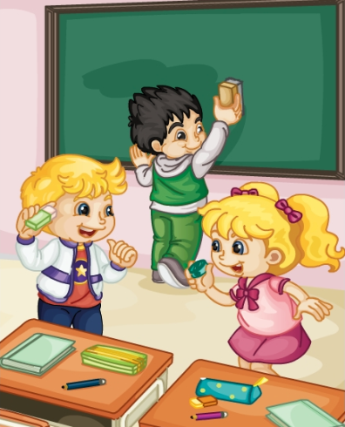
Presentation
Listen and say
听一听，Kate和Peter他们说了什么？
Hi, Kate! This is my eraser.
Hi, Peter. This is my sharpener.

Slide 7
Presentation
Listen and imitate
Hi, Kate! This is my eraser.
Hi, Peter. This is my sharpener.

Slide 8
Show time
两人一组，练习对话并表演，其他同学评价。
 | 模仿录音中的语音语调，有感情地朗读。
 | 可以脱离课本，适当改动其中部分，语音地道。
 | 适当添加内容，意思完整，有创新，表演生动。
Good
Great
Excellent

Slide 9
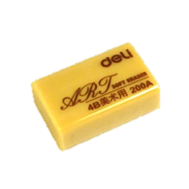
Presentation
Just learn
eraser
This is my eraser.

Slide 10
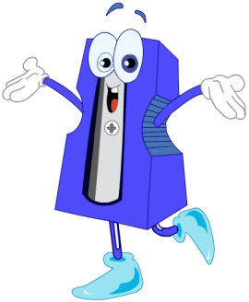
Presentation
Just learn
sharpener
This is my sharpener.

Slide 11
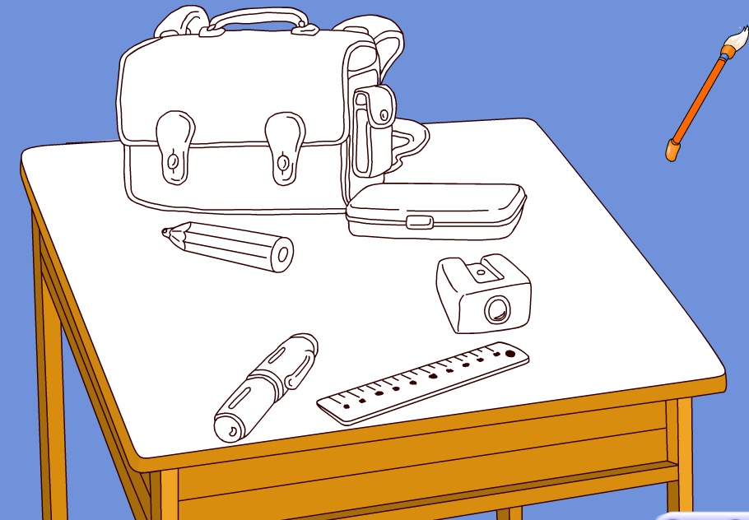
Practice
Draw and say
This is my …

Slide 12
Practice
Touch and guess
What’s in the bag?
It’s a ….

Slide 13
Practice
Let’s sing

Slide 14
Consolidation
Look and match
pen
ruler
pencil
sharpener
pencil-box
eraser

Slide 15
Summary
本课学到的学习用品类单词有:
eraser
sharpener

Slide 16
Summary
如何向别人介绍自己的学习用品？
This is my ….

Slide 17
Homework
1. 跟读Just talk部分的课文录音，并注意语音、语调。
2.学唱本课Let’s sing部分的歌曲，并唱给你的父母听。
3. 预习Lesson11。
Close

