Slide 1
Lesson Two
Unit 7
I’m writing an email.
WWW.PPT818.COM

Slide 2
Let’s sing :
I’m singing, I’m singing. What are you doing ?
I’m dancing, I’m dancing. What are you doing?
I’m reading, I’m reading. What are you doing ?
I’m writing, I’m writing. What are you doing ?

Slide 3
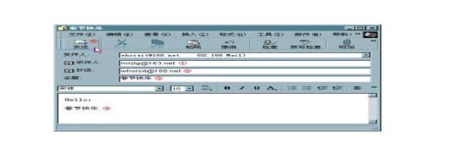
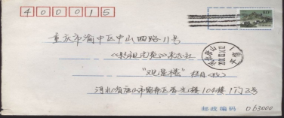
What is Li Ming writing ? ( )
A
A: an email
B: a letter

Slide 4
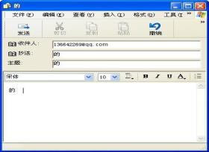
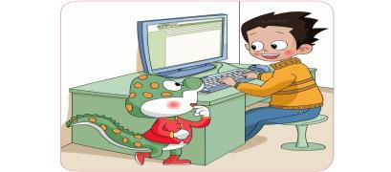
write an email
an
email
white kite
I’m writing an email.

Slide 5
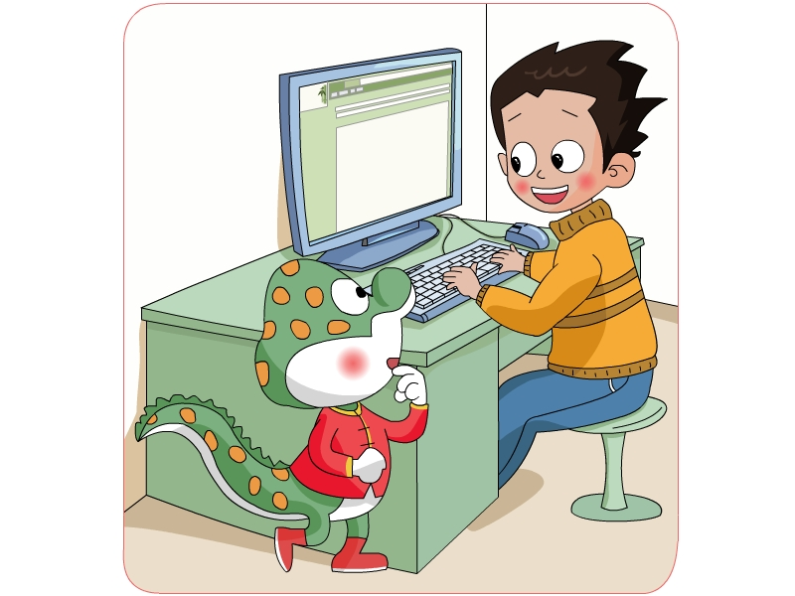
I'm wrting an email to Tom.
Pair work:
What are you doing ?

Slide 6
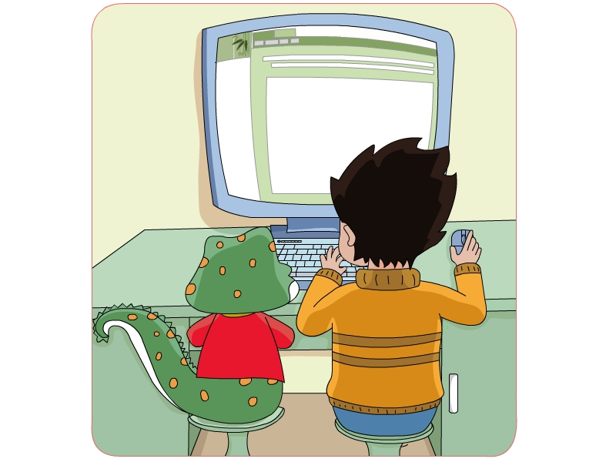
May I have a look ?
Sure.

Slide 7
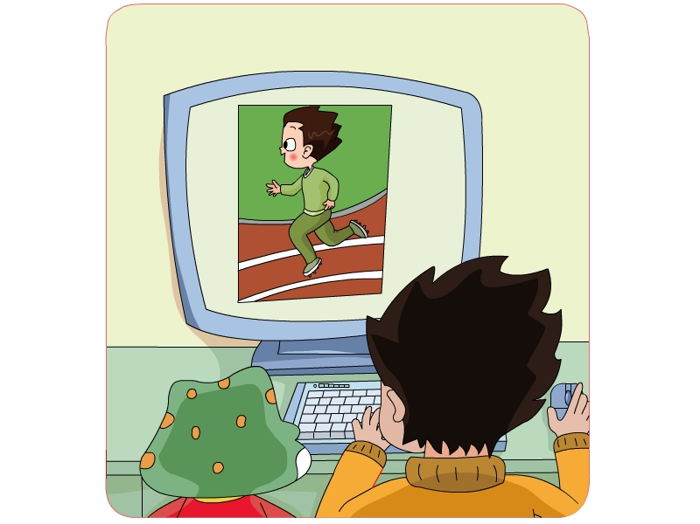
I'm running.

Slide 8
Can Tom see the pictures? ( )
A.Yes, he can .
B.No,he can't.

Slide 9
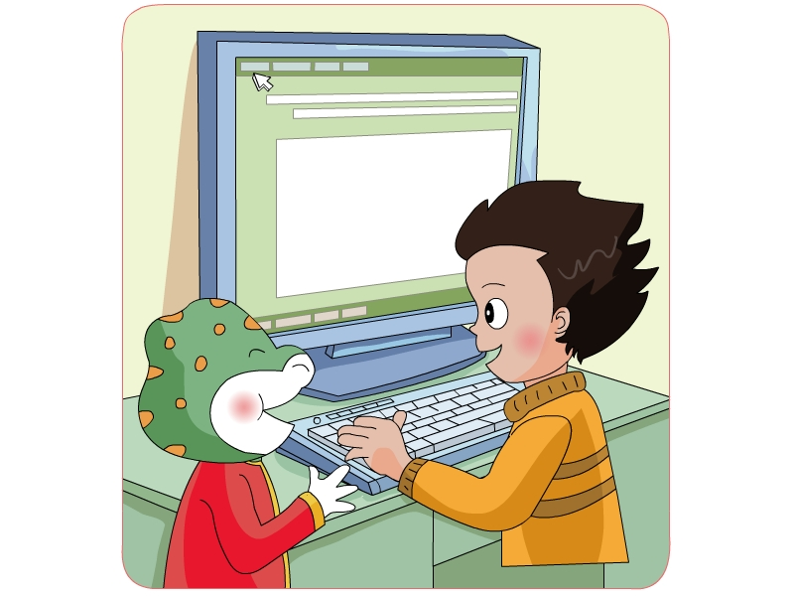
Yes, he can.
Can he see the pictures?

Slide 10
Can he see the pictures? ( )
A
A.Yes, he can .
B.No,he can't.

Slide 11
Pair work:
Danny: What are you doing ?
Li Ming: I'm writing an email to Tom.
Danny: May I have a look?
Li Ming: Sure. I'm running.
Danny: Can he see the pictures?
Li Ming: Yes,he can.

Slide 12
Role play:
Danny: What are you … ?
Li Ming: I'm … to Tom.
Danny: May I have a look?
Li Ming: ….
Li Ming: I'm ….
Danny: Can he see the pictures?
Li Ming: Yes,he ….

Slide 13
Group work (Choose say and do )
Ss: What are you doing ?
What are you doing ?
S : I’m ….

Slide 14
Let’s talk:
(1)
(2)
A: What are you doing ?
B: I'm reading a book.
A: May I have a look?
B: Sure.
A: What are you doing ?
B: I'm writing an email to Li Ming.
A: Can he see the picture?
B: Yes, he can.

Slide 15
summary
Let’s rechant :
I’m running, I’m running. What are you doing ?
I’m writing, I’m writing. I’m writing an email.
I’m running, I’m running. What are you doing ?
I’m writing, I’m writing. I’m writing an email.

Slide 16
Home work
1.Follow the tape, pay attention to your pronunciation and intonation.
2. Write an email to your parents/teachers/friends, and give them your best wishes.

