Slide 1
Unit 4 A good read
WWW.PPT818.COM

Slide 2
Words review
read
cooking
novel
Germany
knowledge
spare
French
writer
ugly
touch
n. 读物
n. 烹饪，烹调
n. 小说
n. 德国
n. 知识
adj. 空闲的；多余的
adj. 法国（人）的
n. 作者，作家
adj. 丑陋的
vt. 感动，触动

Slide 3
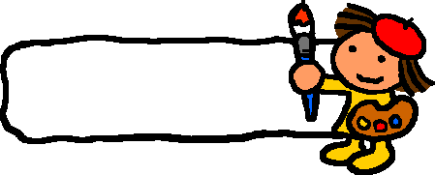
Free Talk
Do you like reading in your spare time?
What books have you read recently?

Slide 4
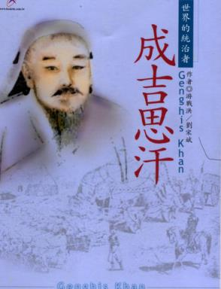
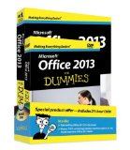
What type of book is this?
computer
history

Slide 5
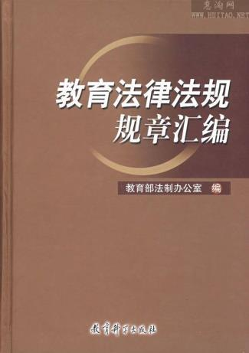
What type of book is this?
law
cooking

Slide 6
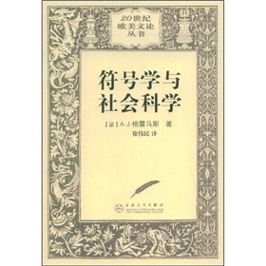
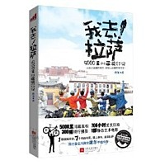
What type of book is this?
science
travel

Slide 7
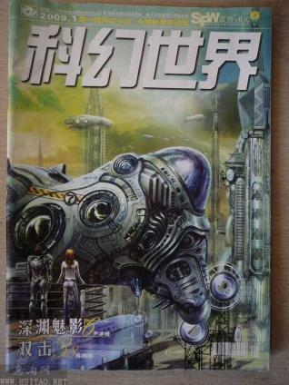
What type of book is this?
health
fantasy

Slide 8
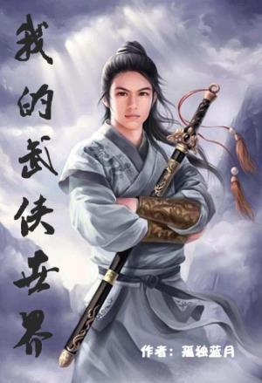
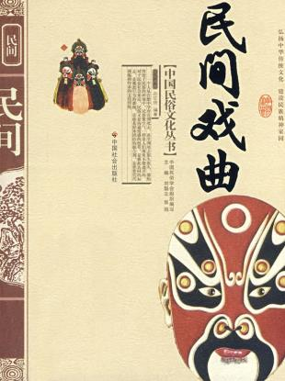
What type of book is this?
play
novel

Slide 9
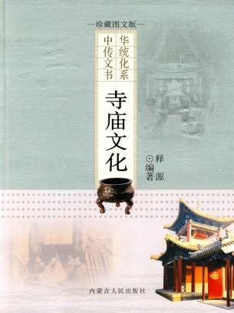
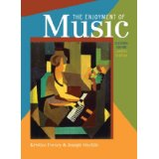
What type of book is this?
culture
music

Slide 10
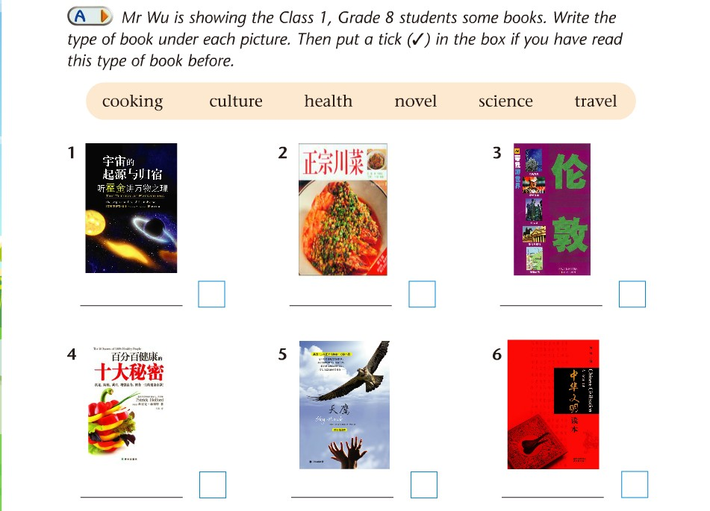
science
cooking
travel
health
novel
culture

Slide 11
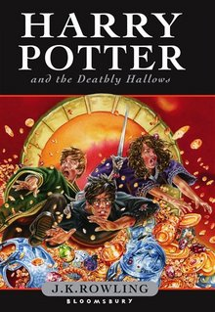
Have you ever read this type of book?
(1)What is the title of the book?
(2)What is the book about?
(3)Do you like the book? Why／Why not?

Slide 12
Sandy and Daniel are talking about what they like to read. Listen to their conversation and answer the questions.
What is Daniel’s favourite type of book? Why?
What is he reading now?
He likes history books best. They improve his knowledge of the past.
He is reading a book about Germany in World War II.

Slide 13
What does Sandy like to read?
What book does she think is great? Why?
She likes reading novels and plays.
The Hunchback of Notre Dame by the French writer Victor Hugo. The story of the ugly man Quasimodo really touched her.

Slide 14
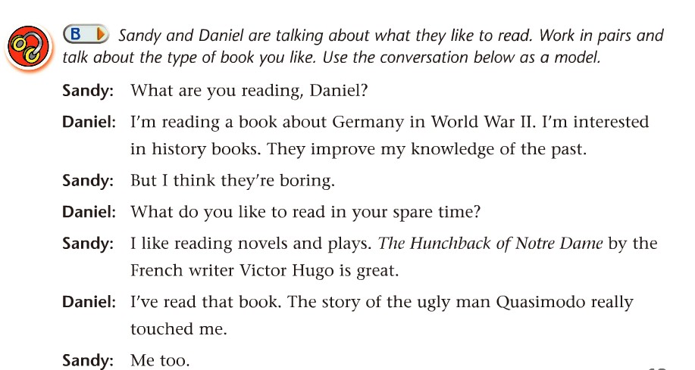

Slide 15
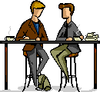
Talk
Work in pairs and ask each other what you like to read and why you like it. Use Sandy and Daniel’s conversation as a model.

Slide 16
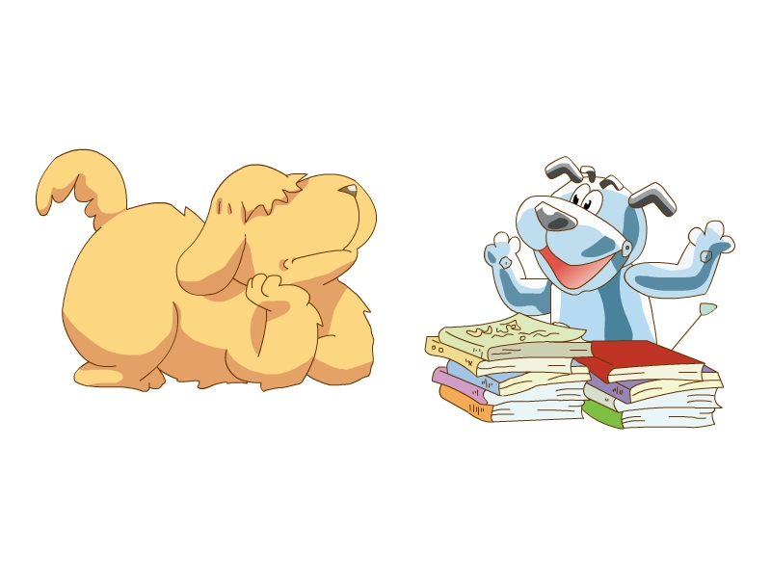
Does Eddie like reading too?

Slide 17
Questions
What did Eddie do after Hobo gave
the books to him?
2. What did Hobo think?
3. Does Eddie really love reading?
He used them to reach the box on the fridge.
He thought that Eddie liked reading books.
No, he does not.

Slide 18
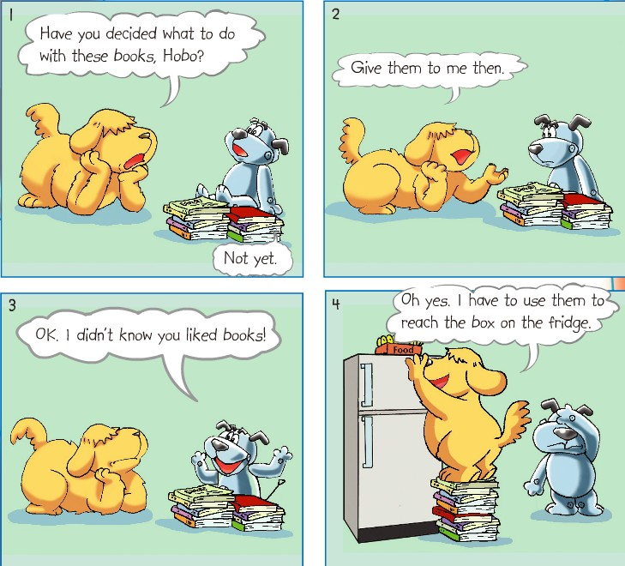

Slide 19
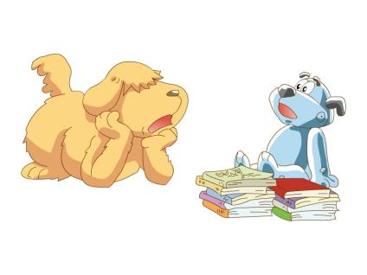
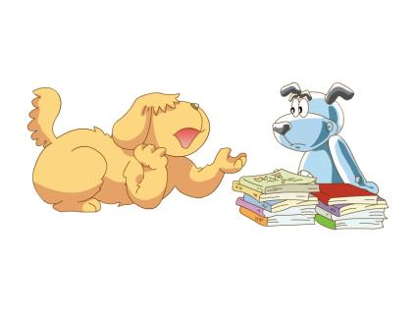
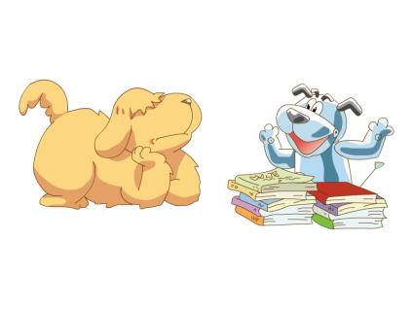
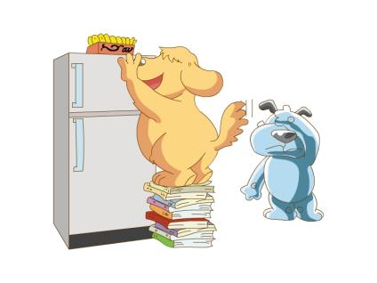

Slide 20
Fill in the blanks.
Eddie asks Hobo ______ ____ ____ with the books. Hobo has not ________ ____. Eddie asks Hobo to give the books to him. Eddie feels __________ because he did not know that Eddie _____ books. In fact, Eddie wants to use the books to ______ the box on the fridge.
what to do
decided yet
surprised
liked
reach

Slide 21
Language Points
Have you decided what to do with these books, Hobo?
句中“疑问词what + 动词不定式”结构作宾语。该结构中的疑问词还可以用when、how、which等。如：
He doesn’t know how to get there.
他不知道如何去那儿。
更多内容详见本单元语法课。

Slide 22
Language Points
The Hunchback of Notre Dame by the French writer Victor Hugo is great.
《巴黎圣母院》是法国作家维克多·雨果(1802-1885)创作的浪漫主义小说，叙述的是一位从小生活在巴黎圣母院钟楼的敲钟人卡西莫多(Quasimodo)的故事。卡西莫多天生身形与长相都异于常人，只能独自在钟楼过着与世隔绝的生活，直到在一场嘉年华会上遇到了吉卜赛女郎艾斯美拉达(Esmeralda)，他的世界才开始发生变化。

Slide 23
Homework
1记忆词汇、词组和句型。
2熟读Comic strip和B部分的对话, 能力较强的学生背诵。
3完成教师布置的相关练习。
4预习Reading, 让学生提前熟悉《格列佛游记》的故事情节或观看电影《格列佛游记》。

