Slide 1
Unit6 Is this your skirt?
人教精通版三年级下册
WWW.PPT818.COM

Slide 2
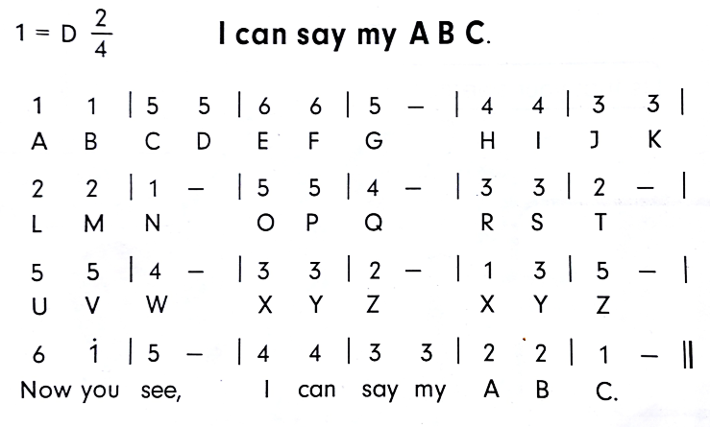
Review
Let’s sing

Slide 3
Review
Game
What’s missing?

Slide 4
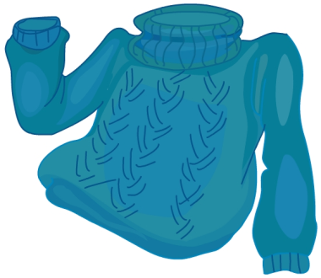
Presentation
Look and say
What’s this?
sweater

Slide 5
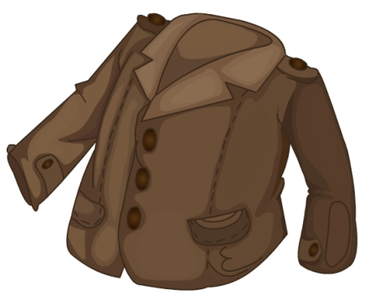
Presentation
Look and say
What’s this?
coat

Slide 6
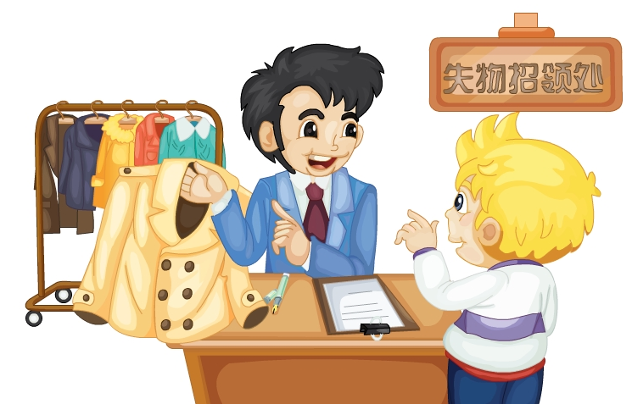
Presentation
Listen and say
What are they talking about?

Slide 7
Presentation
Let’s learn
Is this your coat?
Yes, it is.

Slide 8
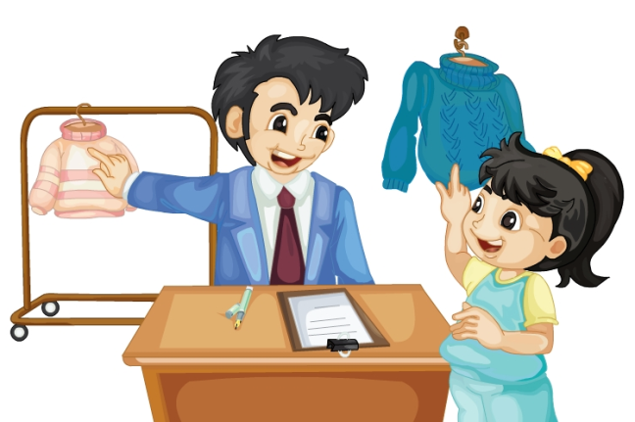
Presentation
Let’s learn
Is that your sweater?
No, it isn’t. This is my sweater.

Slide 9
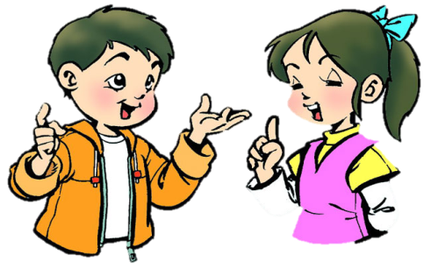
Practice
Role-play
分角色朗读对话，注意模仿语音语调。
两人一组，试着表演出来吧。

Slide 10
Practice
Read it by groups for one minute .
小组读对话一分钟。
一分钟倒计时
60
Learning tip :
50
10
10
四人一组，比赛读句子，看谁能在一分钟内读完，并且读得准确、流利！
20
20
40
30
30
开始

Slide 11
Presentation
Key points
Is this your vest?
Yes, it is.

Slide 12
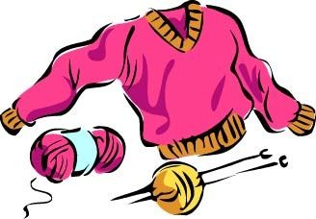
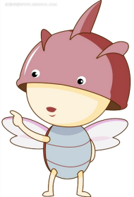
Presentation
Key points
Is that your coat?
No, it isn’t. This is my sweater.

Slide 13
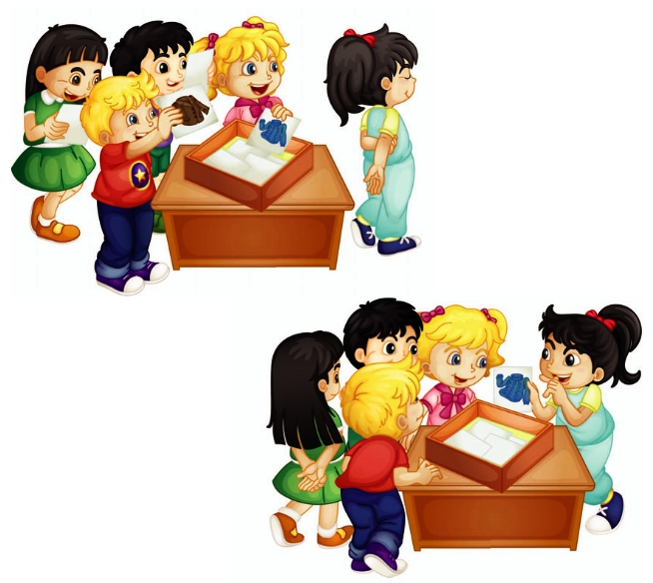
Practice
Let’s play
Is this your sweater?

Slide 14
Summary
本课学到的重点单词：
coat
sweater

Slide 15
Summary
本课学到的重点句型：
—Is this/that your …?
—Yes, it is.
—No, it isn’t.

Slide 16
Homework
1. 观看Just talk部分的课文动画，跟读对话并注意语音、语调。
2. 用本课所学句型 Is this your coat / sweater / watch / vest? 向自己的家人询问，并告知父母该句型的肯定和否定回答。
3. 预习Lesson 36。
Close

