Slide 1
Unit6 My Holiday
陕旅版
五年级下册
第一课时
WWW.PPT818.COM

Slide 2
>>Review
by bus by train by ship
Magic fingers
go home jump rope swim
play football sing songs fly a kite

Slide 3
>>Lead-in
Free talk
1. What are you going to do this evening?
2. What is your father going to do tomorrow morning?
3. What is your grandma going to do next Sunday?
4. What is your friend going to do next week?

Slide 4
>>Presentation
Let’s learn
I’m going to travel.
travel

Slide 5
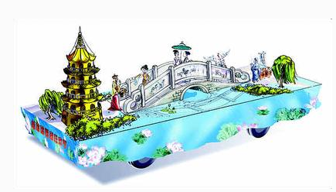
>>Presentation
Let’s learn
I’m going to visit the West Lake.
The West Lake

Slide 6
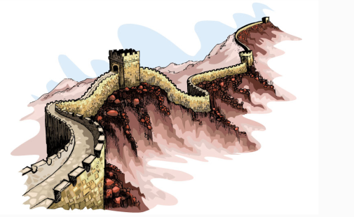
>>Presentation
Let’s learn
I want to visit the Great Wall, too.
It’s in Beijing.
the Great Wall

Slide 7
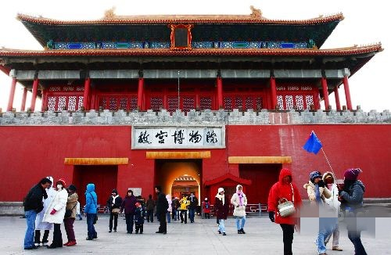
>>Presentation
Let’s learn
The Palace Museum is a famous place.
It’s in Beijing, too.
the Palace Museum

Slide 8
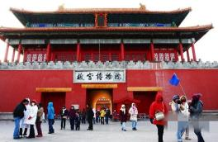
>>Presentation
Let’s learn
I’m going to visit the West Lake, the Great Wall and
the Palace Museum. I’m going to visit these three
places of interest.

Slide 9
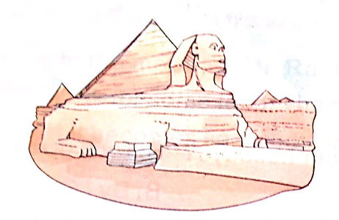
>>Presentation
Let’s learn
place of interest

Slide 10
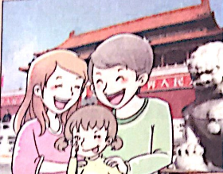
>>Presentation
Let’s learn
Look! I like to travel. I enjoy the visit.
Do you like to travel? Do you enjoy the visit?
enjoy the visit

Slide 11
>>Practice
Play a game
What’s missing?
travel
enjoy
the visit
place of interest
the Palace Museum
the Great Wally
the West Lake

Slide 12
>>Practice
Magic fingers

Slide 13
>>Summary
本课所学的重点单词：
travel enjoy the visit

Slide 14
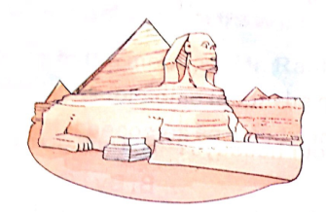
>>Summary
本课所学的重点单词：
place of interest the West Lake

Slide 15
>>Summary
本课所学的重点单词：
the Palace Museum the Great Wall

Slide 16
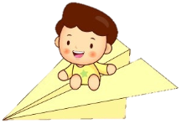
>>Homework
1.听课文录音并跟读，按照正确的语音、语调朗读并表演课文对话。 2.正确书写本课所学单词5遍，并让家人听写1遍。
3.预习A Let’s talk。
close

