Slide 1
Unit 8 It must belong to Carla.
Section A Period 1 1a-2d
WWW.PPT818.COM
Notes:
1
1

Slide 2
clothing | Fun things | Kitchen things
hat
volleyball
plate
jacket
cups
CD
T-shirt
toy car
magazine
book

Slide 3
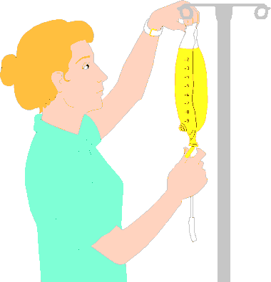
Look and say
What does she do?
nurse
She could/might be a/an______.

Slide 4
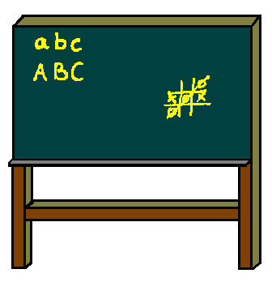
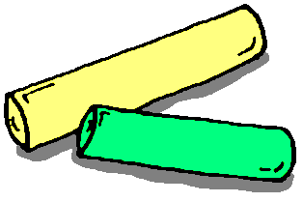
What does she do?
She could/might
be a/an ________.
teacher

Slide 5
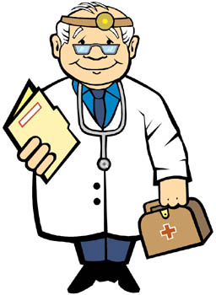
What does he do?
He could/might
be a/an ______.
doctor

Slide 6
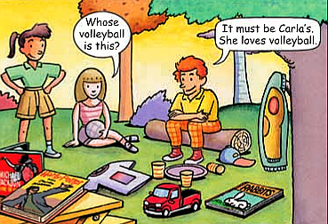
Look at the picture. Write the things you see in the correct columns in the chart.
1a

Slide 7
Listen and match each person with a thing and a reason.
1b
Person | Thing | Reason
Jane’s little brother | volleyball | J. K. Rowling is her favorite writer.
Mary | toy truck | She loves volleyball.
Carla | magazine | He was the only little kid at the picnic.
Deng Wen | book | She always listens to pop music.
Grace | CD | He loves rabbits.

Slide 8
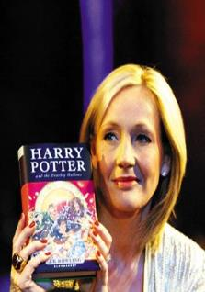
1c
Practice the conversation in the picture above. Then make conversations using the information in 1b.
A: Whose book is this?
B: It must be Mary’s. J. K. Rowling
is her favorite author.
此处must表示推断，通常与be连用，意为“一定是，肯定是”。 must这种表示推测的用法只用于肯定句中。

Slide 9
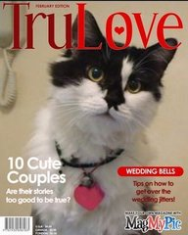
A: Look! Whose magazine is this?
B: It must belong to Deng Wen .
Because he loves cats.

Slide 10
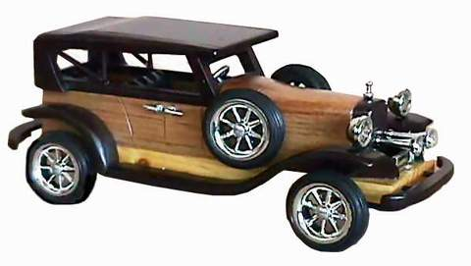
A: Look! Whose toy car is this?
B: It must be Jane’s little brother’s. Because he was the only little kid in the picnic.

Slide 11
2a
Bob and Anna found a schoolbag at the park. Listen and write down the things in the schoolbag.
Things in the schoolbag
1. ____________________
2. ____________________
3. ____________________
T-shirt
hair band
tennis balls

Slide 12
2b
Listen again. Fill in the blanks.
1. The person _____ go to our school.
2. The person _____ be a boy.
3. It _____ be Mei’s hair band.
4. The hair band ______ belong to Linda.
5. It _____ be Linda’s schoolbag.
must
can’t
could
might
must

Slide 13
Make conversations using the information in 2a and 2b.
2c
A: Look! There’s a schoolbag here.
B: What’s inside?
A: There’s a T-shirt,…

Slide 14
表示推测的情态动词
在英语中，表示对某件事物的确定程度，即表示推测的时候，我们通常会用到以下情态动词: must, might, could, may, can’t, couldn’t。

Slide 15
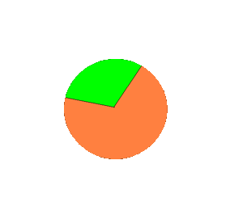
100%
probably true
must
could
might
20%-80%
possibly true
can’t
0
almost not true

Slide 16
Summary:
情态动词 must, might, could, can’t 后接动词原形， 可以表示对现在的情况的 。
推测
★
It can’t ( )…
It might/could ( ) …
It must ( ) …
不可能
有可能
+ be (cold/a CD/ sb’s)
肯定
be Tony’s.（是…的）
It must
★
belong to Tony. (属于…)

Slide 17
Role-play the conversation.
2d
Questions:
1. What’s the matter with Linda?
2.What are there in Linda’s schoolbag?
3.Where did she go?
4.Do you think Linda will find her
schoolbag?

Slide 18
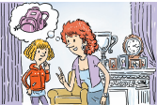
take part in/ attend/ join这组词都有“参加，加入”的意思。其区别是：
take part in 侧重参加某项群众性、集体性的事业、工作或活动，突出参加者在其中发挥一定的作用。
attend 侧重参加或出席会议或学术活动等。
join 普通用词，指加入党派、团体或游戏活动等
2d
Role-play the conversation
Linda: Mom, I ’m really worried.
Mom: Why? What’s wrong?
Linda: I can’t find my schoolbag.
Mom: Well, where did you last put it?
Linda: I can’t remember! I attended a concert
yesterday, so it might still be in the
music hall .

Slide 19
Mom: Do you have anything valuable in your
schoolbag ?
Linda: No, just my books, my pink hair band
and some tennis ball.
Mom: So it can’t be stolen.
Linda: Oh, wait! I went to a picnic after the
concert. I remember I have my schoolbag
with me at the picnic.

Slide 20
Mom: Do you have anything valuable in your
schoolbag ?
Linda: No, just my books, my pink hair band
and some tennis ball.
Mom: So it can’t be stolen.
Linda: Oh, wait! I went to a picnic after the
concert. I remember I have my schoolbag
with me at the picnic.

Slide 21
Mom: So could it still be at the park?
Linda: Yes. I left early before the rest of my
friends. I think somebody must have
picked it up. I’ll call them now to check
if anybody has it.
★情态动词+ have done 此结构表示对过去情况的推测和判断。
The road is wet. It must have rained last night.

Slide 22
Fill in the blanks with must, might /could, can’t, belong to.
1.Whose earrings are these? They _____be Mary’s.
She never wears earrings.
2.—The telephone is ringing,but nobody answers it.
—He __________ be out.
3.—Whose is this book? Oh, it _________Mary.
Her name is on the back.
—No, it _________ mine. She gave it to me
yesterday.
can’t
may/might
belongs to
must be

Slide 23
HOMEWORK
1.Ricte the conversations in 2d.
2.Finish the exercises in the workbook.
Notes:
23
23

