Slide 1
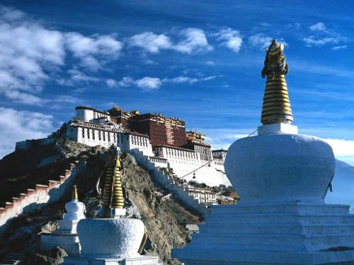
Unit 3
Holiday fun!
第二课时
WWW.PPT818.COM

Slide 2
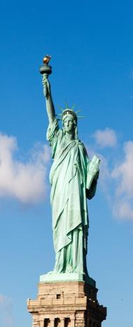
Introduce
What _____(do ) you ____(do) there yesterday ?
How ______(be) your holiday ?
特殊疑问句：特殊疑问词+一般疑问句+其它+？
______(do ) you _____ catch any fish last weekend ?
一般疑问句句型结构：Did +主语+动词原形+其它+ ？

Slide 3
Words
call
/kɔːl/
动词, 表示“ 打电话”;过去式为called。
常用短语：call me 打电话
call a telephone 打一个电话
eg：If she comes ，please call you at once.
如果她来, 请立刻打电话给你。
小练习： call , you, I , yesterday (,)
_____________________________
I call you yesterday.

Slide 4
Words
Bund
/bʌnd/
名词,表示上海（外滩） ,东亚各国的堤岸,码头,同盟。
常用短语：visit the Bund 参观外滩
eg：The Bund has almost become the symbol of Shanghai.
外滩几乎已经成为了上海的标志。
小练习：（ ） I enjoy the beautiful view of the _____ .
A. Bund B. bund
A

Slide 5
Expressions
Where did he go for the holiday?
他假期去哪了？
一般过去时的特殊疑问句。
基本句型：特殊疑问词+助动词did+主语+ 动词原形.......?
eg : -- When did you buy this bike ?你什么时候买的这个自行车？
-- I bought it last year.我去年买的。
小练习 : Liu Tao _________(catch ) a big fish last week.
______ you _____(eat ) breakfast this morning ?
caught
Did
eat

Slide 6
Expressions
How was your National Day Holiday ?
你的国庆假期怎么样？
一般过去时的特殊疑问句,以“how”为疑问词的特殊疑问句。
eg : How do you like this book ?
你觉得这本书怎么样？
小练习 :你的国庆假期怎么样？
_____was your ________ _____ holiday ?
How
National Day

Slide 7
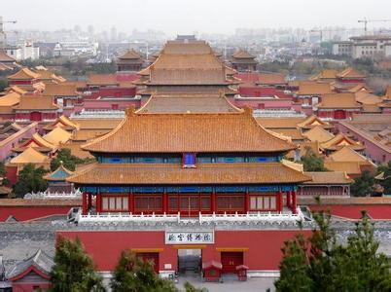
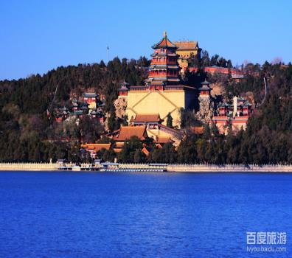
Dialogues
Share your holiday story through dialogue!

Slide 8
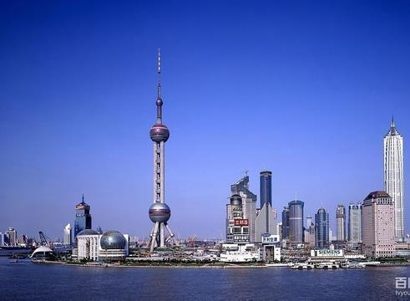
Expand
The Bund
上海开埠以来,很多英文文献开始用The Bund表述原英租界的黄浦江滩。1876年《北华捷报》绘制的 “上海英美租界道路图” 将英租界的黄浦滩标示为“Bundor Yang-tsze Road”。但是直到19世纪70年代后期, 中国文人王韬仍写着“浦滨月色,最可娱人”的句子,可见“外滩 ”并不是Bund的对应汉译。

Slide 9
Summary
call Bund
Where\How\Why+ was(were)\did+ sb.+ do···?

Slide 10
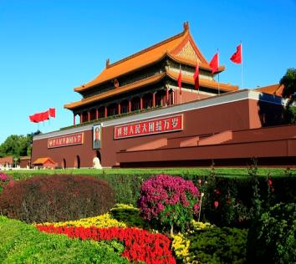
Exercise
1.---- Where did you _____ ?
----- I went to Nanjing .
A. do B. go C. went
2. I wanted to _______ the Tian’anmen Square.
A. go B. visit C. visited
B
B

Slide 11
Exercise
3. Helen called me , but I ____ at home.
A. was B. weren’t C. wasn’t
4.Liu Tao ____ to the farm and visited her uncle.
A. goes B. went C. go
C
B

Slide 12
Exercise
5. My family would like _____ boating this Sunday.
A .went B. to go C. going
6.We caught a big fish and _____ it.
A. eat B. eated C. ate
B
C

Slide 13
Homework
Write a small drama with your friends!
一般疑问句 | Did you catch any fish ? | Yes, I did .
句型结构 | Did +主语+动词原形+其它 ？ | Yes，主语+did. No, 主语+ didn’t .
特殊疑问句 | What did you do there ? How was your holiday , Mike ? | We went to the Bound . It was fun.
句型结构 | 特殊疑问词+一般疑问句+？ | 主语+动词过去式规则与不规则变化。

