Slide 1
Module8 Accidents
While the lights were changing to reda car suddenly appeared
WWW.PPT818.COM

Slide 2
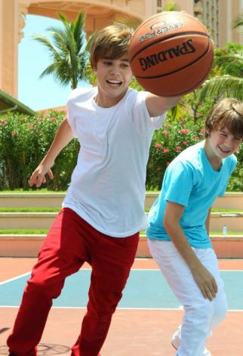
The boy __________
basketball yesterday.
played

Slide 3
were playing
They ____________ basketball at 4 p.m. yesterday.

Slide 4
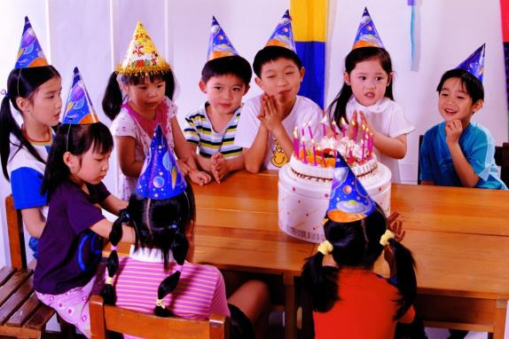
had
They ____ a birthday party last night.

Slide 5
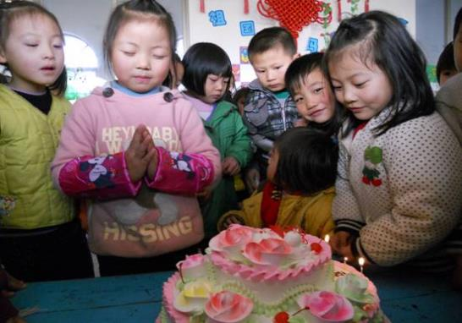
They ___________ a birthday party
at nine last night.
were having

Slide 6
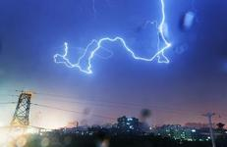
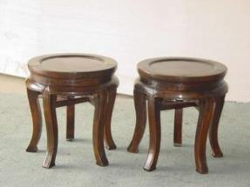
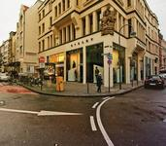
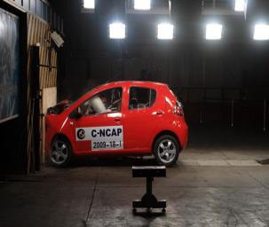
看图片学单词
pale
appear
round
corner
hit
glad

Slide 7
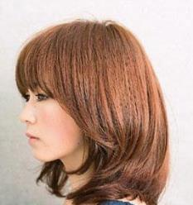
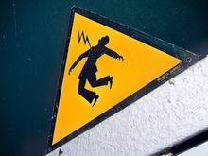
risk
attention
side

Slide 8
比一比，看谁能快速说出下面短语的含义
注意；留心
in time
从……跌落
fall off
pay attention
及时
side by side
并排地；肩并肩地

Slide 9
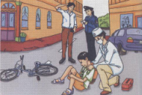
Look at the picture and say what is happening.
accident driver happen
mobile phone policeman road

Slide 10
Listen and underline the correct words.
The driver was/was not going fast.
The driver was/was not looking.
The driver was/was not talking on
his mobile phone.

Slide 11
Listen and answer questions
Who saw the accident?
2. Did the car stop just in time?
Ms James.
Yes, it did.

Slide 12
3. What was the boy doing when he was
riding his bike?
He was listening to music.
4. When did a car suddenly appear round
the corner?
While the lights were changing to red.
5. Did the boy fall off his bike?
Yes, he did.

Slide 13
When you are riding a bike, think about the risk of an accident!
Pay ___________ and stop at
the ___________.
Don’t ______ too fast.
Don’t ride ____________ with your
friends.
Don’t ______________!
attention
red lights
ride
side by side
listen to music

Slide 14
appear attention glad hit side
Accidents do not happen very often, I’m (1) _____ to say. However, when you’re riding your bike, pay (2) _________ all the time, especially on the corner of the road and at traffic lights. Don’t ride side by (3) _____ with your friends. Sometimes cars (4) _______ round the corner and don’t stop. They may (5) ___ you.
glad
attention
side
appear
hit

Slide 15
Everyday English
Are you all right?
That’s very dangerous!
That’s too bad.
Anything else?

Slide 16
Language points
You look pale.
pale表示“苍白的”，形容词。
look是感官动词。
look pale 看起来苍白
e.g. She has a pale face. 她脸色苍白。

Slide 17
2. A car suddenly appeared round the corner.
appear v. 出现；显露
round prep. 转到（某物的）另一边
e.g. The boy suddenly appeared from
under the bed. 小男孩突然从床下钻出来。
He walked round the corner into the
next street. 他走过拐角，到了另一条街上。

Slide 18
3. The car stopped just in time, but the boy fell off his bike and hurt his knee.
in time表示“及时”，just强调“刚刚，正好” 。表达“及时做某事”可以用in time to do sth.
e.g. If we don’t hurry up, we won’t be
in time to catch the train.
如果不抓紧时间的话，我们就来
不及赶上火车了。

Slide 19
fell是fall的过去式。
fall off表示“从……跌落”。
e.g. He fell off the tree and hurt his leg.
他从树上跌落，摔伤了腿。
fall down表示“摔倒”。
e.g. You must watch your step so as not
to fall down. 你必须留心脚下才不会跌下去。

Slide 20
5. Pay attention, stop at the red lights…
pay attention 表示“注意，留心”。
pay attention to n./ v-ing
表示“注意……”。
e.g. You must pay attention to your study. 你必须专心学习。
Please pay attention to spelling.
请注意拼写。

Slide 21
6. Don’t ride side by side with your friends.
side by side表示“并排的，肩并肩的”。
e.g. They were walking side by side in
the street.
他们肩并肩走在街上。

Slide 22
Pronunciation and speaking
1. While the lights were changing to red, a car suddenly appeared round the corner.
2. When I was waiting to cross the road, the accident happened.
/
/

Slide 23
Work in pairs
Student A: You’re a policeman at an accident scene in the street. Ask people questions.
Student B, C and D: You saw the accident. Answer the policeman’s questions.

Slide 24
A: What were you doing when the
accident happened?
B: When the accident happened, I was
walking along the street.
C: When the accident happened,…
D: …

Slide 25
过去进行时
1. 定义：
表示过去某一具体时间正在发生的动作。
2. 时间标志：
at … yesterday morning
at that time
from nine to ten last evening
when, while, as

Slide 26
e.g.
We were watching TV from six to nine last night.
What was he researching all day last Sunday?

Slide 27
3. 过去进行时还可以和when, while, as引导的过去时间状语从句连用，形成复合句。
e.g. While the lights were changing to red, a car suddenly appeared round the corner.
正当交通信号灯要变成红灯的时候，一辆小轿车突然从拐角处驶出来。

Slide 28
One day, when Henry was working in a restaurant, a snake suddenly appeared.
一天，当亨利正在餐馆里工作时，一条蛇突然钻了出来。
I was trying to pick it up when it bit me again.
我正试图捡起（那条蛇），突然它又咬了我一口。
As the doctors were checking him, the pain got worse.
医生给他做检查时，疼痛加剧了。

Slide 29
when，while，as都可以引导时间状语从句，但用法区别非常大。
一、when可以和延续性动词连用，也可以和短暂性动词连用；而while和as只能和延续性动词连用。
e.g. They arrived while we were
having dinner. =
They arrived when we were
having dinner.
我们吃饭的时候他们到了。

Slide 30
二、由when引导的时间状语从句，如果主句是过去进行时，从句应该用一般过去时，表示一个动作正在进行的时候另一个动作突然发生了，强调后一动作发生的突然性。
e.g. We were talking when the teacher
came in.
我们正在讲话，老师（突然）进
来了。

Slide 31
三、当主句和从句的动作都是延续的或同时发生的，两句都用过去进行时的时候，多用while引导。
e.g. They were singing while were
dancing.
他们在唱歌，我们在跳舞。

Slide 32
练一练
A
1. Safety comes first. We should _______ to keep safe on the road.
① obey the traffic (交通) rules
② be careful of passing cars and buses
③ run fast after others
④ not read the messages on our mobile
phones
⑤ play basketball with our friends
A. ①②④ B. ①③⑤ C. ②④⑤

Slide 33
2. I ______ a meal when you _____
me.
A. cooked, were ringing
B. was cooking, were ringing
C. was cooking, rang
D. cooked, rang
C

Slide 34
3. They _____ a football game from 7 to 9 last night.
A. were watching B. watch
C. watched D. are watching
4. Would the driver see him _________?
A. on time B. in time C. for time
5. The old man _________ the ladder yesterday afternoon.
A. fell off B. fell down
C. fell of D. fell up
A
B
A

Slide 35
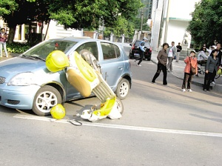
Homework
编写一个对话,介绍你亲眼目睹的一次交通事故。

