Slide 1
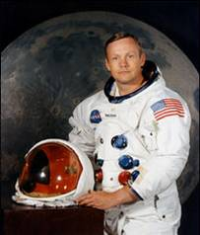
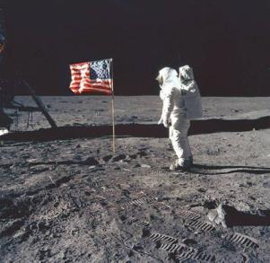
Unit 2 Great people
Reading 1
WWW.PPT818.COM

Slide 2
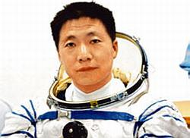
Do you know him?
What’s his job?
Has he been to the moon?
Yes. He is called Yang Liwei.
He is an astronaut.
No, he hasn’t.
He is the first man to go into space in China.

Slide 3
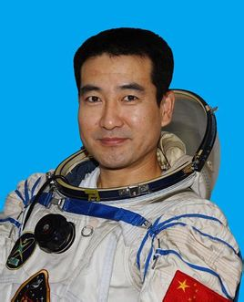
Do you know him?
What’s his job?
Has he been to the moon?
Yes. He is called Zhai Zhigang.
He is an astronaut, too.
Yes, he has.
He is the first man to walk in space in China.

Slide 4
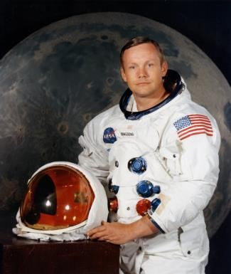
Do you know who is the first man to walk on the moon?
Read the article quickly and find the answer.
Neil Armstrong.

Slide 5
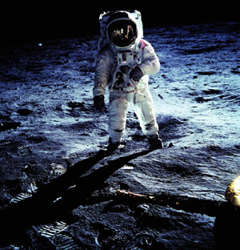
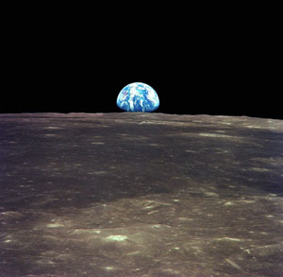
Neil Armstrong

Slide 6
New words
pilot 飞行员
licence 执照
navy 海军
serve 服役
test 测试
aircraft 飞机 航空器
astronaut 宇航员
spacecraft 宇宙飞船
spin 快速旋转
control 控制
order 命令
cut… short 缩短
Pacific 太平洋
ocean 海洋
land 着陆
step n. 一步
mankind 人类
giant 巨大的
leap 跳跃
step v. 走，跨步
surface 表面
further 更多的
citizen 公民
pride 自豪，骄傲

Slide 7
Simon has read the article about Neil Armstrong, but he does not know some of the words. Help him find out the meanings of the words. Circle the correct letters.
1 A licence is ______.
a some money b a type of power
c a piece of paper that shows you are
allowed to do something
c

Slide 8
2 An astronaut ________.
a draws maps b travels to space
c travels to different countries
3 Something that is spinning is ______.
a turning round and round quickly
b going very slowly
c making a lot of noise
b
a

Slide 9
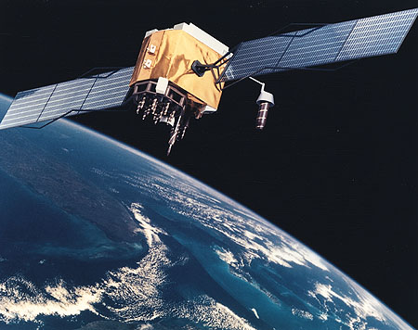
4 A leap is ______.
a a new place
b a long or high jump
c a walk
5 A surface is _______.
a the inside of something
b the bottom of something
c the outside or top part of something
b
c
pl. spacecraft

Slide 10
6 A citizen is a person who ______.
a lives in a country and enjoys rights there
b is kind and helpful
c does something important
a

Slide 11
Listen to the article and answer the following questions
What did Armstrong receive when he was 16?
2. When did he join the navy?
3. How many people walked on the moon from Apollo11?
4. What did astronauts take back to Earth?
5. What was the highest award that Neil Armstrong received?
He received his student pilot’s licence.
In 1949.
Two.
Some Moon rocks.
The Medal of Freedom.

Slide 12
B2:Reading the article and finishing the table.
Time | Major events
1930 | born on Aug.5th,1930 in______, USA
1936
1946
1949
1955
1962
1966
1969
Ohio
took his first flight
received his student pilot’s licence
joined the navy and served as a pilot
became a test pilot
was chosen to become an astronaut
went into space as command pilot of Gemini 8
became the first man to walk on the Moon

Slide 13
Simon is working out a timeline for Neil Armstrong. Help him complete it.
Neil Armstrong
1930: born in (1) __________________, the USA.
1936: took his (2) ____________________
1946: received his student (3)_____________
1949: joined (4) _______________
1955: became (5)__________________
1962: became (6) _________________
1966: went into (7) _________________with David Scott
1969: became the first man to walk on (8) _____________
Ohio
first flight
pilot’s licence
the navy
a test pilot
an astronaut
space
the Moon

Slide 14
B3:Read the article and judge the following statements
1. The Gemini 8 flight was a great success.
2. Gemini 8 landed in the Western Pacific Ocean.
3. Three men from Apollo 11 walked on the Moon together.
4. The astronauts took some Moon plants back to the Earth.
5. Neil Armstrong received the Medal of Citizen.
F
T
F
F
F

Slide 15
B4: Millie is asking Simon some questions about Neil Armstrong. Help Simon answer her questions. Use the information on pages 22 and 23 to help you.
When did Armstrong become interested in flying?
__________________________________________
2 How old was Armstrong when he became an astronaut?
___________________________________________
3 What did Armstrong do when the spacecraft was out of control during his first trip into space?
___________________________________________
He became interested in flying at the age of six.
He became an astronaut when he was 32.
He successfully brought the spacecraft down into the western Pacific Ocean.

Slide 16
Millie is asking Simon some questions about Neil Armstrong. Help Simon answer her questions. Use the information on pages 22 and 23 to help you.
4 What was the first spacecraft to land on the Moon?
__________________________________________
5 How long did Armstrong and Aldrin walk on the Moon?
___________________________________________
6 What did Armstrong mean by his famous words “ one small step for (a) man, one giant leap for mankind”?
___________________________________________
Apollo 11.
For about two and a half hours.
It means it’s a small step for a man but a long step for mankind.
对一个人来说这是一小步，但对整个人类
来说却是一次巨大的飞跃。

Slide 17
Sum up
Name: Neil Armstrong
Date of birth: 5th August 1930
Place of birth: Ohio, the USA
Major events:
at 6: took his first flight
at 16: received his student pilot’s licence
young

Slide 18
1949: joined the navy
1962: became an astronaut
1966: went into space
20th July 1969: walked on the moon
Awards: Medal of Freedom

Slide 19
Homework
1.Recite the paragraphs.
2.Preview the following paragraphs.

