Slide 1

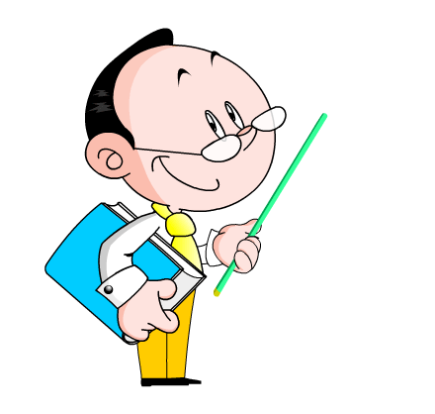
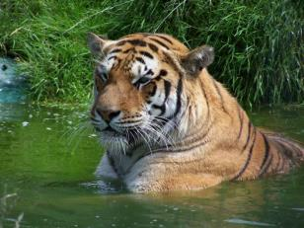
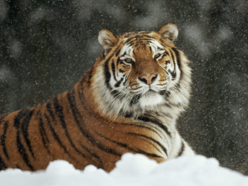
Module 6 A trip to the zoo
Unit 1 Does it eat meat?
WWW.PPT818.COM

Slide 2
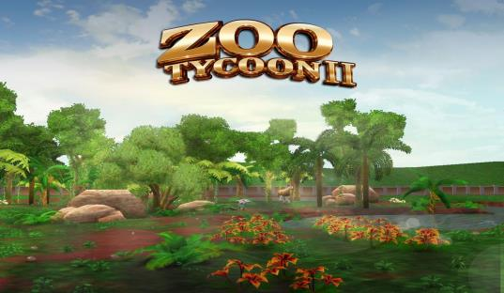
Lead-in
There are many animals in the zoo.
Would you like to go to the zoo?
I’d like to be your guide.

Slide 3
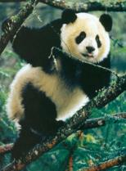
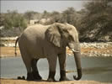


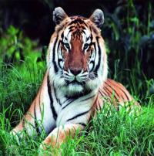
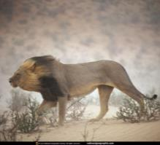
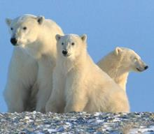
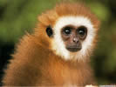
panda
elephant
zebra
giraffe
tiger
lion
bear
monkey

Slide 4

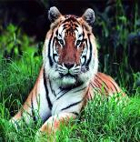
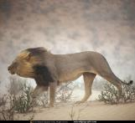

Work in pairs.
—That’s a giraffe.
—Yes, and there are some giraffes.

Slide 5
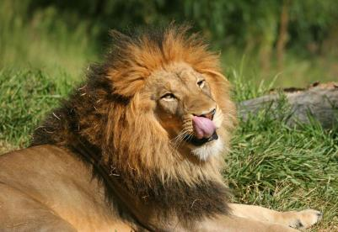
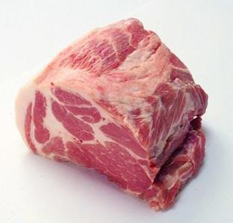
—Do lions eat meat?
—Yes, they do.

Slide 6
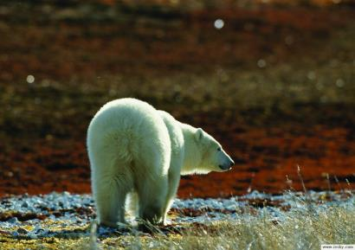
—Do bears eat meat?
—Yes, they do.

Slide 7
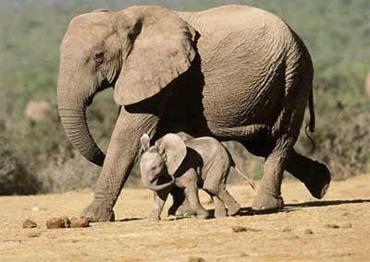
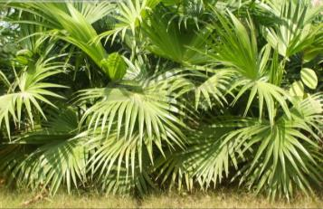
—Do elephants eat meat?
—No, they don’t.
They eat plants.

Slide 8
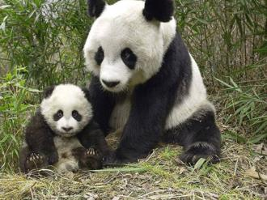

—Do pandas eat plants and leaves?
—Yes, they do.
They love bamboo.

Slide 9


Listen and read

Slide 10

Complete the table.
Animals | Things they eat
Lions
Bears
Elephants
Pandas
meat
meat and plants
plants
plants and leaves

Slide 11

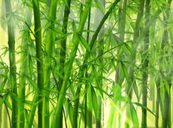
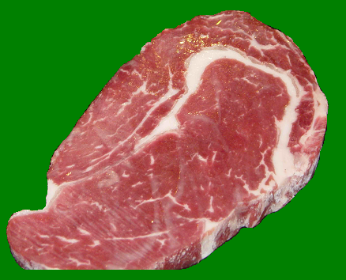
Work in pairs. Ask and answer questions.
A: Does the bear eat meat?
B: Yes, it does.
A: Does the tiger eat bamboo?
B: No, it doesn’t. It eats meat.

Slide 12
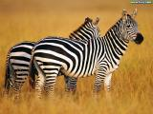

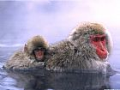
Play a game
Look and guess.
zebra
monkey

Slide 13
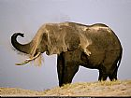

elephant
lion

Slide 14
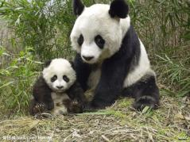
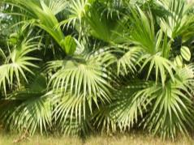
Work in pairs. Ask and answer.
A: What’s your favourite animal? Does it eat plants?
B: Yes, it does.
A: Does it come from China?
B: Yes, it does.
A: Is it the panda?

Slide 15

Practice
Ⅰ. 单项选择
1. Welcome ______ Beijing Zoo.
A. of B. in C. to D. at
2. This is Daming. He ______ China.
comes from B. comes to C. come from D. come to
3. The panda is _____ favourite animal.
me B. my C. I D. you
4. The monkey ______ bamboo.
A. not eat B. isn’t eat C. eat D. doesn’t eat

Slide 16
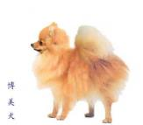
Ⅱ.用所给单词的适当形式填空
How many _______ (zebra) are there in the zoo?
The pandas _______ (come) from China.
Shall we _______（go）to Beijing zoo tomorrow?
_______ (do) tiger come from Liaoning?
The elephants ____________ (not eat) meat.
zebras
come
go
Does
don’t eat

Slide 17
Homework
Workbook

