Slide 1
Unit 1 Tidy up!
WWW.PPT818.COM

Slide 2
Are they yours?
它们是你的 吗？
No,they are't.
不，它们不是。
your是形容词性物主代词，后面必须跟名词。
yours是名词性物主代词，后面不需要加名词。
eg:This is your book.=This book is yours.

Slide 3
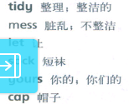
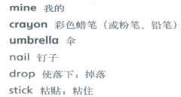
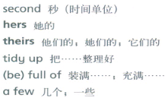
UNIT 1
Tidy up!

Slide 4
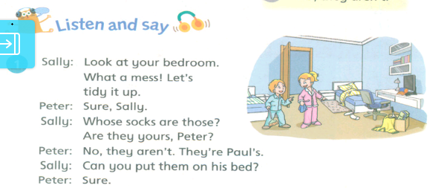
UNIT 1
Listen and say

Slide 5
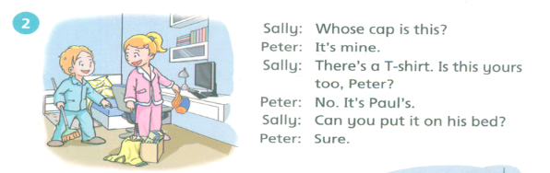
UNIT 1
Listen and say
PPT模板：www.1ppt.com/moban/ PPT素材：www.1ppt.com/sucai/
PPT背景：www.1ppt.com/beijing/ PPT图表：www.1ppt.com/tubiao/
PPT下载：www.1ppt.com/xiazai/ PPT教程： www.1ppt.com/powerpoint/
资料下载：www.1ppt.com/ziliao/ 范文下载：www.1ppt.com/fanwen/
试卷下载：www.1ppt.com/shiti/ 教案下载：www.1ppt.com/jiaoan/
PPT论坛：www.1ppt.cn PPT课件：www.1ppt.com/kejian/
语文课件：www.1ppt.com/kejian/yuwen/ 数学课件：www.1ppt.com/kejian/shuxue/
英语课件：www.1ppt.com/kejian/yingyu/ 美术课件：www.1ppt.com/kejian/meishu/
科学课件：www.1ppt.com/kejian/kexue/ 物理课件：www.1ppt.com/kejian/wuli/
化学课件：www.1ppt.com/kejian/huaxue/ 生物课件：www.1ppt.com/kejian/shengwu/
地理课件：www.1ppt.com/kejian/dili/ 历史课件：www.1ppt.com/kejian/lishi/

Slide 6
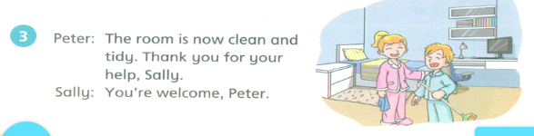
UNIT 1
Listen and say

Slide 7
UNIT 1
Listen and say
What a mess! 真是一团糟！
tidy……up 把……整理好

Slide 8
UNIT 1
Listen and say
名词性物主代词：
my-mine-我的 our-ours-我们的
your-yours-你的 your-yours-你们的
his-his-他的 their-theirs-他们的
her-hers-她的
its-its-它的

Slide 9
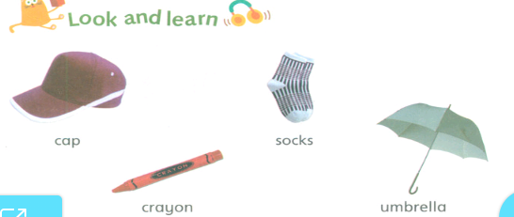
UNIT 1
Look and learn

Slide 10
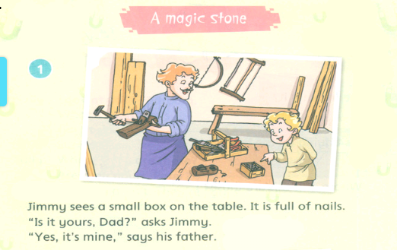
UNIT 1
Read a story

Slide 11
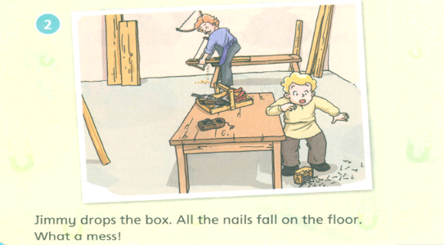
UNIT 1
Read a story

Slide 12
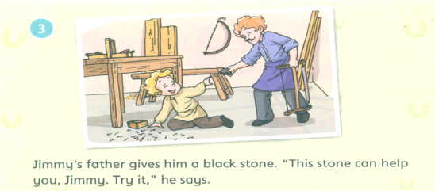
UNIT 1
Read a story

Slide 13
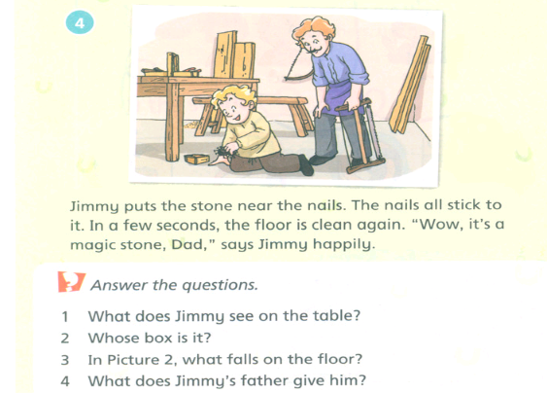
UNIT 1
Read a story

Slide 14
UNIT 1
Read a story
be full of 装满
stick to 粘在……上
in a few seconds 过了几秒

Slide 15
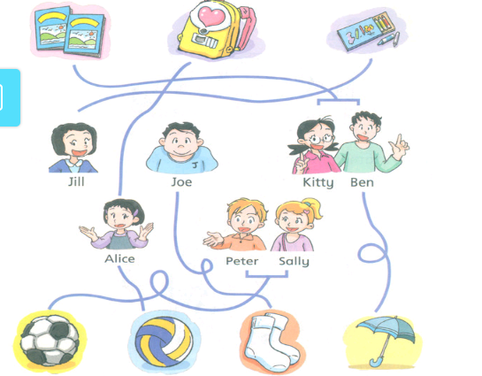
UNIT 1
Think and write

Slide 16
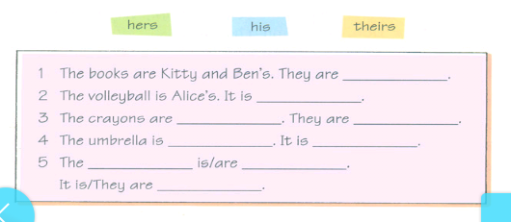
UNIT 1
Think and write

Slide 17
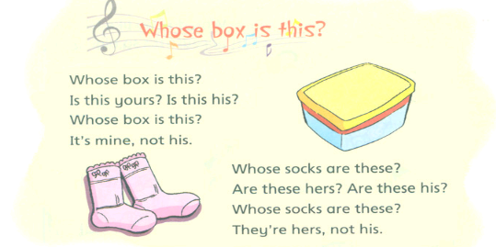
UNIT 1
Sing a song

Slide 18
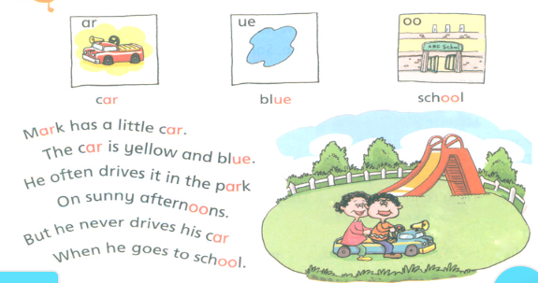
UNIT 1
Learn the sounds

Slide 19
UNIT 1
Learn the sounds
音标学习
ar-[a:] ue-[u:] oo-[u:]

