Slide 1
Unit 8 Countries around the world
单元自我综合评价
WWW.PPT818.COM

Slide 2
单元自我综合评价
Ⅰ.单项填空(共15小题；每小题2分，满分30分)
1．This is ________ map of Australia. It's ________old map.
A．a; an B．an; a C．a; a D．an; an
A
【解析】 map以辅音音素开头，冠词用a；old以元音音素开头，冠词用an。

Slide 3
单元自我综合评价
2. Li Ming can ________ French very well.
A．say B．speak C．talk D．tell
B
【解析】“speak＋语言”意为“说某种语言”。

Slide 4
单元自我综合评价
3．Taiwan is a part of China. It is ________the southeast of our country.
A．on B．in C．to D．at
B

Slide 5
单元自我综合评价
4．—What do you know ________ Lin Junjie?
—I only know he is a famous singer from Singapore.
A．with B．from C．for D．about
D
【解析】 know about意为“了解”。

Slide 6
单元自我综合评价
5. Do you come from America or ________？
A．Canadian B．Australian
C．England D．Chinese
C
【解析】此句是选择疑问句。由“America”可知“or”后应填表示国家的名词。

Slide 7
单元自我综合评价
6．Thank you for ________ me learn English.
A．help B．to C．helping D．helps
C
【解析】thank you for后接动词时，应用动名词形式。

Slide 8
单元自我综合评价
7．________ country is northeast of China, Canada or Australia?
A．Where B．Which
C．When D．Whose
B

Slide 9
单元自我综合评价
8．Tomorrow is my birthday. I will ________ my friends ________ my party.
A．invites; to B．inviting; to
C．invite; for D．invite; to
D
【解析】invite sb. to…意为“邀请某人去……”；情态动词will后用动词原形。

Slide 10
单元自我综合评价
9．Here ________ a pen and some erasers for you.
A．be B．is
C．are D．will be
10．—________ is that girl?
—She is my friend Lily.
A．When B．Who C．What D．How
B
B

Slide 11
单元自我综合评价
11. Here ________ a map of ________ United States.
A．is; the B．are; / C．is; / D．are; the
12．—________ stars does China's flag have?
—Five.
A．How many B．How about
C．How much D．How far
A
A

Slide 12
单元自我综合评价
D
13．John and Peter like to ________ their lives.
A．talk B．talk to
C．talk with D．talk about
14．The flag of the U.K. has ________ colours ________ that of the U．S.
A．same; as B．the same; such
C．a same; as D．the same; as
D

Slide 13
单元自我综合评价
Ⅱ.完形填空(共10小题；每小题1分，满分10分)
The Jones family are from Canada. Mr. and Mrs. Jones are __16__ in a company(公司) in Beijing. Their son Jimmy lives __17__ them. Jimmy can speak good English, __18__ he is not good at Chinese. Jimmy is in Grade Five in a(n) __19__ school now. His teachers and classmates are all Chinese. Jimmy plays with __20__ friends every day and he feels very __21__.

Slide 14
单元自我综合评价
He listens to Chinese news, __22__ Chinese books and __23__ e­mails(电子邮件) in Chinese. Now he can speak a little Chinese.
On Sunday, Jimmy goes to a __24__. He wants to order his favourite __25__—Peking Roast Duck (北京烤鸭). So he says to the waiter, “May I have some Beijing kaoya？”

Slide 15
单元自我综合评价
16．A. driving B．working C．playing D．living
17．A. for B．after C．with D．in
18．A. but B．and C．or D．then
19．A. English B．French C．Canadian D．Chinese
20．A. he B．his C．my D．her
B
C
A
D
B

Slide 16
单元自我综合评价
21．A. happy B．sad C．lonely D．sick
22．A. looks B．watches C．sees D．reads
23．A. makes B．Draws C．writes D．sings
24．A. school B．Shop C．restaurant D．post office
25．A. colour B．clothes C．drink D．food
A
D
C
C
D

Slide 17
单元自我综合评价
Ⅲ.阅读理解(共10小题；每小题2分，满分20分)
A
In many countries the presidents, kings or queens live in special houses. These houses have different names. Many of these houses are famous in the world. The president of the U．S. lives in the White House. It is white outside. It really looks like a white house.

Slide 18
单元自我综合评价
In the U.K., kings and queens live in Buckingham Palace. It is very beautiful and we can visit some areas(地区) of the palace. The Palace Museum was old China's emperors'(皇帝的) palace. Now there's no emperor in China and it becomes (变成) a museum. Every year, people come to Beijing to visit it.

Slide 19
单元自我综合评价
26．It talks about(谈论) ________ in the passage.
A．presidents B．kings and queens
C．palaces D．emperors
27．In the United Kingdom, kings and queens live in________．
A．different houses B．the Palace Museum
C．the White House D．Buckingham Palace
C
D

Slide 20
单元自我综合评价
28．It's________ outside the White House.
A．blond B．white
C．green D．red
29．In China today，________ lives in the Palace Museum.
A．a president B．a king
C．a queen D．no emperor
B
D

Slide 21
单元自我综合评价
30．Can we visit the Palace Museum today?
A．Yes, we can. B．No, we can't.
C．We don't know. D．I don't think so.
A

Slide 22
单元自我综合评价
B
Many buildings are famous in the world. Do you want to know more about them?

Slide 23
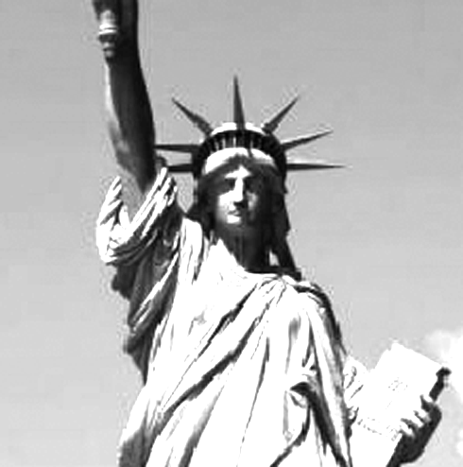
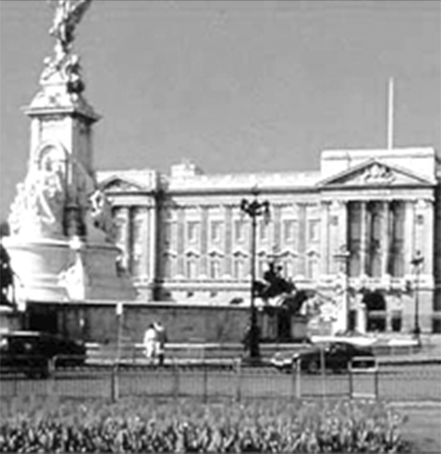
单元自我综合评价
The Statue of Liberty has been in New York for more than(超过) 100 years. It was a present from France in 1884. The Statue of Liberty is 93 metres tall from the bottom(底部). The lady has a torch(火炬) in her right hand. Buckingham Palace is in London. The Queen lives and works in it. In summer, sometimes(有时) you can go into the palace when the Queen is not in it. In Buckingham Palace, you can see famous drawings, antiques(古董), and the Queen's dresses and jewellery(首饰).

Slide 24
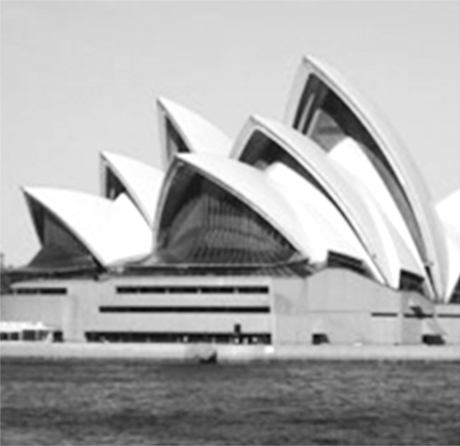
单元自我综合评价
The Sydney Opera House is in Australia. It was opened (开放) on October 20, 1973. The Sydney Opera House is 67 metres tall. It has about 100 rooms, five theatres, four restaurants and many souvenir(纪念品) shops.

Slide 25
单元自我综合评价
根据短文内容，判断正(T)误(F)。
31．The Statue of Liberty was a present from the U.K. to the
U.S.
32．You can go into Buckingham Palace at any time of the year.
33．There are five restaurants and four theatres in the Sydney
Opera House.
F
F
F

Slide 26
单元自我综合评价
T
34．The Statue of Liberty is taller than(比) the Sydney Opera
House.
35．The three famous buildings are in different countries.
T

Slide 27
单元自我综合评价
Ⅳ. 任务型阅读(共5小题；每小题2分，满分10分)
Canada is a very big country. It is north of the U．S. The population(人口) of Canada is over 35，000，000. Canada has two official languages, French and English.
The weather in Canada is different in different areas. In the north, the winters are long, with snow for six months of the year. In the west coast(海岸) of Canada, it rains every month of the year.

Slide 28
单元自我综合评价
There is a famous waterfall in Canada. It is the Niagara Falls. Would you like to come to Canada to visit it?

Slide 29
单元自我综合评价
根据短文内容，完成下列表格。
Canada
Location(位置) | 36.________ of the U．S.
37.________ | Over 35，000，000.
Official languages | 38.________________.
Weather | In the north, it snows for six months of the year. In the west coast, it 39.________every month of the year.
Famous waterfall | 40.________________.
North
Population
French and English
rains
Niagara Falls

Slide 30
单元自我综合评价
Ⅴ.根据短文内容及首字母或所给词提示完成短文(共5小题；每小题2分，满分10分)
Look at the map of the world. We can find all the 41.________(country) on it. Look here, it's Africa. I have a pen pal. She is 42.f________ Africa. She tells me there are many kinds of wild animals in her hometown.
countries
rom

Slide 31
单元自我综合评价
And she 43.i________ me to travel to her country next summer. She can speak three languages: Chinese, English and 44.F________. I hope 45.________(visit) Africa soon.
nvites
rench
to visit

Slide 32
单元自我综合评价
Ⅵ.连词成句(共5小题；每小题1分，满分15分)
46．Betty, is, from, where
_________________________________________________?
47．on, is, the, blue, map, the U．K.
__________________________________________________.
48．cities, list, make, of, famous, a
__________________________________________________.
Where is Betty from
The U．K. is blue on the map
Make a list of famous cities

Slide 33
单元自我综合评价
49．Tian'anmen Square, to, I, visit, want
___________________________________________________.
50. east, China, is, country, which, of
___________________________________________________?
I want to visit Tian'anmen Square
Which country is east of China

Slide 34
单元自我综合评价
Ⅶ.书面表达(满分15分)
假如你作为你们学校的代表，应邀前往美国(或英国、加拿大、澳大利亚)的中学参观学习。在欢迎会上，你需要用英文介绍中国的基本情况。你准备怎样介绍呢？请根据提示词写一篇介绍中国的短文。60词左右。
提示词：Asia(亚洲), history(历史), beautiful(漂亮的), the Summer Palace(颐和园), the Great Wall(长城), the Fragrant Hills(香山)

Slide 35
单元自我综合评价
One possible version：
I am very glad to tell you something about China. China is a large country in the east of Asia. It has a long history. China's flag is red. It has five yellow stars. Beijing is our capital city. It has many famous places of interest，such as Tian'anmen Square, the Summer Palace, the Great Wall and the Fragrant Hills. They are all beautiful and interesting.
Welcome to visit China.
Thank you！

